Slide 1
Outline
Global Company Profile: McDonald’s
The Strategic Importance Of Layout Decisions
Types of Layout
Office Layout

Slide 2
Outline – Continued
Retail Layout
  Servicescapes
Warehousing and Storage Layouts
  Cross-Docking
  Random Docking
  Customizing
Fixed-Position Layout

Slide 3
Outline – Continued
Process-Oriented Layout
  Computer Software for Process-Oriented Layouts
Work Cells
  Requirements of Work Cells
  Staffing and Balancing Work Cells
  The Focused Work Center and the Focused Factory

Slide 4
Outline – Continued
Repetitive and Product-Oriented Layout
  Assembly-Line Balancing

Slide 5
Learning Objectives
When you complete this chapter, you should be able to:
Identify or Define:
Fixed-position layout
Process-oriented layout
Work cells
Focused work center
Office layout

Slide 6
Learning Objectives
When you complete this chapter, you should be able to:
Identify or Define:
Retail layout
Warehouse layout
Product-oriented layout
Assembly-line

Slide 7
Learning Objectives
When you complete this chapter, you should be able to:
Describe or Explain:
How to achieve a good layout for the process facility
How to balance production flow in a repetitive or product-oriented facility

Slide 8
Innovations at McDonald’s
Indoor seating (1950s)
Drive-through window (1970s)
Adding breakfast to the menu (1980s)
Adding play areas (1990s)
Three out of the four are layout decisions!

Slide 9
McDonald’s New Kitchen Layout
Fifth major innovation
  Sandwiches assembled in order
  Elimination of some steps, shortening of others
  No food prepared ahead except patty
  New bun toasting machine and new bun formulation
  Repositioning condiment containers
  Savings of $100,000,000 per year in food costs

Slide 10
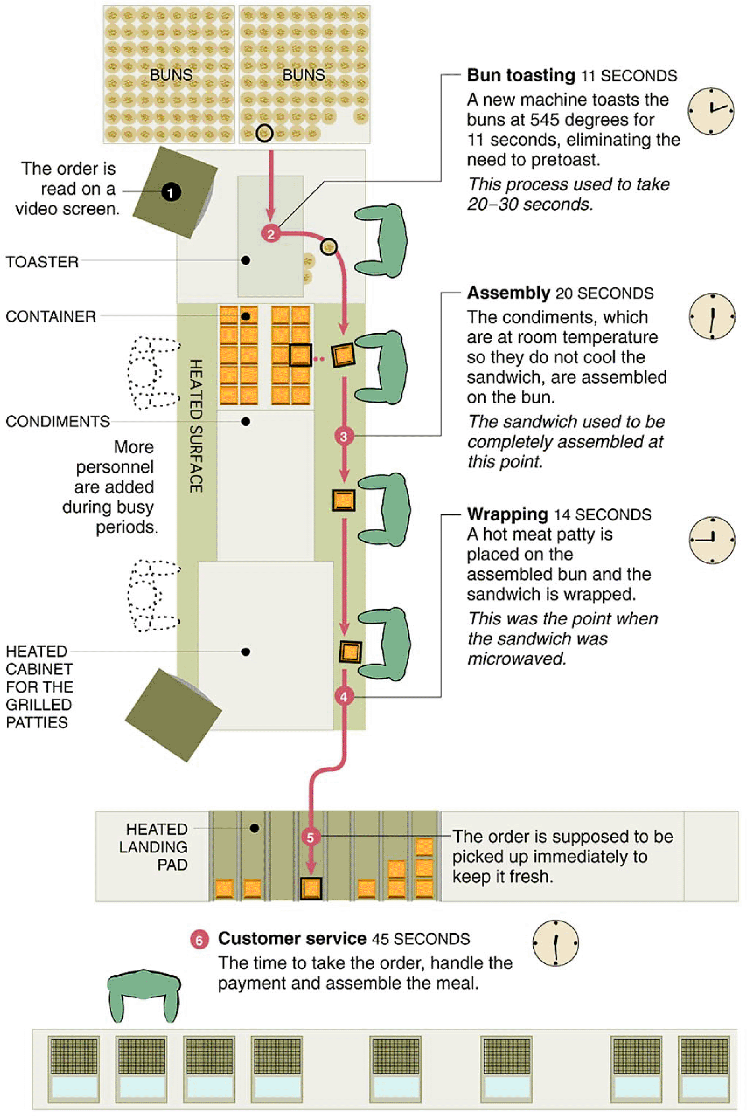
McDonald’s New Kitchen Layout

Slide 11
Strategic Importance of Layout Decisions
The objective of layout strategy is to develop an economic layout that will meet the firm’s competitive requirements

Slide 12
Layout Design Considerations
Higher utilization of space, equipment, and people
Improved flow of information, materials, or people
Improved employee morale and safer working conditions
Improved customer/client interaction
Flexibility

Slide 13
Types of Layout
Office layout
Retail layout
Warehouse layout
Fixed-position layout
Process-oriented layout
Work cell layout
Product-oriented layout

Slide 14
Types of Layout
Office layout - positions workers, their equipment, and spaces/offices to provide for movement of information
Retail layout - allocates shelf space and responds to customer behavior
Warehouse layout - addresses trade-offs between space and material handling

Slide 15
Types of Layout
Fixed-position layout - addresses the layout requirements of large, bulky projects such as ships and buildings
Process-oriented layout - deals with low-volume, high-variety production (also called job shop or intermittent production)

Slide 16
Types of Layout
Work cell layout - a special arrangement of machinery and equipment to focus on production of a single product or group of related products
Product-oriented layout - seeks the best personnel and machine utilizations in repetitive or continuous production

Slide 17
Good Layouts Consider
Material handling equipment
Capacity and space requirements
Environment and aesthetics
Flows of information
Cost of moving between various work areas

Slide 18
Layout Strategies
Office | Retail | Warehouse (storage)
 | Examples
Allstate Insurance Microsoft Corp. | Kroger’s Supermarket Walgreens Bloomingdale’s | Federal-Mogul’s warehouse The Gap’s distribution center
 | Problems/Issues
Locate workers requiring frequent contact close to one another | Expose customer to high-margin items | Balance low-cost storage with low-cost material handling
Table 9.1

Slide 19
Layout Strategies
Project (fixed position) | Job Shop (process oriented)
Examples
Ingall Ship Building Corp. Trump Plaza Pittsburgh Airport | Arnold Palmer Hospital Hard Rock Cafes
Problems/Issues
Move material to the limited storage area around the site | Manage varied material flow for each product
Table 9.1

Slide 20
Layout Strategies
 | Work Cells (product families) | Repetitive/ Continuous (product oriented)
 | Examples
 | Hallmark Cards Wheeled Coach Standard Aero | Sony’s TV assembly line Dodge minivans
 | Problems/Issues
 | Identify product family, build teams, cross train team members | Equalize the task time at each workstation
Table 9.1

Slide 21
Office Layout
Grouping of workers, their equipment, and spaces to provide comfort, safety, and movement of information
Movement of information is main distinction
Typically in state of flux due to frequent technological changes

Slide 22
Relationship Chart
Value | Closeness
A | Absolutely necessary
E | Especially important
I | Important
O | Ordinary OK
U | Unimportant
X | Not desirable
President
Chief Technology Officer
Engineer’s area
Secretary
Office entrance
Central files
Equipment cabinet
Photocopy equipment
Storage room
1
2
O
3
U
4
A
A
5
I
I
6
O
I
I
7
I
I
U
8
A
I
O
O
9
A
E
U
O
X
E
E
U
U
A
O
O
U
I
O
X
U
A
E
E
Figure 9.1

Slide 23
Supermarket Retail Layout
Objective is to maximize profitability per square foot of floor space
Sales and profitability vary directly with customer exposure

Slide 24
Five Helpful Ideas for Supermarket Layout
Locate high-draw items around the periphery of the store
Use prominent locations for high-impulse and high-margin items
Distribute power items to both sides of an aisle and disperse them to increase viewing of other items
Use end-aisle locations
Convey mission of store through careful positioning of lead-off department

Slide 25
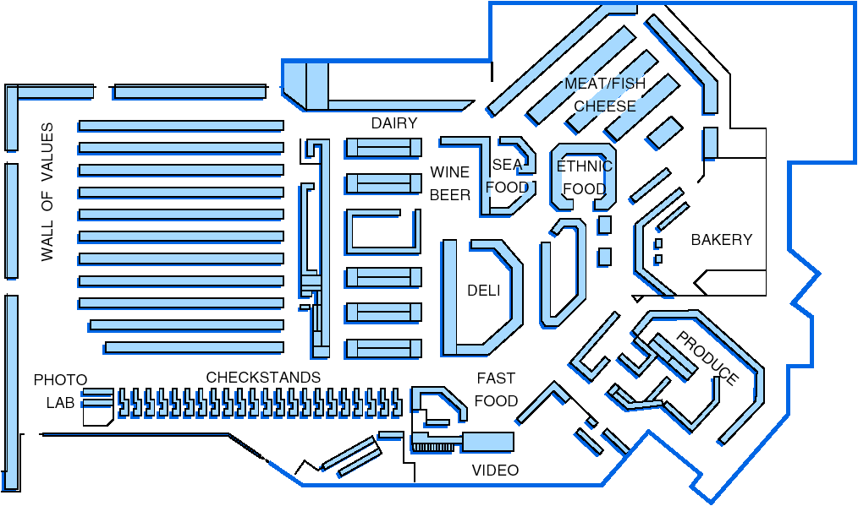
Store Layout
Figure 9.2

Slide 26
Servicescapes
Ambient conditions - background characteristics such as lighting, sound, smell, and temperature
Spatial layout and functionality - which involve customer circulation path planning, aisle characteristics, and product grouping
Signs, symbols, and artifacts - characteristics of building design that carry social significance

Slide 27
Retail Slotting
Manufacturers pay fees to retailers to get the retailers to display (slot) their product
Contributing factors
  Limited shelf space
  An increasing number of new products
  Better information about sales through POS data collection
  Closer control of inventory

Slide 28
Retail Store Shelf Space Planogram
Computerized tool for shelf-space management
Generated from store’s scanner data on sales
Often supplied by manufacturer
5 facings
Shampoo
Shampoo
Shampoo
Shampoo
Shampoo
Shampoo
Shampoo
Shampoo
Shampoo
Conditioner
Conditioner
Conditioner
2 ft.

Slide 29
Warehousing and Storage Layouts
Objective is to optimize trade-offs between handling costs and costs associated with warehouse space
Maximize the total “cube” of the warehouse – utilize its full volume while maintaining low material handling costs

Slide 30
Warehousing and Storage Layouts
Material Handling Costs
All costs associated with the transaction
  Incoming transport
  Storage
  Finding and moving material
  Outgoing transport
  Equipment, people, material, supervision, insurance, depreciation
Minimize damage and spoilage

Slide 31
Warehousing and Storage Layouts
Warehouse density tends to vary inversely with the number of different items stored
Automated Storage and Retrieval Systems (ASRS) can significantly improve warehouse productivity
Dock location is a key design element

Slide 32
Cross-Docking
Materials are moved directly from receiving to shipping and are not placed in storage in the warehouse
Requires tight scheduling and accurate shipments, typically with bar code identification

Slide 33
Random Stocking
Typically requires automatic identification systems (AISs) and effective information systems
Random assignment of stocking locations allows more efficient use of space
  Maintain list of open locations
  Maintain accurate records
  Sequence items to minimize travel time
  Combine picking orders
  Assign classes of items to particular areas

Slide 34
Customization
Value-added activities performed at the warehouse
Enable low cost and rapid response strategies
  Assembly of components
  Loading software
  Repairs
  Customized labeling and packaging

Slide 35
Warehouse Layout
Traditional Layout
Storage racks
Customization
Conveyor
Staging
Office
Shipping and receiving docks

Slide 36
Warehouse Layout
Cross-Docking Layout
Shipping and receiving docks
Office
Shipping and receiving docks

Slide 37
Fixed-Position Layout
Product remains in one place
Workers and equipment come to site
Complicating factors
  Limited space at site
  Different materials required at different stages of the project
  Volume of materials needed is dynamic

Slide 38
Alternative Strategy
As much of the project as possible is completed off-site in a product-oriented facility
This can significantly improve efficiency but is only possible when multiple similar units need to be created

Slide 39
Process-Oriented Layout
Like machines and equipment are grouped together
Flexible and capable of handling a wide variety of products or services
Scheduling can be difficult and setup, material handling, and labor costs can be high

Slide 40
Process-Oriented Layout
Patient A - broken leg
ER triage room
Emergency room admissions
Surgery
Patient B - erratic heart pacemaker
Laboratories
Radiology
ER Beds
Pharmacy
Billing/exit
Figure 9.3

Slide 41
Process-Oriented Layout
Arrange work centers so as to minimize the costs of material handling
Basic cost elements are
  Number of loads (or people) moving between centers
  Distance loads (or people) move between centers

Slide 42
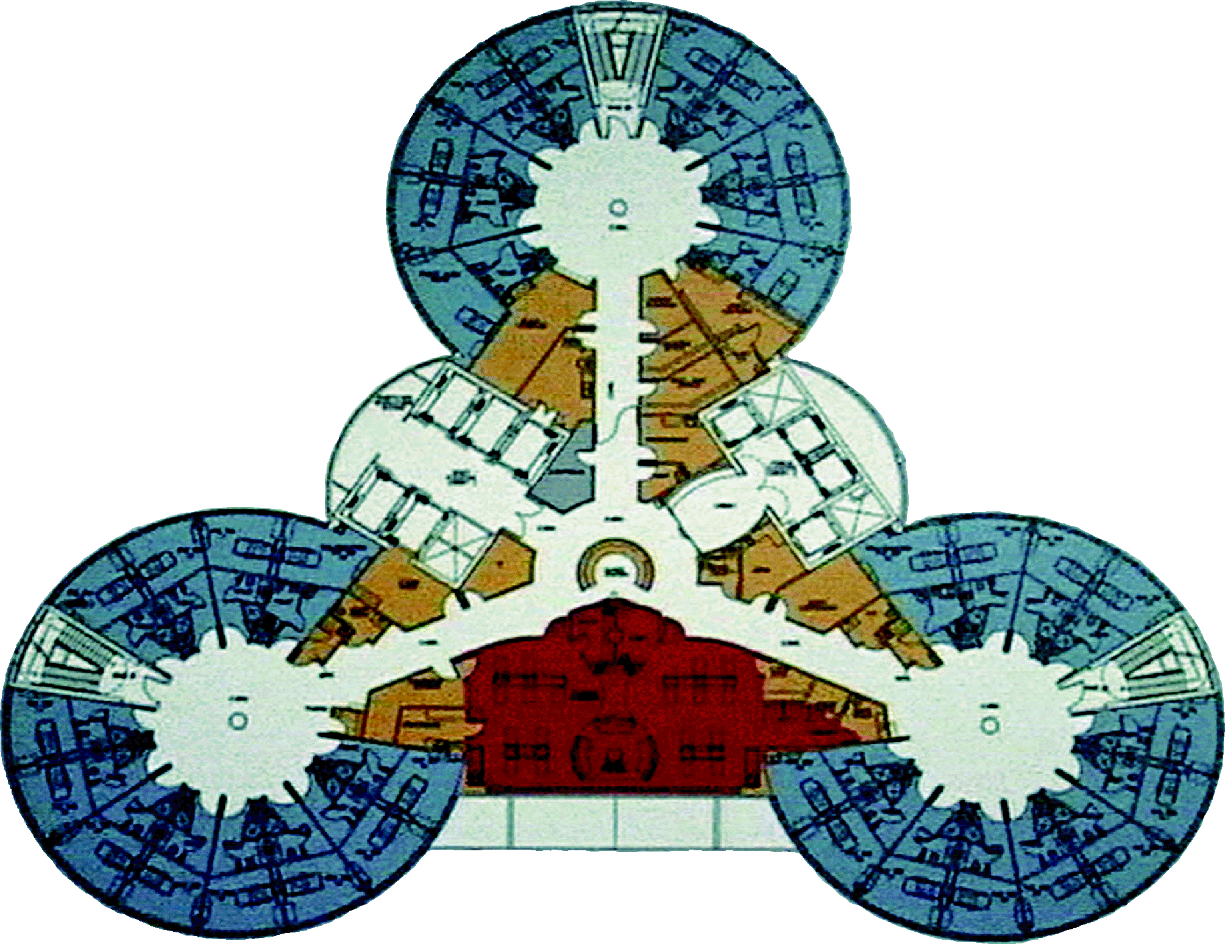
Layout at Arnold Palmer Hospital

Slide 43
Process-Oriented Layout
n
i = 1
n
j = 1
Minimize cost = ∑ ∑ X_{ij} C_{ij}
where n = total number of work centers or departments
i, j = individual departments
X_{ij} = number of loads moved from department i to department j
C_{ij} = cost to move a load between department i and department j

Slide 44
Process Layout Example
Arrange six departments in a factory to minimize the material handling costs. Each department is 20 x 20 feet and the building is 60 feet long and 40 feet wide.
Construct a “from-to matrix”
Determine the space requirements
Develop an initial schematic diagram
Determine the cost of this layout
Try to improve the layout
Prepare a detailed plan

Slide 45
Process Layout Example
Number of loads per week
Department Assembly Painting Machine Receiving Shipping Testing
(1) (2) Shop (3) (4) (5) (6)
Assembly (1)
Painting (2)
Machine Shop (3)
Receiving (4)
Shipping (5)
Testing (6)
50 100 0 0 20
30 50 10 0
20 0 100
50 0
0
Figure 9.4

Slide 46
Process Layout Example
Room 1 Room 2 Room 3
Room 4 Room 5 Room 6
Assembly Painting Machine Shop
Department Department Department
(1) (2) (3)
40’
Receiving Shipping Testing
Department Department Department
(4) (5) (6)
Figure 9.5
60’

Slide 47
Process Layout Example
n
i = 1
n
j = 1
Cost = ∑ ∑ X_{ij} C_{ij}
Cost = $50 + $200 + $40
(1 and 2) (1 and 3) (1 and 6)
+ $30 + $50 + $10
(2 and 3) (2 and 4) (2 and 5)
+ $40 + $100 + $50
(3 and 4) (3 and 6) (4 and 5)
= $570

Slide 48
Process Layout Example
Interdepartmental Flow Graph
100
50
30
1
2
3
20
20
10
50
100
4
5
6
50
Figure 9.6

Slide 49
Process Layout Example
n
i = 1
n
j = 1
Cost = ∑ ∑ X_{ij} C_{ij}
Cost = $50 + $100 + $20
(1 and 2) (1 and 3) (1 and 6)
+ $60 + $50 + $10
(2 and 3) (2 and 4) (2 and 5)
+ $40 + $100 + $50
(3 and 4) (3 and 6) (4 and 5)
= $480

Slide 50
Process Layout Example
Interdepartmental Flow Graph
30
50
100
2
1
3
10
50
20
100
50
50
4
5
6
Figure 9.7

Slide 51
Process Layout Example
Room 1 Room 2 Room 3
Room 4 Room 5 Room 6
Painting Assembly Machine Shop
Department Department Department
(2) (1) (3)
40’
Receiving Shipping Testing
Department Department Department
(4) (5) (6)
Figure 9.8
60’

Slide 52
Computer Software
Graphical approach only works for small problems
Computer programs are available to solve bigger problems
  CRAFT
  ALDEP
  CORELAP
  Factory Flow

Slide 53
CRAFT Example
1 2 3 4 5 6
1 A A A A B B
2 A A A A B B
3 D D D D D D
4 C C D D D D
5 F F F F F D
6 E E E E E D
1 2 3 4 5 6
1 D D D D B B
2 D D D D B B
3 D D D E E E
4 C C D E E F
5 A A A A A F
6 A A A F F F
PATTERN
PATTERN
TOTAL COST 20,100
EST. COST REDUCTION .00
ITERATION 0
TOTAL COST 14,390
EST. COST REDUCTION 70.
ITERATION 3
(a)
(b)
Figure 9.9

Slide 54
Work Cells
Reorganizes people and machines into groups to focus on single products or product groups
Group technology identifies products that have similar characteristics for particular cells
Volume must justify cells
Cells can be reconfigured as designs or volume changes

Slide 55
Advantages of Work Cells
Reduced work-in-process inventory
Less floor space required
Reduced raw material and finished goods inventory
Reduced direct labor
Heightened sense of employee participation
Increased use of equipment and machinery
Reduced investment in machinery and equipment

Slide 56
Improving Layouts Using Work Cells
Current layout - workers in small closed areas. Cannot increase output without a third worker and third set of equipment.
Improved layout - cross-trained workers can assist each other. May be able to add a third worker as additional output is needed.
Figure 9.10 (a)

Slide 57
Improving Layouts Using Work Cells
Current layout - straight lines make it hard to balance tasks because work may not be divided evenly
Improved layout - in U shape, workers have better access. Four cross-trained workers were reduced.
U-shaped line may reduce employee movement and space requirements while enhancing communication, reducing the number of workers, and facilitating inspection
Figure 9.10 (b)

Slide 58
Requirements of Work Cells
Identification of families of products
A high level of training and flexibility on the part of employees
Either staff support or flexible, imaginative employees to establish work cells initially
Test (poka-yoke) at each station in the cell

Slide 59
Staffing and Balancing Work Cells
Determine the takt time
total work time available
units required
Takt time =
Determine the number of operators required
total operation time required
takt time
Workers required =

Slide 60
Staffing Work Cells Example
600 Mirrors per day required
Mirror production scheduled for 8 hours per day
From a work balance chart
total operation time = 140 seconds
60
50
40
30
20
10
0
Standard time required
Assemble
Paint
Test
Label
Pack for
shipment
Operations

Slide 61
Staffing Work Cells Example
600 Mirrors per day required
Mirror production scheduled for 8 hours per day
From a work balance chart
total operation time = 140 seconds
Takt time = (8 hrs x 60 mins) / 600 units
= .8 mins = 48 seconds
total operation time required
takt time
Workers required =
= 140 / 48 = 2.91

Slide 62
Work Balance Charts
Used for evaluating operation times in work cells
Can help identify bottleneck operations
Flexible, cross-trained employees can help address labor bottlenecks
Machine bottlenecks may require other approaches

Slide 63
Focused Work Center and Focused Factory
Focused Work Center
  Identify a large family of similar products that have a large and stable demand
  Moves production from a general-purpose, process-oriented facility to a large work cell
Focused Factory
  A focused work cell in a separate facility
  May be focused by product line, layout, quality, new product introduction, flexibility, or other requirements

Slide 64
Focused Work Center and Focused Factory
Work Cell | Focused Work Center | Focused Factory
A work cell is a temporary product-oriented arrangement of machines and personnel in what is ordinarily a process-oriented facility. | A focused work center is a permanent product-oriented arrangement of machines and personnel in what is ordinarily a process-oriented facility. | A focused factory is a permanent facility to produce a product or component in a product-oriented facility. Many focused factories currently being built were originally part of a process-oriented facility.
Example: A job shop with machinery and personnel; rearranged to produce 300 unique control panels. | Example: Pipe bracket manufacturing at a shipyard. | Example: A plant to produce window mechanism for automobiles.
Table 9.2

Slide 65
Repetitive and Product-Oriented Layout
Organized around products or families of similar high-volume, low-variety products
Volume is adequate for high equipment utilization
Product demand is stable enough to justify high investment in specialized equipment
Product is standardized or approaching a phase of life cycle that justifies investment
Supplies of raw materials and components are adequate and of uniform quality

Slide 66
Product-Oriented Layouts
Fabrication line
  Builds components on a series of machines
  Machine-paced
  Require mechanical or engineering changes to balance
Assembly line
  Puts fabricated parts together at a series of workstations
  Paced by work tasks
  Balanced by moving tasks
Both types of lines must be balanced so that the time to perform the work at each station is the same

Slide 67
Product-Oriented Layouts
Advantages
Low variable cost per unit
Low material handling costs
Reduced work-in-process inventories
Easier training and supervision
Rapid throughput
Disadvantages
High volume is required
Work stoppage at any point ties up the whole operation
Lack of flexibility in product or production rates

Slide 68
Assembly-Line Balancing
Objective is to minimize the imbalance between machines or personnel while meeting required output
Starts with the precedence relationships
  Determine cycle time
  Calculate theoretical minimum number of workstations
  Balance the line by assigning specific tasks to workstations

Slide 69
Copier Example
Performance Task Must Follow
Time Task Listed
Task (minutes) Below
A 10 —
B 11 A
C 5 B
D 4 B
E 12 A
F 3 C, D
G 7 F
H 11 E
I 3 G, H
Total time 66
This means that tasks B and E cannot be done until task A has been completed

Slide 70
Copier Example
Performance Task Must Follow
Time Task Listed
Task (minutes) Below
A 10 —
B 11 A
C 5 B
D 4 B
E 12 A
F 3 C, D
G 7 F
H 11 E
I 3 G, H
Total time 66
5
C
10
11
3
7
A
B
F
G
4
3
12
D
11
I
E
H
Figure 9.13

Slide 71
Copier Example
Performance Task Must Follow
Time Task Listed
Task (minutes) Below
480 available mins per day
40 units required
A 10 —
B 11 A
C 5 B
D 4 B
E 12 A
F 3 C, D
G 7 F
H 11 E
I 3 G, H
Total time 66
Production time available per day
Units required per day
Cycle time =
= 480 / 40
= 12 minutes per unit
5
n
i = 1
C
10
11
3
7
A
∑ Time for task i
Cycle time
Minimum number of workstations
B
F
G
=
4
3
12
D
11
I
= 66 / 12
= 5.5 or 6 stations
E
H
Figure 9.13

Slide 72
Copier Example
Line-Balancing Heuristics
1. Longest task time | Choose the available task with the longest task time
2. Most following tasks | Choose the available task with the largest number of following tasks
3. Ranked positional weight | Choose the available task for which the sum of following task times is the longest
4. Shortest task time | Choose the available task with the shortest task time
5. Least number of following tasks | Choose the available task with the least number of following tasks
Performance Task Must Follow
Time Task Listed
Task (minutes) Below
480 available mins per day
40 units required
A 10 —
B 11 A
C 5 B
D 4 B
E 12 A
F 3 C, D
G 7 F
H 11 E
I 3 G, H
Total time 66
Cycle time = 12 mins
Minimum workstations
= 5.5 or 6
5
C
10
11
3
7
A
B
F
G
4
3
12
D
11
I
E
H
Table 9.4
Figure 9.13

Slide 73
Copier Example
Performance Task Must Follow
Time Task Listed
Task (minutes) Below
480 available mins per day
40 units required
A 10 —
B 11 A
C 5 B
D 4 B
E 12 A
F 3 C, D
G 7 F
H 11 E
I 3 G, H
Total time 66
Cycle time = 12 mins
Station 2
5
Minimum workstations
= 5.5 or 6
C
10
11
3
7
A
B
F
G
4
3
D
Station 4
I
12
11
Station 1
Station 6
E
H
Station 3
Station 5
Figure 9.14

Slide 74
Copier Example
Performance Task Must Follow
Time Task Listed
Task (minutes) Below
480 available mins per day
40 units required
A 10 —
B 11 A
C 5 B
D 4 B
E 12 A
F 3 C, D
G 7 F
H 11 E
I 3 G, H
Total time 66
Cycle time = 12 mins
Minimum workstations
= 5.5 or 6
∑ Task times
(actual number of workstations) x (largest cycle time)
Efficiency =
= 66 minutes / (6 stations) x (12 minutes)
= 91.7%

