Slide 1
NAZARETH COLLEGE OF ARTS AND SCIENCE
(Affiliated to University of Madras
Re-Accredited by NAAC with ‘B’ Grade)
DEPARTMENT OF COMMERCE
SUBJECT – ADVANCED COST ACCOUNTING
UNIT - V
BY
MS.BELSIA BRITTO.A
ASSISTANT PROFESSOR
NCAS

Slide 2


Slide 3
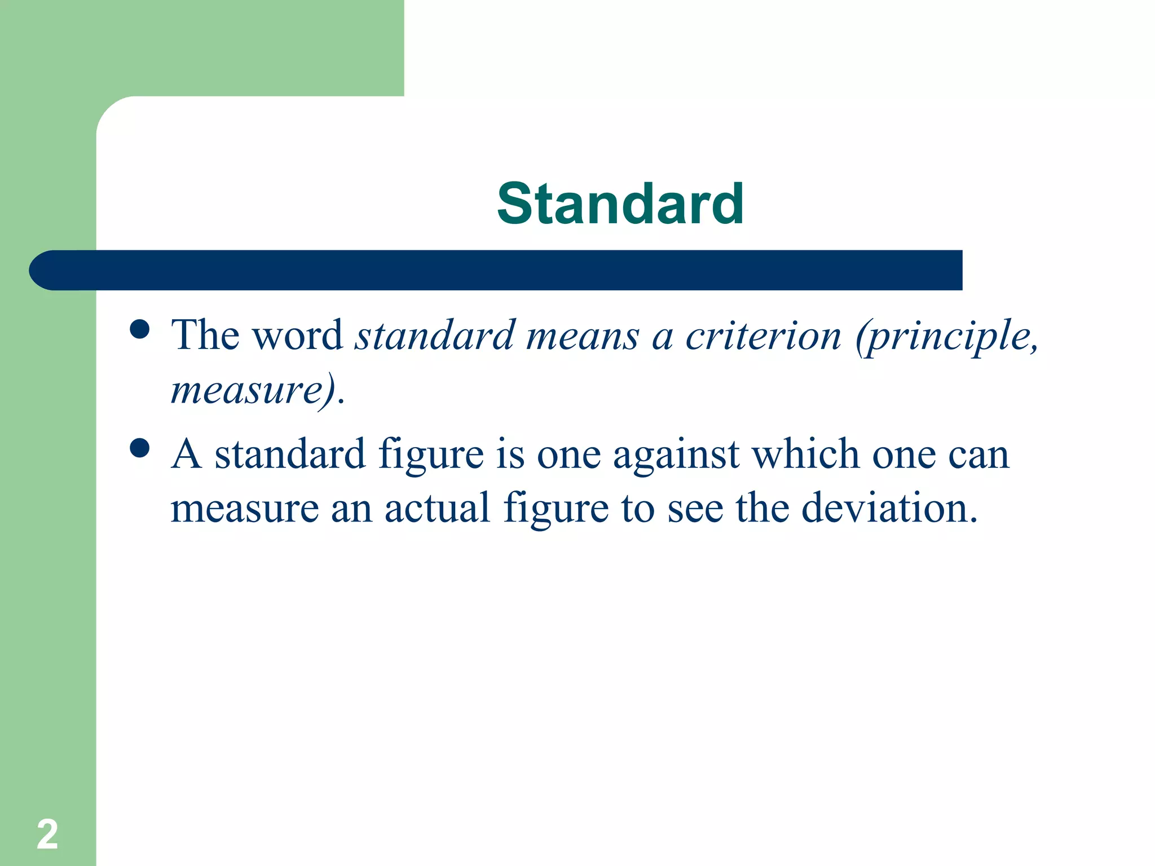

Slide 4
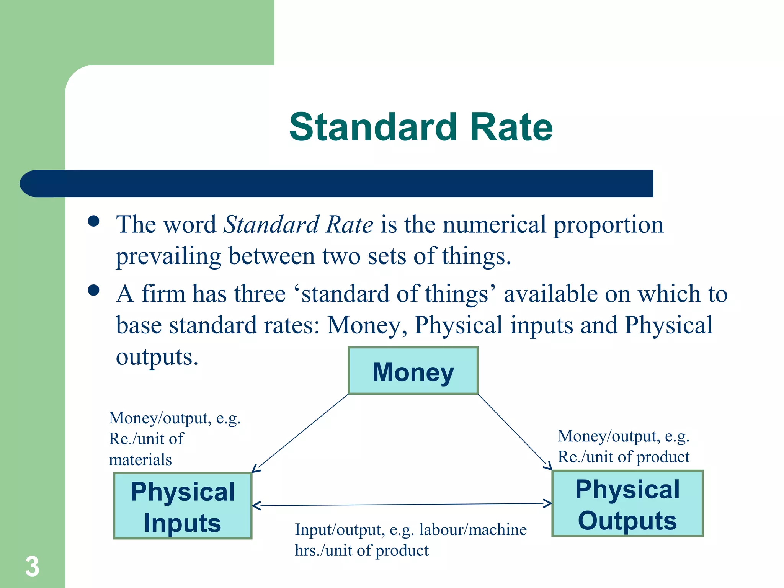

Slide 5
STANDARD COST
Standard cost is ‘a predetermined cost which is compared in advance of production on the basis of specifications of all the factors affecting costs and used in standard costing.’
In other words, standard cost is a predetermined cost that should be attained under a given set of operating conditions.

Slide 6
Standard Costing
Standard costing is a technique which is used in many industries, where production is of repetitive nature.
Standard costing is developed due to the shortcomings of historical costing.
CIMA, London, defines standard costing ‘as the predetermined cost based on technical estimates of materials, labour and overheads for selected period of time and for the prescribed set of working conditions’.
Standard costing is that technique in which the standard cost is determined before starting the production.

Slide 7
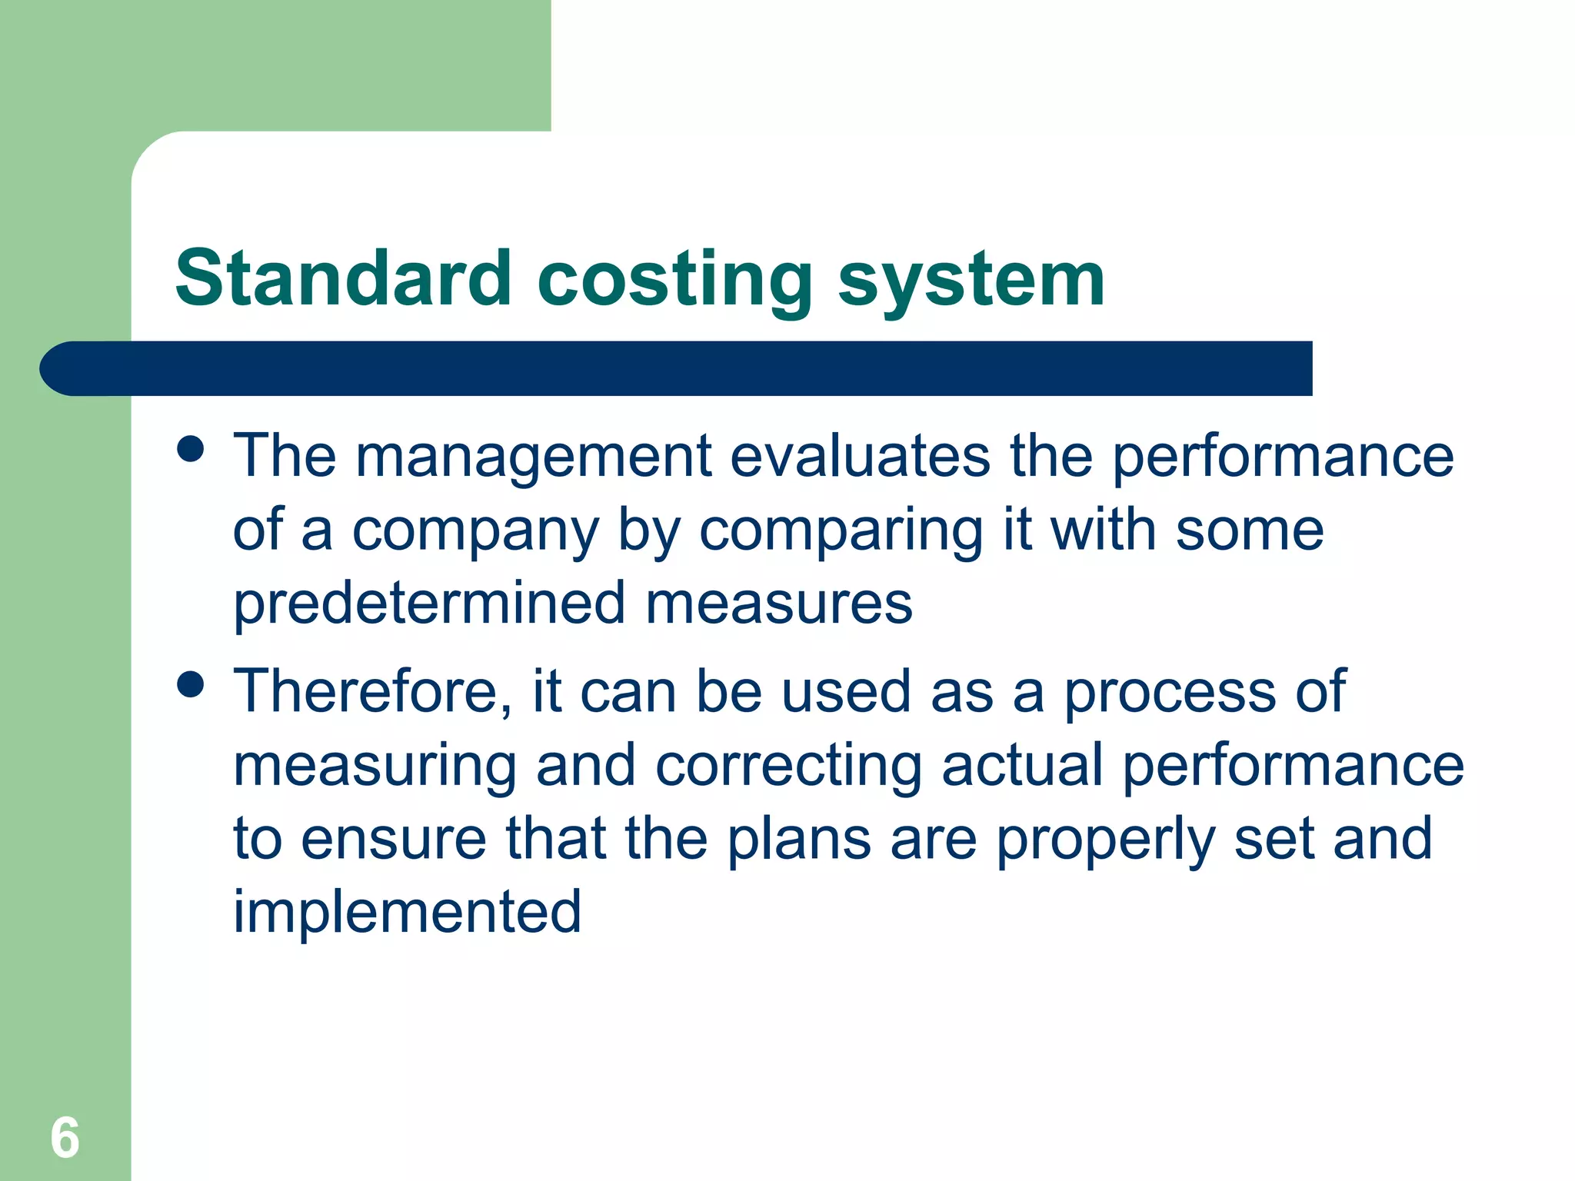

Slide 8
Objectives Of Standard Costing
To establish control
To set standards for various elements of cost
To fix responsibility
To make budgetary control more effective

Slide 9
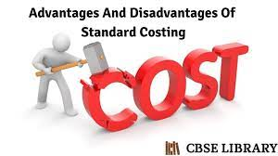

Slide 10
Advantages Of Standard Costing
Formulation of price and production policies
Comparison and analysis of data
Management by exception
Delegation of authority and responsibility
Cost consciousness
Better capacity to anticipate
Better economy, efficiency, and productivity
Preparation of periodical financial statements
Facilities budgeting

Slide 11
Limitations Of Standard costing
High degree of technical skill
Segregation of variances into controllable and no controllable factors
Duplication in recording
Either too strict or too liberal.

Slide 12
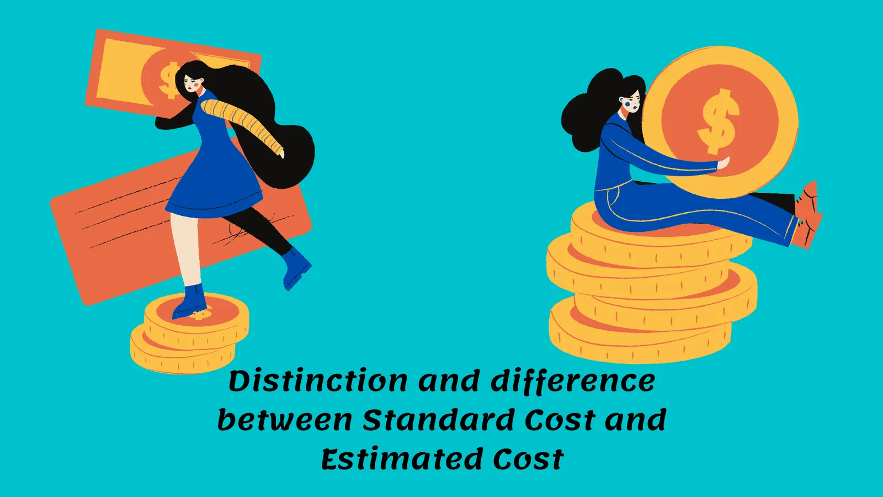

Slide 13
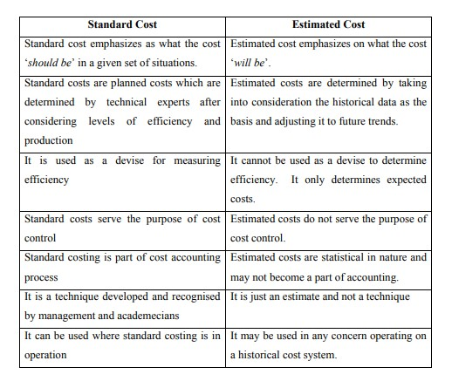

Slide 14
Installation of a Standard Costing System
To Set the predetermined standards for sales margin and production costs
To ascertain and collect the actual results
To compare the actual performance with pre-determined standards
To determine the variances
To analyze and investigate the variances
To ascertain the causes of variance
To take corrective action where necessary
To adjust the budget in order to make the standards more realistic

Slide 15


Slide 16
Variance analysis
A variance is the difference between the standards and the actual performance
When the actual results are better than the expected results, there will be a favourable variance (F)
If the actual results are worse than the expected results, there will be an adverse variance (A)

Slide 17
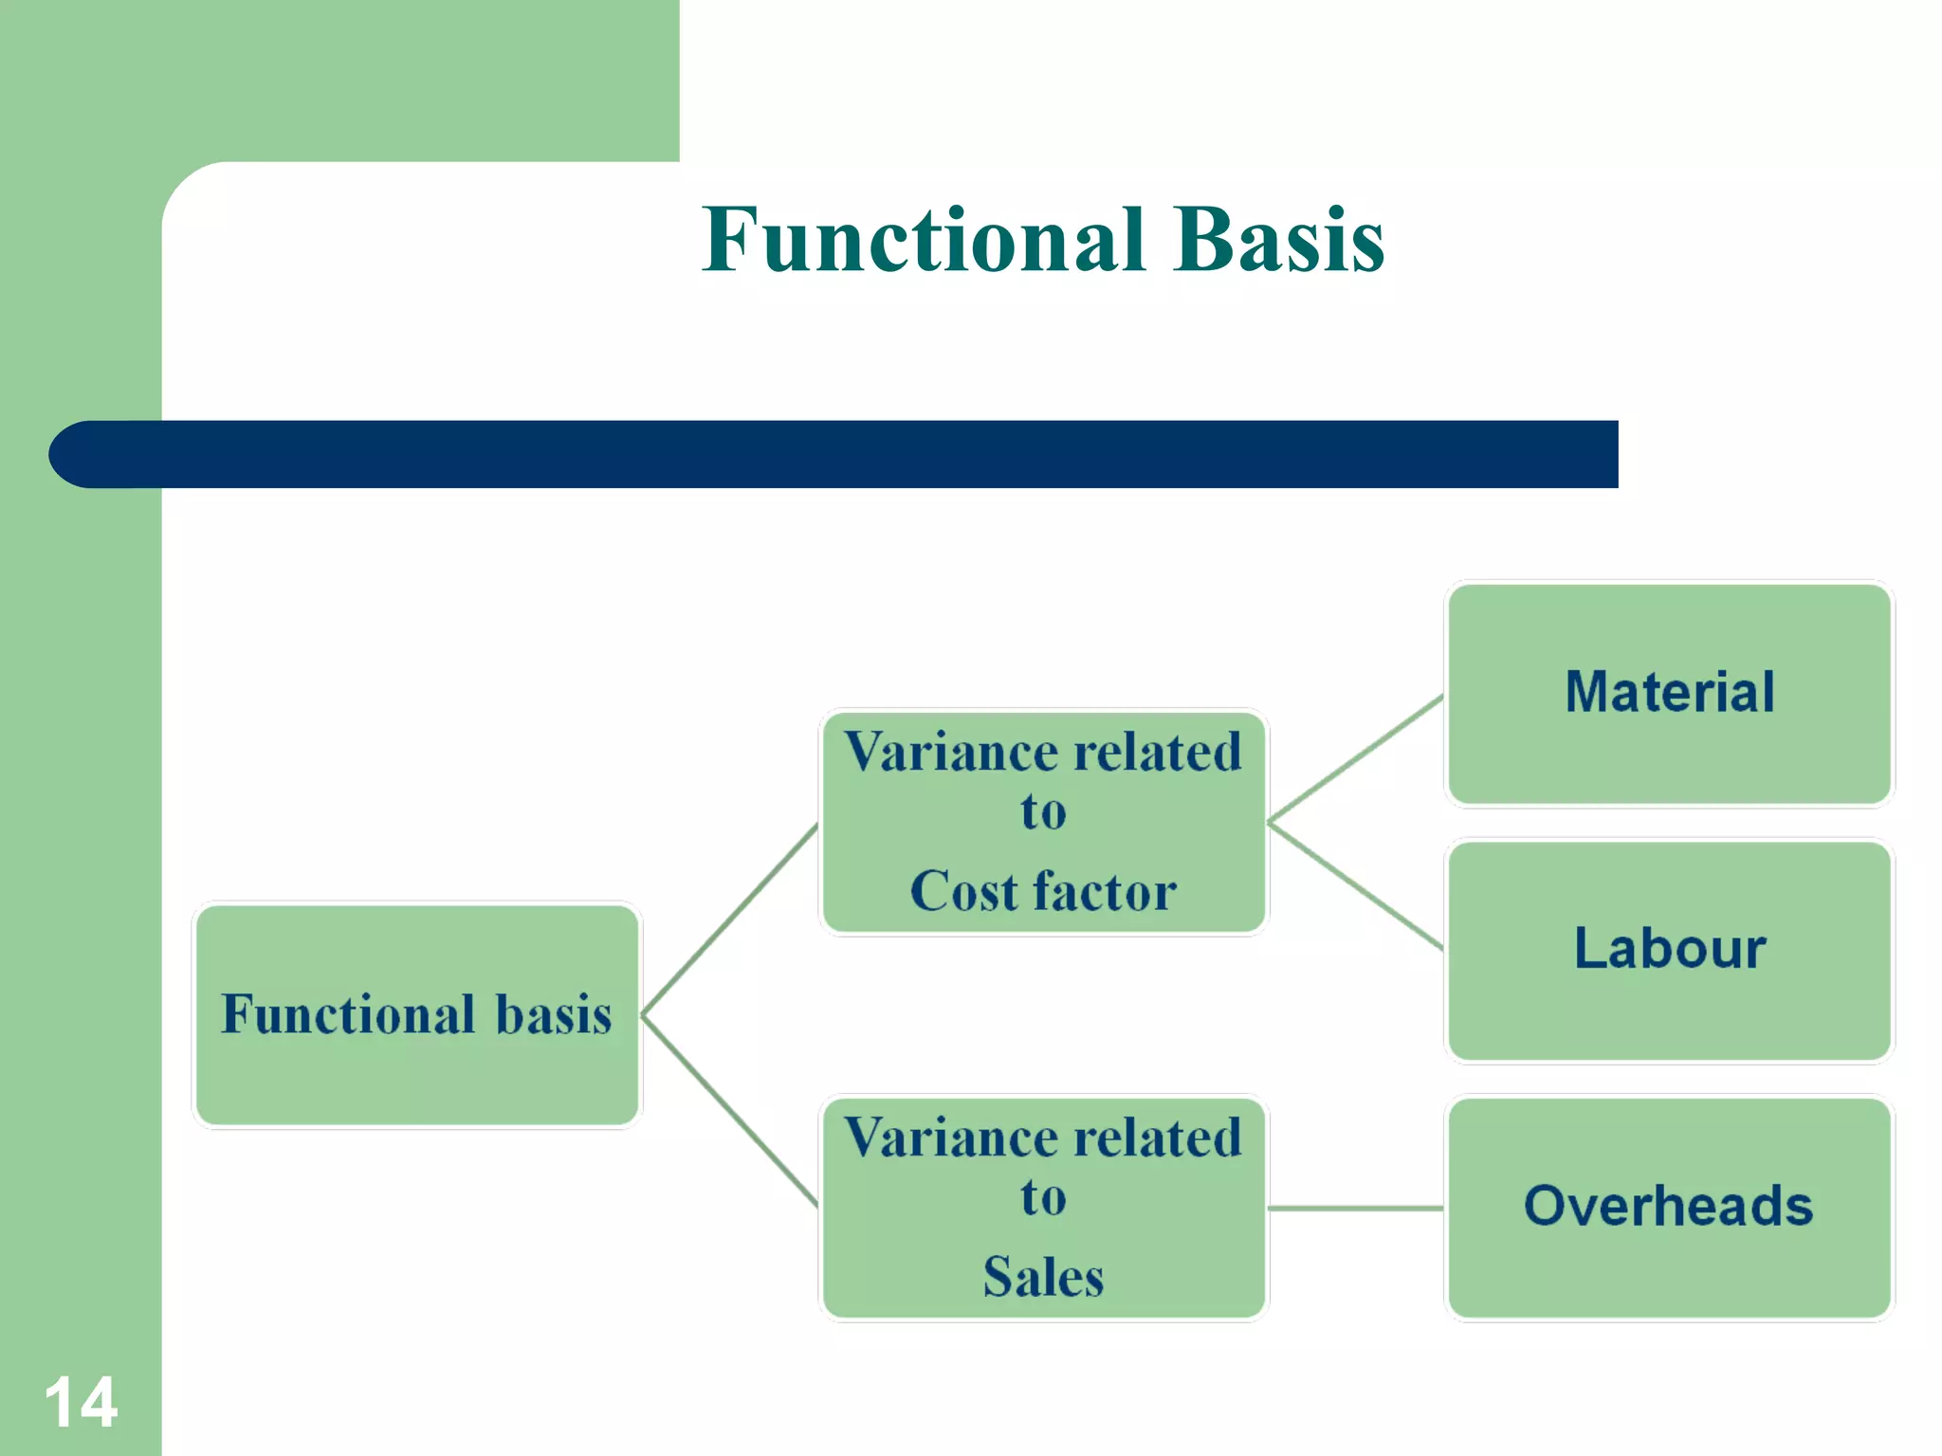

Slide 18
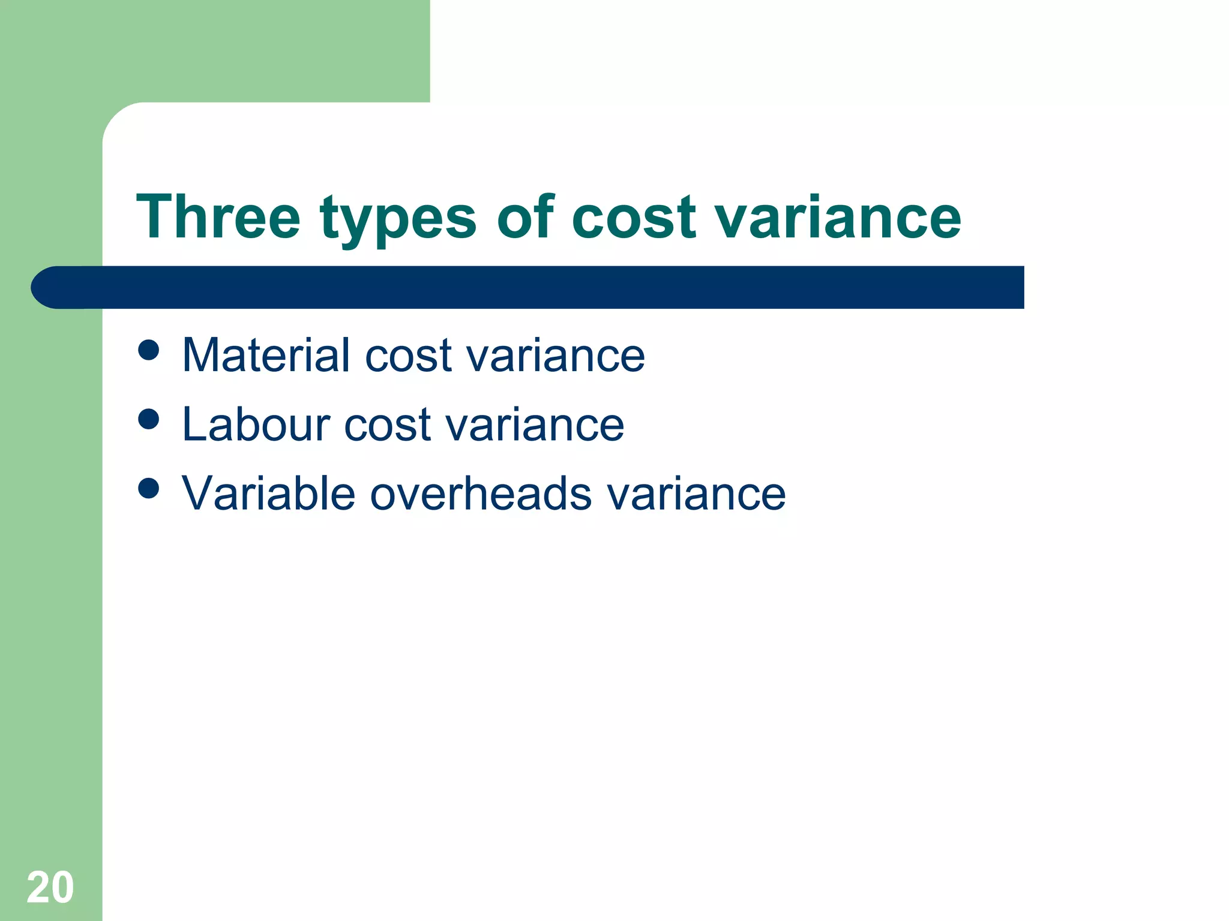

Slide 19
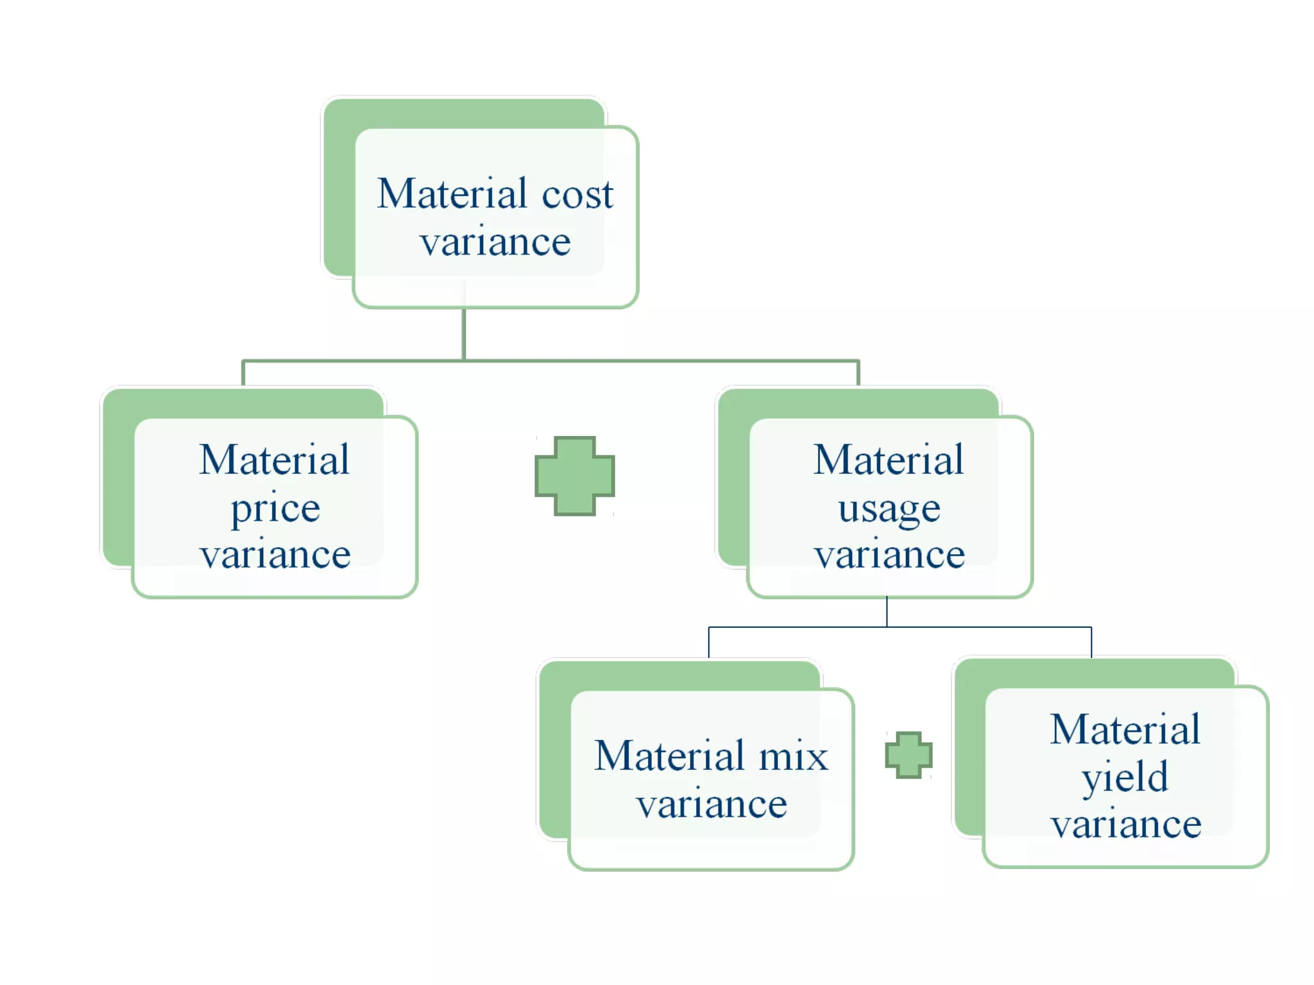

Slide 20
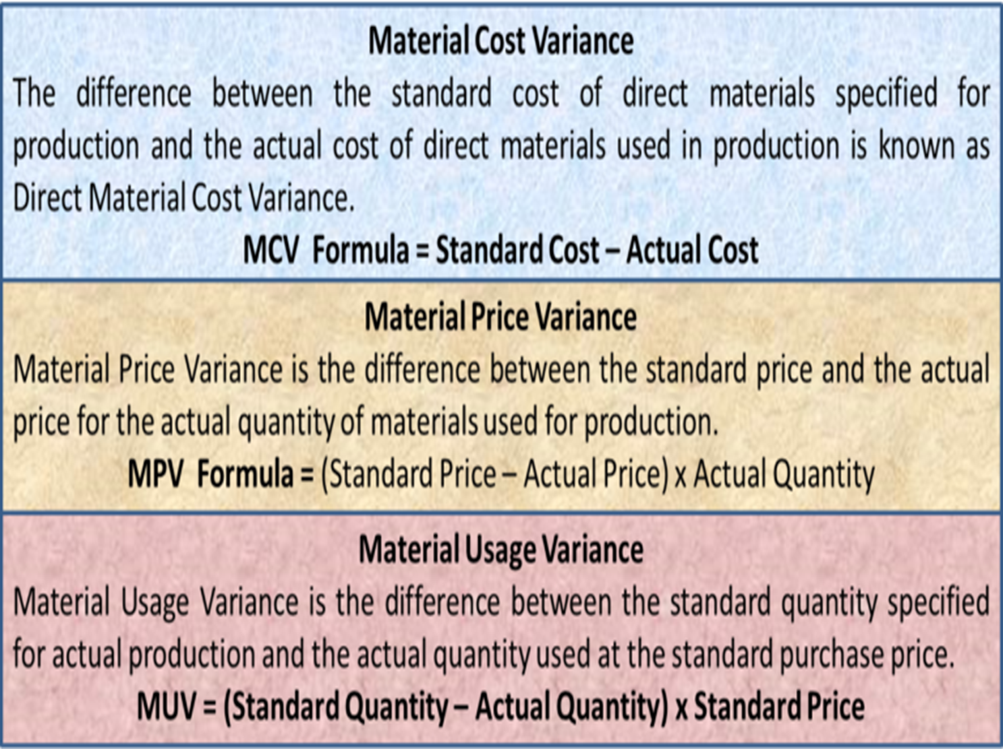

Slide 21
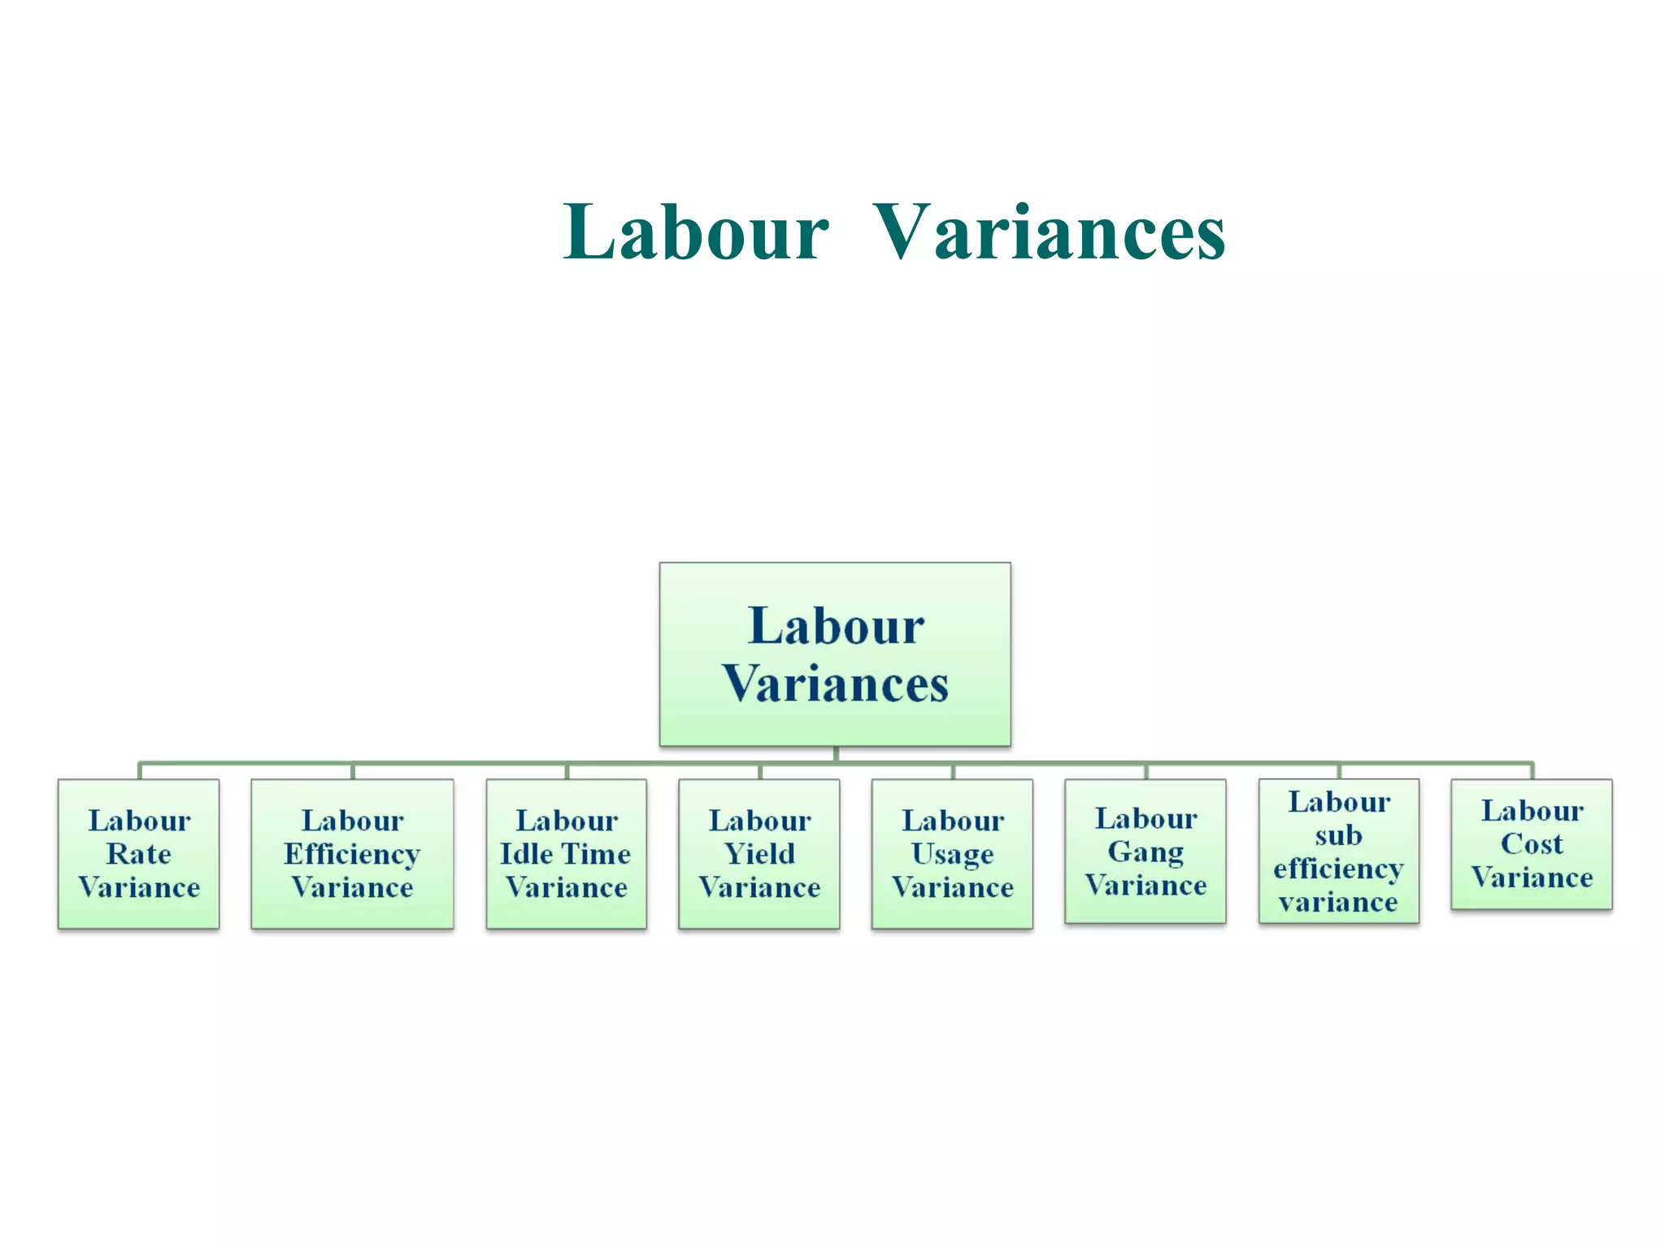

Slide 22
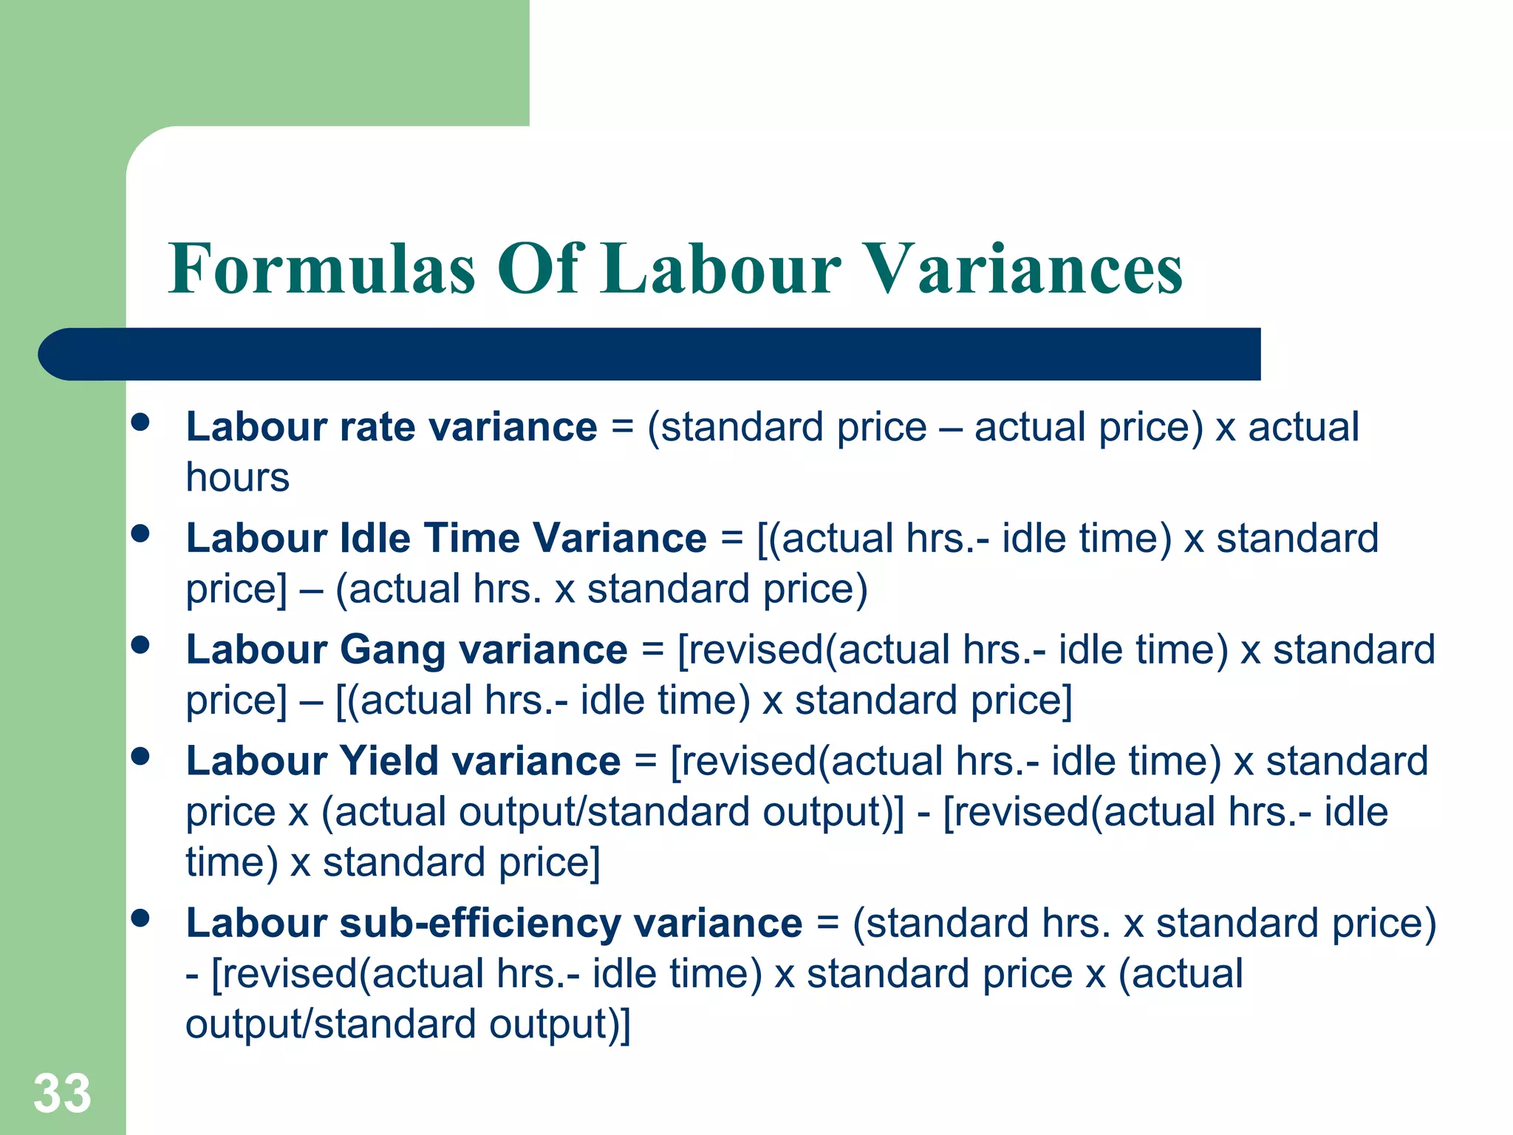

Slide 23
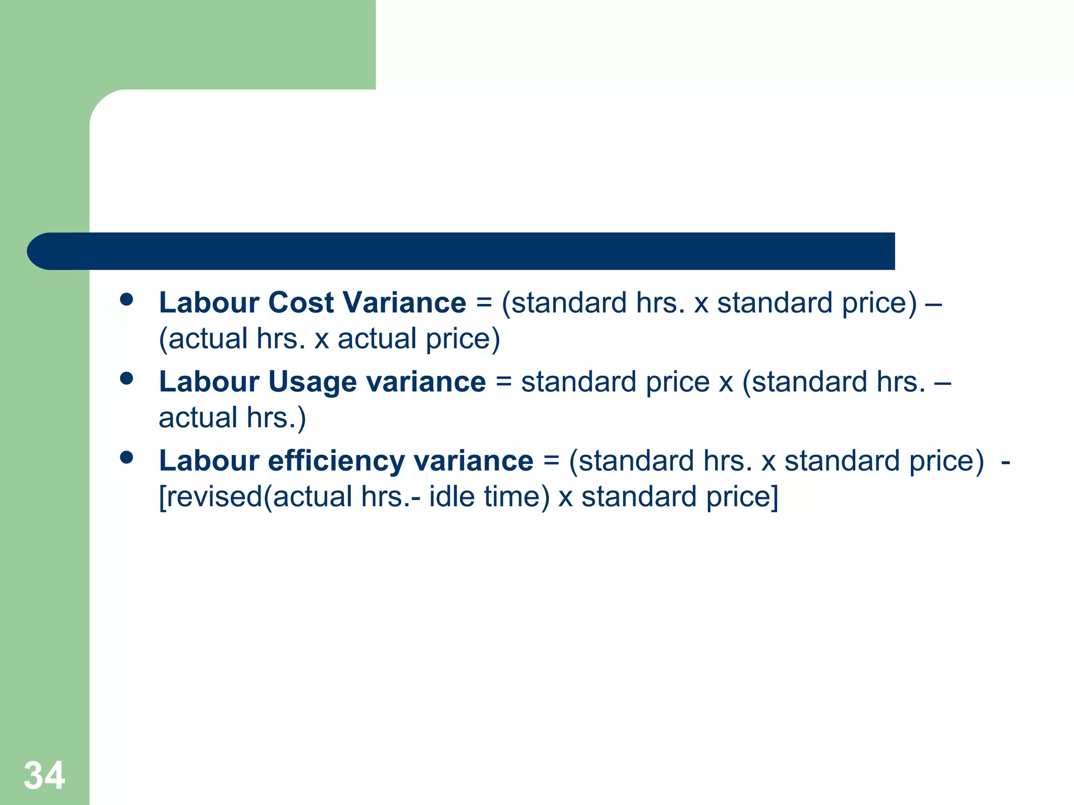

Slide 24
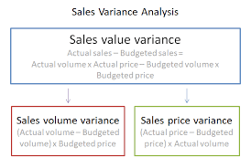
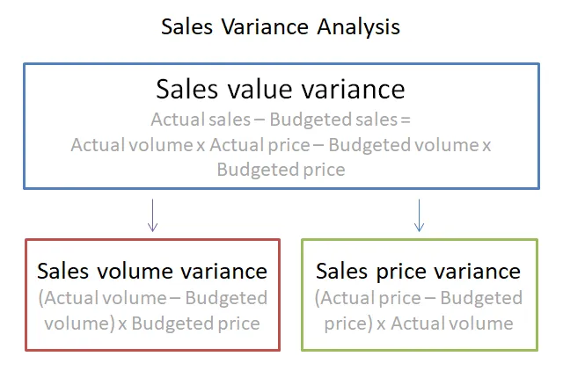

Slide 25
THANK YOU

