Slide 1
BANKING THEORY LAW AND PRACTICE

Slide 2
INTRODUCTION TO BANKING
A bank is a financial institution licensed to receive deposits and make loans.
Banking is defined as the business activity of accepting and safeguarding money owned by other individuals and entities, and then lending out this money in order to conduct economic activities such as making profit or simply covering operating expenses.

Slide 3
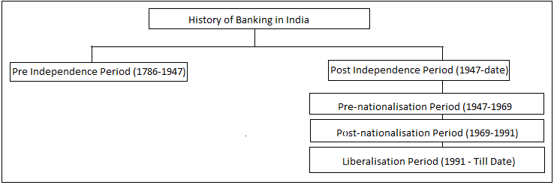
HISTORY OF BANKING

Slide 4
COMPONENTS OF INDIAN BANKING
There are four main components of the Indian Financial system. This includes:
Financial Institutions
Financial Assets
Financial Services
Financial Markets
Let’s discuss each component of the system in detail

Slide 5
FINANCIAL INSTITUTIONS
The financial institutions can further be divided into two types:
Banking Institutions or Depository Institutions – This includes banks and other credit unions which collect money from the public against interest provided on the deposits made and lend that money to the ones in need
Non Banking Institutions or Non Depository Institutions – Insurance, mutual funds and brokerage companies fall under this category. They cannot ask for monetary deposits but sell financial products to their customers.

Slide 6
FINANCIAL ASSESTS
Call Money – When a loan is granted for one day and is repaid on the second day, it is called call money. No collateral securities are required for this kind of transaction.
Notice Money – When a loan is granted for more than a day and for less than 14 days, it is called notice money. No collateral securities are required for this kind of transaction.
Term Money – When the maturity period of a deposit is beyond 14 days, it is called term money.
Treasury Bills – Also known as T-Bills, These are Government bonds or debt securities with maturity of less than a year. Buying a T-Bill means lending money to the Government.
Commercial Paper – It is an unsecured short-term debt instrument issued by corporations

Slide 7
FINANCIAL SERVICES
The financial services in India include:
Banking Services – Any small or big service provided by banks like granting loan, depositing money, issuing debit/credit cards, opening accounts, etc.
Insurance Services – Services like issuing of insurance, selling policies, insurance undertaking and brokerages, etc are all a part of the Insurance services
Investment Services – It mostly includes asset management
Foreign Exchange Services – Exchange of currency, foreign exchange, etc. are a part of the Foreign exchange services

Slide 8
FINANCIAL MARKET
Capital market
(a)Corporate Securities Market
(b)Government Securities Market
(c)Long Term Loan Market
Money market
Foreign exchange market
Credit market

Slide 9
INDIAN BANKING SYSTEM
Scheduled commercial banks
Regional rural banks
Co-operative banks
Payment banks and small financial banks

Slide 10
PHASES OF DEVELOPMENT
Early phase from 1786 to 1969 of Indian banks.
Nationalisation of Indian Banks and up to 1991 prior to Indian banking sector Reforms.
New phase of Indian Banking System with the advent of Indian Financial and Banking Sector Reforms after 1991.

Slide 11
TO BE CONTINUED .....

