Slide 1

NAZARETH COLLEGE OF ARTS AND SCIENCE
(Affiliated to University of Madras
Re-Accredited by NAAC with ‘B’ Grade)
DEPARTMENT OF COMMERCE
SUBJECT - BUSINESS LAW
UNIT - I
BY
MS.A.BELSIA BRITTO
(ASSITANT PROFESSOR
DEPARTMENT OF COMMERCE)

Slide 2








Slide 3


Slide 4

UNIT - I
Indian contract Act – Formation – Nature and elements of contract – Classification of contracts – Contract VS Agreement.

Slide 5



Slide 6



WHAT IS LAW?
Law is a system of rules, usually enforced through a set of institutions.
It shapes politics, economics and society in numerous ways and serves as the foremost social mediator in relations between people.
Law governs a wide variety of social activities.

Slide 7
EXAMPLE
The word “law” is a general term and has different connotations for different people,
A citizen may think of law as a set of rules which he must obey.
A lawyer who practises law may think of law as a vocation.
A legislator may look at law as something created by him.
A judge may think of law as guiding principles to be applied in making decisions.

Slide 8




DEFINITION OF LAW
DEFINITION OF LAW
Salmond defined law as, “ the law may be defined as body of principles recognised and applied by the state in the administration of justice.”

Slide 9


MEANING OF CONTRACT
A contract is an agreement made between two or more parties which the law will enforce.
In other words, Legally enforceable promises are termed as contracts.

Slide 10



DEFINITION OF CONTRACT
According to sec 2(h) of the Indian contract act,1872, “An agreement enforceable by law is a contract”.
A contract is “An agreement creating and defining obligation between the parties”. - Salmond

Slide 11



Agreement
Sec.2(e),An agreement is defined as “Every promise and every set of promises, forming consideration for each other”

Slide 12

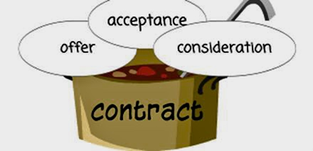
Promise
Sec.2(b), “When a person to whom the proposal is made signifies his assent thereto, the proposal is said to be accepted. A proposal when accepted, becomes a promise.”
Agreement = Offer + Acceptance.

Slide 13




Slide 14
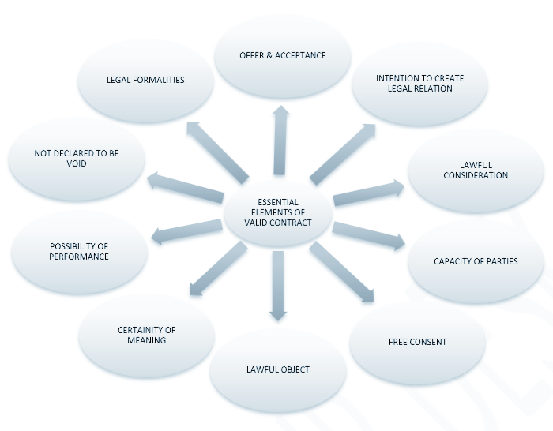

Slide 15
Essentials Elements of a Valid Contract
Offer and acceptance
Intention to create legal relationship
Lawful consideration.
Capacity of parties – Competency
Free and genuine consent
Lawful object
Agreement not expressly declared void
Certainty and possibility of performance
Legal formalities

Slide 16

1. Offer and Acceptance:
In order to create a valid contract there must be a lawful offer by one party and lawful acceptance of the same by the other party.
For Example:
‘A’ offers to sell his motorcycle to ‘B’ for 30,000, ‘B’ agrees to pay Rs. 30,000 for the motorcycle. Here, ‘A’ is the offerer and ‘B’ is the Acceptor

Slide 17

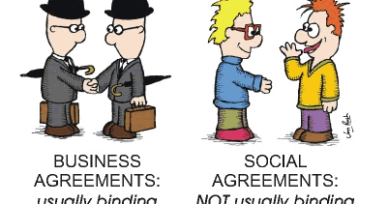
2. Intention to create legal relation
In case, there is no such intention on the part of parties, there is no contract. Agreements of social or domestic nature do not contemplate legal relations.
For example:
An agreement to have lunch at a friend’s house is not an agreement intending to create legal relation. Agreement between husband and wife generally lack of intention to create legal relation.

Slide 18

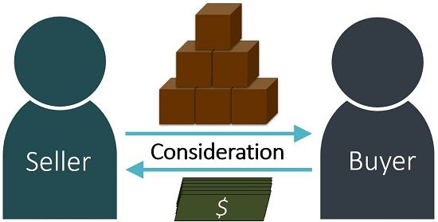
3. Lawful consideration
Consideration is an essential element in a contract. Promises made for nothing are unenforceable under the Indian Contract Act. The law enforces only those promises which are made for consideration. Consideration may take the form of money, goods, services, a promise to marry, etc. it may be past, present or future. But it must be real and lawful.
For example: ‘A’ agrees to sell his house to ‘B’ for Rs. 10, 00,000. Here ‘A’s promise to sell his house is, for ‘B’s consideration to pay Rs 10, 00,000.

Slide 19
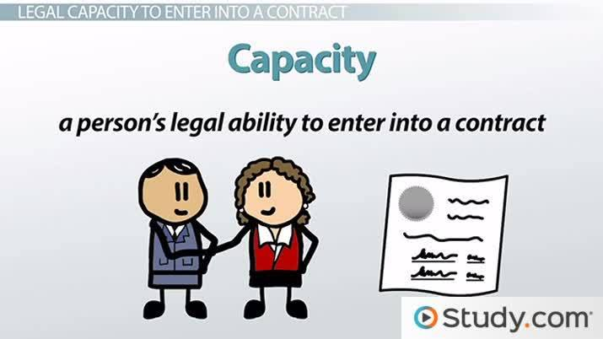
4. Capacity of parties
The parties to an agreement must be competent to contract. If either of the parties does not have the capacity to contract, the contract is not valid. According, to section 11 “every person is competent to contract, who is of the age of majority according to the law to which he is subject, and who is of sound mind and is not disqualified from contracting by any law to which he is subject.”
For example: Minors, persons of unsound mind and persons disqualified by law are incompetent to contract.

Slide 20


5.Free and genuine consent
Consent’ means the parties must have agreed upon the same thing in the same sense.
For example: ‘A’ who owns two cars, one ford and other BMW, offers to sell 'B' one car. ‘A’ intending it to be a ford car. ‘B’ accepts the offer thinking that it is the BMW. There is no free consent and hence, no contract.

Slide 21


6.Lawful object
The object of an agreement must be lawful. The object has nothing to do with consideration. It means the purpose or design of the contract.
For example: ’A’ hires a house for use as a gambling house, the object of the contract is to run a gambling house.

Slide 22

7.Agreement not declared void
The agreement though satisfying all the conditions for a valid contract must not have been expressly declared void by any law in force in the country.
For example: Agreements in restraint of trade, marriage, legal proceedings etc.

Slide 23

8.Certainty and possibility of performance
If the act is impossible in itself, physically or legally it cannot be enforceable by law.
For example: Mr. A agrees with Mr. B to discover treasure by magic. Such an agreement is not enforceable.

Slide 24



9.Legal formalities
An oral contract is a perfectly valid contract except in those cases where writing, registration etc are required.
For example: In India writing is required in cases of sale, mortgage, lease, negotiable instrument etc.

Slide 25



CLASSIFICATION OF CONTRACTS

Slide 26
CLASSIFICATION OF CONTRACTS
1.Validity
2.Formation
3.Performence
Valid contract
Express contract
Unilateral contract
Void contract
Implied contract
Bilateral contract
Voidable contract
Quasi contract
Executed contracts
Void agreement
E-contract
Executory contract
Unenforceable contract
Illegal contract

Slide 27
I. Classification according to validity
Valid contract
A valid contract is an agreement which is binding and enforceable. In other words a contract which satisfies all the conditions prescribed by law is a valid contract
Void contract.
A void contract is really not a contract at all. It is an agreement which is without any legal effect. According to sec 2(j) of the Indian contract act 1872 , A contract which ceases to be enforceable by law becomes void when it ceases to be enforceable.

Slide 28
Voidable Contract
section 2(i) of the Indian Contract Act defines the term voidable contract. Voidable Contract are those contracts which are enforceable by law at the option of one or more of the parties but not by others.
In a voidable contract, one of the parties has to be bound by the terms of the contract. The other party is not bound by such terms of the contract and they can repudiate or accept the terms of contract.
Void Agreement:
An agreement not enforceable by law is said to be void. A void agreement does not create any legal rights or obligations.

Slide 29

Unenforceable contract:
under the common law of contract, is one that the courts will not enforce because the purpose of the agreement is to achieve an illegal end.
Which is valid but for certain reasons such as want of proof
expiry of period within which enforceable etc it becomes unenforceable.
Illegal agreement:
An illegal agreement is one which transgresses some rule of basic public policy or which is criminal in nature or which is immoral. Such an agreement is a nullity and has much wider import than a void contract. All illegal agreements are void but all void agreements or contracts are not necessarily illegal.

Slide 30
II. Classification according to formation
Express Contracts:
contracts entered into between the parties by words spoken or written;
Example: A says to B ‘will you purchase my bike for Rs.20,000?” B says to A “Yes”.
Implied contract: Contract which come into being on account of the act or conduct of the parties not by their express words, written or spoken.
Example: A stops a taxi by waving his hand and takes his seat. There is an implied contract that A will pay the prescribed fare.

Slide 31

Quasi-contract
In such a contract the rights and obligations arise not by an agreement but by operation of law.
Example: If Mr A leaves his goods at Mr B’s shop by mistake, then it is for Mr. B to return the goods or to compensate for the price.
E-contract
An e-contract is a contract made through the digital mode.
Example: Via Internet

Slide 32
III. Classification according to Performance
Executed contract
In an executed contract both the parties have performed their promises under a contract.
Example: A contracts to buy a car from B by paying cash, B instantly delivers his car.
Executory contract
In a Executory contract both the parties are yet to perform their promises.
Example: A sells his car to B for Rs. 2 lakh. If A is still to deliver the car and B is yet to pay the price, it is an executory contract.

Slide 33
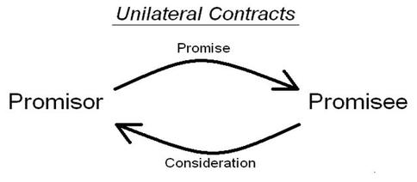
Unilateral Contract
A Unilateral Contract is also known as a one sided contract. It is a type of contract where only one party has to perform his promise.
Example: Anuj promises to pay Rs. 1000 to anyone who finds his lost cellphone. B finds and returns it to Anuj. From the time B found the cellphone, the contract came into existence. Now Anuj has to perform his promise, i.e. the payment of Rs. 1,000.

Slide 34
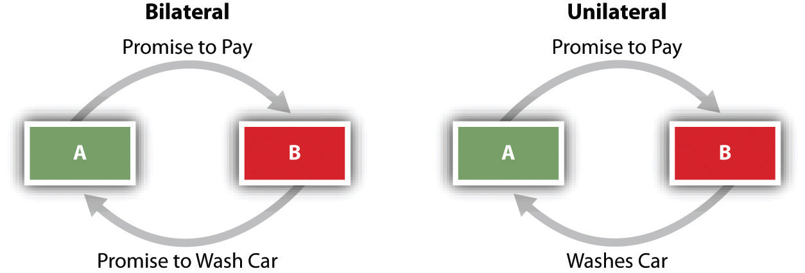
Bilateral contract
A Bilateral contract is one where the obligation or promise is outstanding on the part of both the parties. It is also known as a two sided contract.
Example: A promises to sell his car to B for Rs. 1 lakh and agrees to deliver the car on the receipt of the payment by the end of the week. The contract is bilateral as both the parties have exchanged a promise to be performed within a stipulated time.

Slide 35
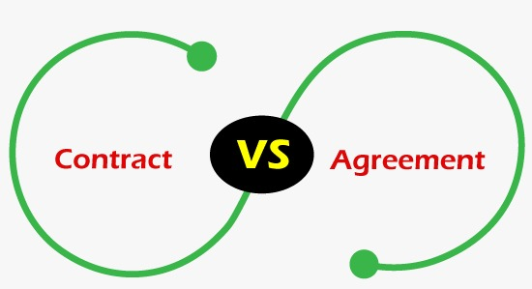


Slide 36
S.NO | AGREEMENT | CONTRACT
1 | The enforceability depends on the nature of agreement. | It is enforceable under the provisions of the law of the country.
2 | Agreements may be lawful or unlawful | Only lawful agreements become contracts enforceable in a court of law.
3 | An offer when accepted becomes an agreement. | A contract is entered into by an agreement and hence valid contracts are enforceable.
4 | When agreements are illegal or immoral, the parties are not liable to perform. | It creates legal obligation on the parties to the contract.
5 | The scope of an agreement is more comprehensive than contracts, as agreements can be social agreements , legal agreements, unlawful agreements ,and domestic agreements | The scope is limited as only legal agreements become contracts that are enforceable.

Slide 37


