Slide 1
BUSINESS COMMUNICATION

Slide 2
Audience
What do they need to know?
How much do they already know about your subject?
What do they expect to see?
What prejudices/preconceptions might they have?
What’s on their agenda?

Slide 3
Speaker
What do you want the audience to remember?
How will you show your credibility?
How will you demonstrate you are an authority on the subject?
What do you have in common with your audience to create a bond?

Slide 4
Message
What are you trying to achieve?
° Inform
° Express
° Persuade (that’s always the case)
° Is it necessary?

Slide 5
Effective Communication ...
Most powerful tool for personal and/or
professional success.
° Empowers you to influence others.
Is challenging day-to-day with co-
workers, family and friends.
° One of the quickest ways to alienate yourself from other people is to communicate unsuccessfully.
80% of problems in the workplace are
communication related.

Slide 6
What is Communication?
Communication is the giving and receiving of feedback between individuals and/or groups for the purpose of exchanging information.

Slide 7
What is Business Communication?
Business communication is the giving and receiving of feedback between individuals and/or groups for the purpose of exchanging information and altering performance in the workplace.

Slide 8

Effective Communications

Slide 9
Audience
What do they need to know?
How much do they already know about your subject?
What do they expect to see?
What prejudices/preconceptions might they have?
What’s on their agenda?

Slide 10
And Here?
Message
Audience
Speaker

Slide 11
Effective Business Communication
The structure of effective Presentations and Reports.

Slide 12
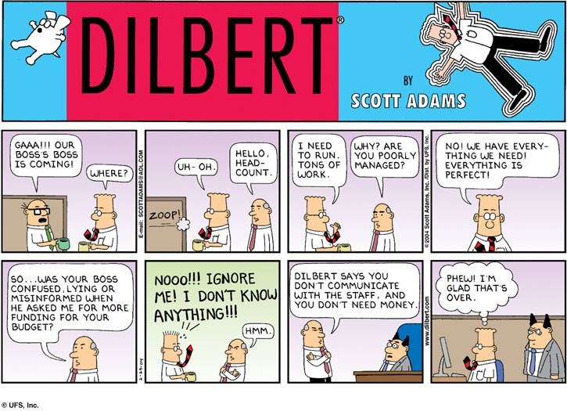

Slide 14
Communication Checklist
How do you construct an effective presentation or report?
Who is your audience?
What are they interested in?
What do you want them to remember?

Slide 15
Example: Audience for Field Project Report Sections

Slide 16
Components of an Effective Presentation
Purpose
Format
Data
Conclusion
So What
Restate
Tag Ending

Slide 17
Key points
Introduction and summary for each chapter.
Direct, simple sentences.
Short paragraphs.
White space, bullets and graphics.
Tables and figures stand on their own.
Text stands on its own.
There is nothing too obvious to say.

Slide 19
Components of an Effective Presentation
Purpose
Format
Data
Conclusion
So What
Restate
Tag Ending

Slide 20
PURPOSE: Define task.
"The purpose of this presentation is ... “
Describe what the original problem was and what you were asked to do.

Slide 21
PURPOSE: Define task.
"The purpose of this presentation is ... “
Describe what the original problem was and what you were asked to do.

Slide 22
FORMAT: What is the presentation going to do?
"This presentation recommends
o ...
o ... "
Tell them what you are going to say. This is the agenda. Effective presentations use this to outline the critical things that will be covered, not copy the grading sheets.

Slide 23
DATA: Information and data about the problem.
"You should note the following facts in support of these recommendations...”
This is background. Spend only the time here that you absolutely need.

