Slide 1
NAZARETH COLLEGE OF ARTS AND SCIENCE
DEPARTMENT OF COMMERCE
BUSINESS LAW
TOPIC: Fraud, Misrepresentation & Mistake
BY
P.PUNITHA VINODHINI LAKSHMI
Asst. Professor

Slide 2
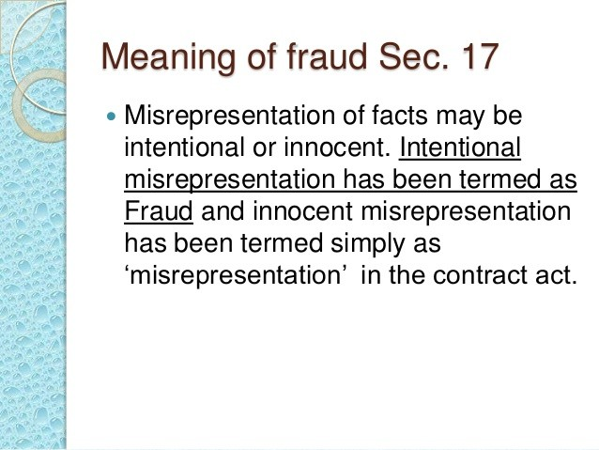

Slide 3
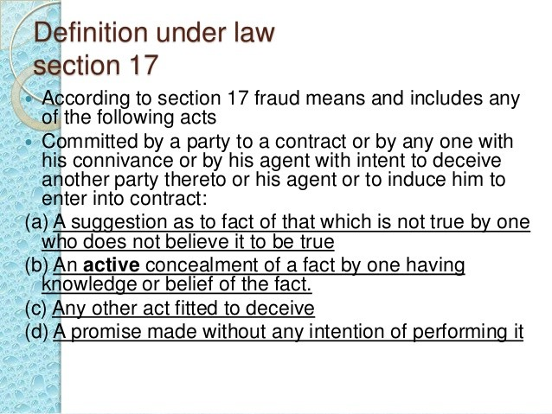

Slide 4
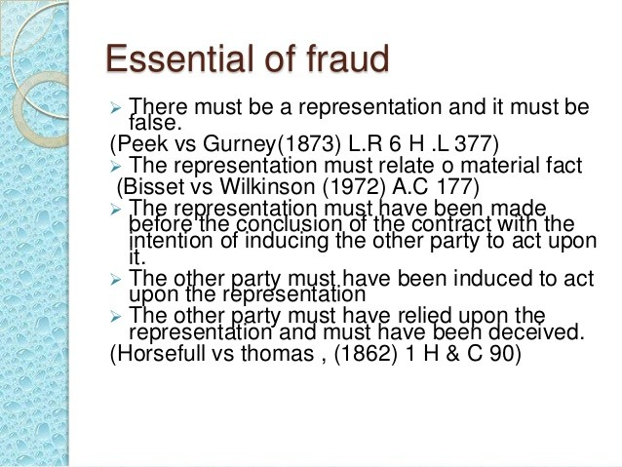

Slide 5
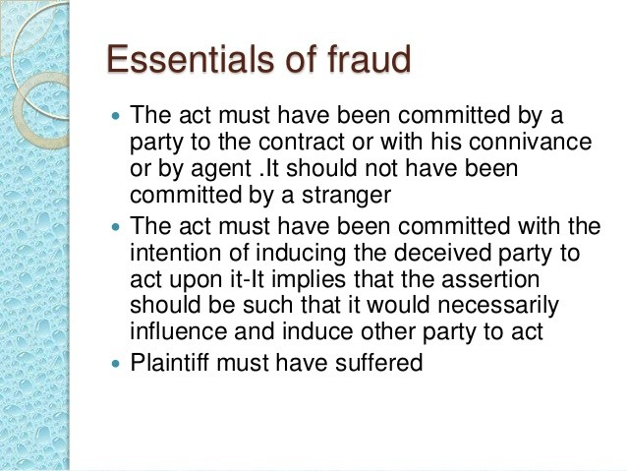

Slide 6
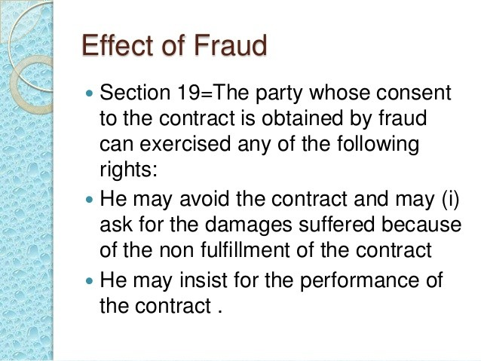

Slide 7
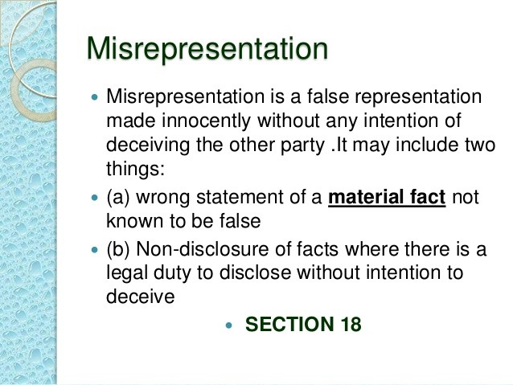

Slide 8
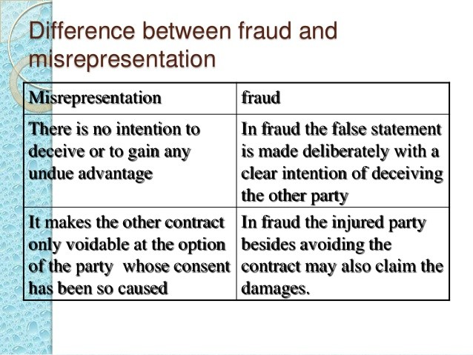

Slide 9
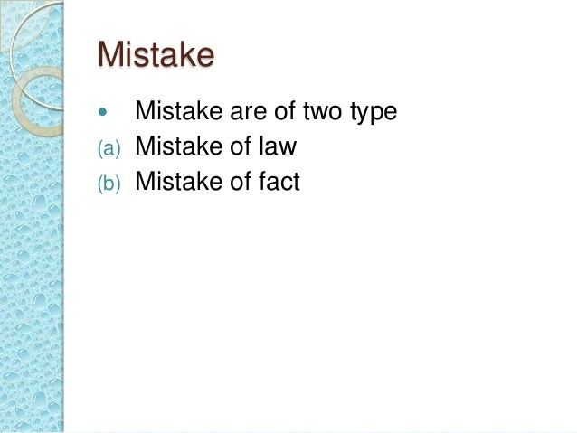

Slide 10
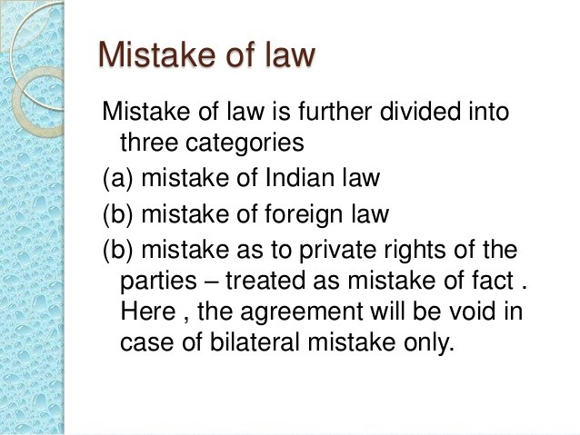

Slide 11
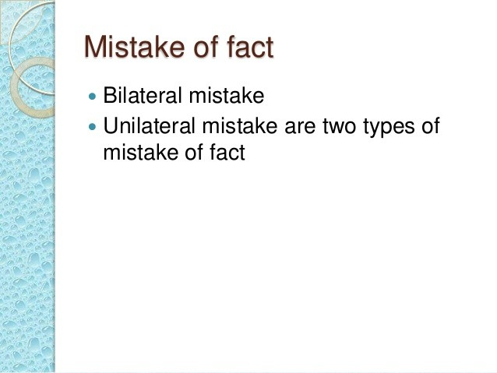

Slide 12
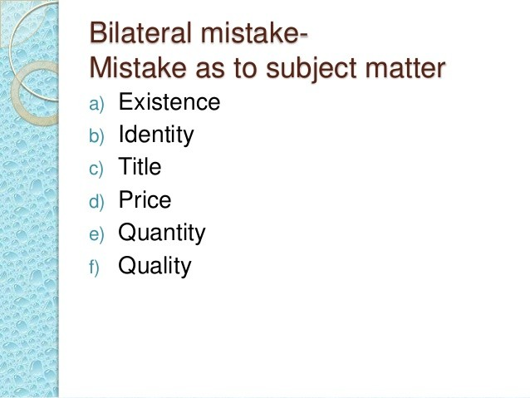

Slide 13
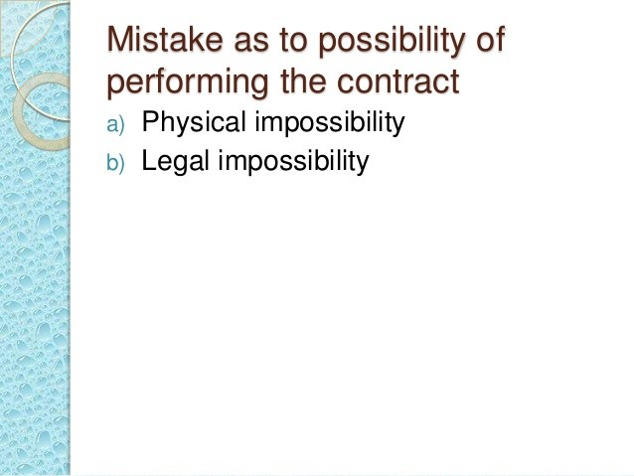

Slide 14
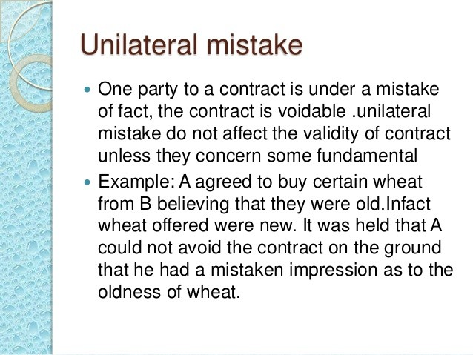

Slide 15
THANK YOU

