Slide 1
NAZARETH COLLEGE OF ARTS AND SCIENCE
(Affiliated to University of Madras
Re-Accredited by NAAC with ‘B’ Grade)
DEPARTMENT OF COMMERCE
SUBJECT – COMPANY LAW
UNIT - I
BY
MS.BELSIA BRITTO.A
ASSISTANT PROFESSOR
NCAS

Slide 2


Slide 3
Memorandum of Association
It is the charter of the company
It contains the fundamental conditions upon which the company can be incorporated
It contains the objects of the company’s formation
The company has to act within objects specified in the MOA
It defines as well as confines the powers of the company Any thing done beyond the objects specified in the MOA will be ultra vires.
Their transactions will be null and void
The outsider have to transact looking into the MOA

Slide 4
Conditions of the MOA
It should be printed
Divided into paragraph and numbers consecutively Signed by at least seven persons or two in case of public and private company respectively.
The signature should be in the presence of a witness, who will have to attest the signature Members have to take shares and write the number of shares taken with full address

Slide 5
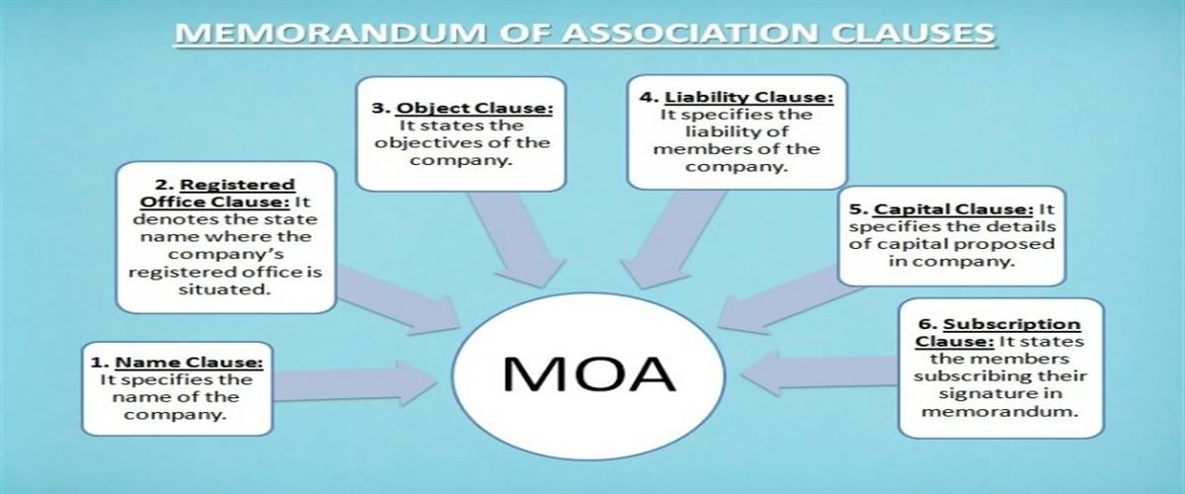

Slide 6
CONTENTS OF THE MOA
The Name Clause – it decides on the name of the company based on the capital involved
The Registered Office Clause- where it has registered its head office and other branch office ( The registered office can be changed with the permission of the ROC)
The Object Clause- Main object, ancillary object and the other objects of the company are clearly specified The applicable doctrine here is the “ Doctrine of Ultra Vires” beyond the powers of the company (opposed to Intra Vires)

Slide 7
The Liability Clause- What is the liability of its members.. limited by shares or guarantee or unlimited, there can be alteration in the liability clause
The Capital Clause - The amount of the nominal capital of the company, number of shares in which it is to be divided… alteration of the capital clause etc
The Association or Subscription clause- Where the subscribers to the MOA declare that they respectively agree to take the number of the shares in the capital.
They have to sign in the presence of two witnesses, who attest the signatures,
The subscriber to take at least one share. After the name the subscriber has to write the number of shares taken

Slide 8
Doctrine of Ultra Vires”
The powers exercisable by the company are to be confined to the objects specified in the MOA.
So it is better to define and include the provisions regarding the acquiring of business, sharing of profits, promoting company and other financial, gifts , political party funds etc
If the company acts beyond the powers or the objects of the company that is specified in the MOA, the acts are considered to be of ultra vires.
Even if it is ratified by the all the members, the action is considered to be ineffective.
Even the charitable contributions have to be based on the object clause.

Slide 9
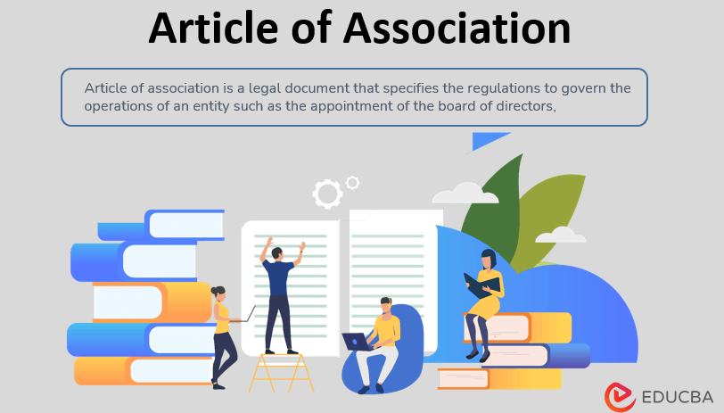

Slide 10
Articles of Association
It is the companies bye- laws or rules to govern the management of the company for its internal affairs and the conduct of its business.
AOA defines the powers of its officers and also establishes a contract between the company and the members and between the members
It can be originally framed and altered by the company under previous or existing provisions of law.

Slide 11
AOA plays a subsidiary part to the MOA
Any thing done beyond the AOA will be considered to be irregular and may be ratified by the shareholders.
The content of the AOA may differ from company to company as the Act has not specified any specific provisions
Flexibility is allowed to the persons who form the company to adopt the AOA within the requirements of the company law
The AOA will have to be conversant with the MOA, as they are contemporaneous documents to be read together.
Any ambiguity and uncertainty in one of them may be removed by reference to the other.

Slide 12
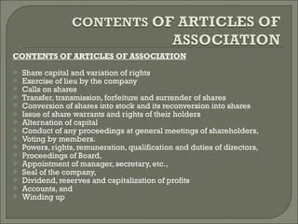

Slide 13
Contents of the AOA
Share capital
Lien on shares
Calls on shares
Transfer and transmission of shares
Forfeiture of the shares
Surrender of the shares
General meetings
Alteration of the capital
Directors etc..
Dividends and reserves
Account and audit
Borrowing powers
Winding up
Adoption of the preliminary contracts etc….

Slide 14
Doctrine of Constructive notice and Indoor Management
Persons dealing with the company have to satisfy themselves. But need not know the internal irregularity.
The doctrine of Constructive notice can be invoked by the company to operate against the persons dealing with the company.
The outsider cannot embark, but only can acquaint upon the MOA and AOA. (Official Liquidator, Manasube &Co Pvt Lid V. Commissioner of Police)

Slide 15
Exceptions to the Doctrine of Where the outsider cannot claim the relief on the grounds of “Indoor management”
Knowledge of irregularity
No knowledge of articles
Negligence
Forgery
Non- Existent authority of the company

Slide 16


Slide 17
Prospectus
It is an invitation issued to the public to purchase or subscribe shares or debentures of the company.
Every prospectus must be dated. The date of publication and the date of issue must be specifically stated in the prospectus.
The golden rule of the prospectus is that every detail has to be given in strict and accuracy. The material facts given in the prospectus are presumed to be true

Slide 18
Various forms in which the prospectus can be issued.
Shelf Prospectus: Prospectus is normally issued by financial institution or bank for one or more issues of the securities or class of securities mentioned in the prospectus.
There can be deemed prospectus also if it is issued by the issue house‘
Information Memorandum’: It means a process, which is undertaken prior to the filing of prospectus.
Even an Advertisement , that the shares are available is considered to be prospectus

Slide 19
Contents of the prospectus
General information
Capital structure
Terms of present issue
Management and projects
Management and perception of risk factor
It is compulsory to register the prospectus with the Registrar

Slide 20
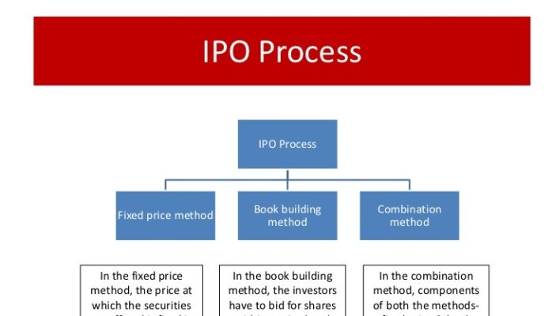

Slide 21
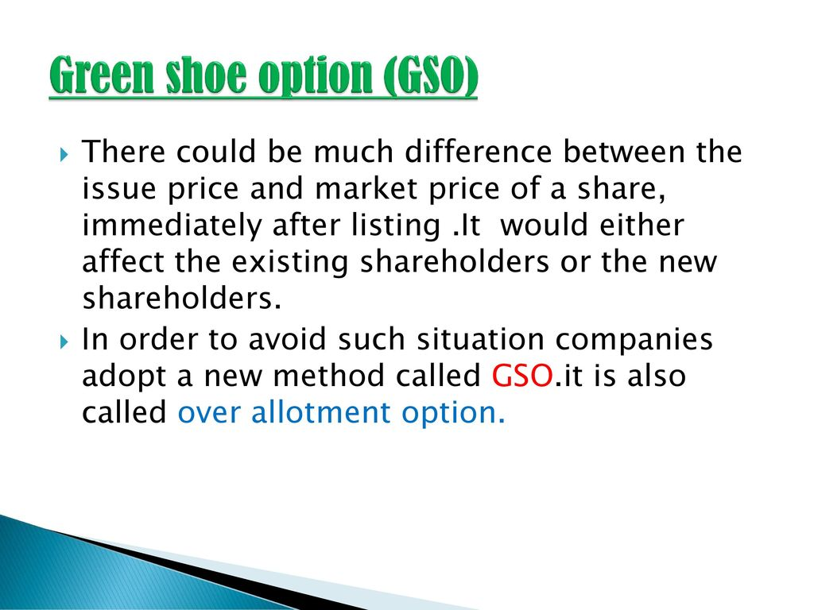

Slide 22


Slide 23
