Slide 1
NAZARETH COLLEGE OF ARTS AND SCIENCE Affiliated To University Of Madras Re-accredited by NAAC with ‘B’ grade
FUNDAMENTALS OF INFORMATION TECHNOLOGY
UNIT V
APPLICATION SOFTWARE
CLASS :II MCOM
SEMESTER: ODD(2021-2022)
STAFF NAME: MS.S.V.RAJIGA
DEPARTMENT: COMPUTER SCIENCE

Slide 2
Objectives
Distinguish between operating systems and applications software
List the various methods by which individuals and businesses acquire software
List and briefly describe various types of task-oriented software
Identify the kinds of software available for both large and small businesses
Discuss ethical issues associated with software
Describe the functions of various computer professionals

Slide 3
Contents
Applications Software
Software Types
Task-Oriented Productivity Software
Business Software
Application Software and Ethics
Computers and People

Slide 4
Software Types Custom Software
Written by programmers
Takes a lot of time to write and test
When specifications are unique

Slide 5
Acquiring Software
Freeware
Free to all
Copyrighted
Distributed in machine-readable format
Shareware
Freely distributed for a trial period
Pay a nominal fee to register with the author

Slide 6
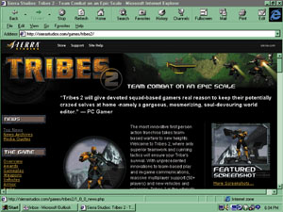
Application Software Ethics
What is legal?

Slide 7
Software Piracy
Making illegal copies of copyrighted software
Why the fuss?
Very easy to duplicate software vs. a text book
Software company may lose hundreds of dollars per pirated copy
Prosecution
Yes: Small-medium sized business who purchase a few copies and distribute to many users
No: Individual users who probably would not have purchased software on their own anyway

Slide 8
Counterfeiting
Software is copied onto CD-ROMS / DVD-ROMS
Package duplicates the original
Sold in flea markets or small stores
Cheaper price
Occurs more overseas

Slide 9
Copying Software
Legitimate reasons
Backup copy
Copy to hard disk
Illegitimate reasons
Obtain software without paying for it

Slide 10
Thank you

