Slide 1
Digital Image Processing
Components of Image Processing System

Slide 2
Image Processing System
Digital image processing is the processing of an image by means of a digital computer.
Digital image processing uses different computer algorithms to perform image processing on the digital images.

Slide 3
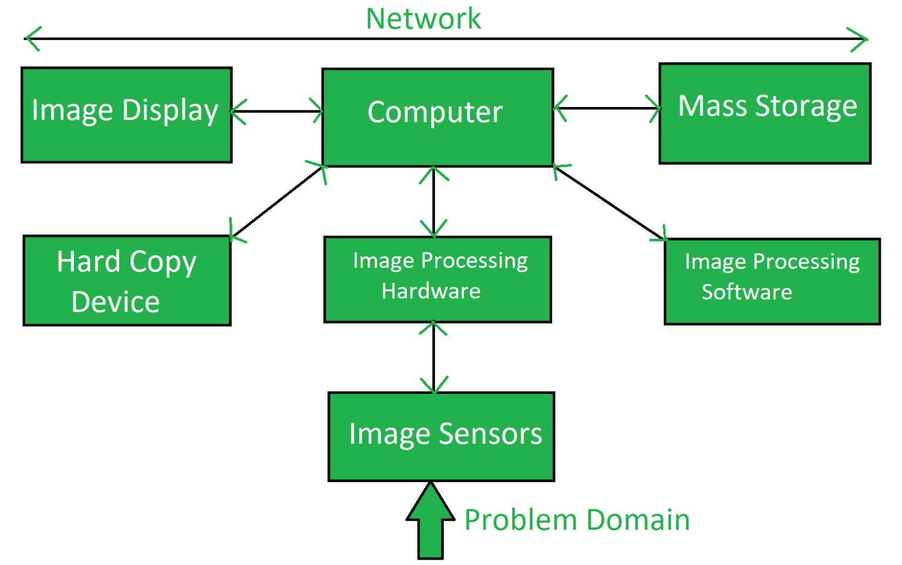
Components of Image Processing System

Slide 4
.
I. Image Sensors:
Image sensors senses the intensity, amplitude, co-ordinates and other features of the images and passes the result to the image processing hardware. It includes the problem domain.
II. Image Processing Hardware:
Image processing hardware is the dedicated hardware that is used to process the instructions obtained from the image sensors. It passes the result to general purpose computer.

Slide 5
.
III. Computer:
Computer used in the image processing system is the general purpose computer that is used by us in our daily life.
IV. Image Processing Software:
Image processing software is the software that includes all the mechanisms and algorithms that are used in image processing system.
V. Mass Storage:
Mass storage stores the pixels of the images during the processing.

Slide 6
.
VI. Hard Copy Device:
Once the image is processed then it is stored in the hard copy device. It can be a pen drive or any external ROM device.
VII. Image Display:
It includes the monitor or display screen that displays the processed images.
VIII. Network:
Network is the connection of all the above elements of the image processing system.

