Slide 1
NAZARETH COLLEGE OF ARTS AND SCIENCE
Affiliated To University Of Madras Re-accredited by NAAC with ‘B’ grade
DATA SCIENCE
INTRODUCTION
CLASS :III B.SC CS
SEMESTER: EVEN(2022-2023)
STAFF NAME: MS.R.MEENAKSHI
DEPARTMENT: COMPUTER SCIENCE

Slide 2
Outline
Data, Big Data and Challenges
Data Science
  Introduction
  Why Data Science
Data Scientists
  What do they do?
Major/Concentration in Data Science
  What courses to take.

Slide 3




Data All Around
Lots of data is being collected
and warehoused
  Web data, e-commerce
  Financial transactions, bank/credit transactions
  Online trading and purchasing
  Social Network

Slide 4
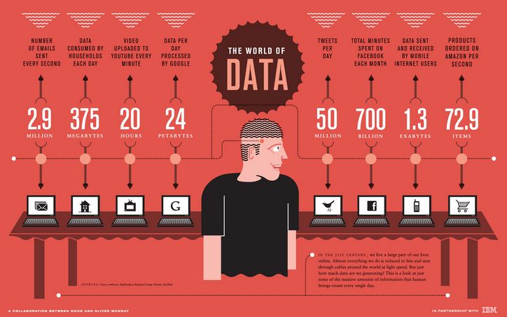
How Much Data Do We have?
Google processes 20 PB a day (2008)
Facebook has 60 TB of daily logs
eBay has 6.5 PB of user data + 50 TB/day (5/2009)
1000 genomes project: 200 TB
Cost of 1 TB of disk: $35
Time to read 1 TB disk: 3 hrs
(100 MB/s)

Slide 5
Big Data
  Big Data is any data that is expensive to manage and hard to extract value from
  Volume
    The size of the data
  Velocity
    The latency of data processing relative to the growing demand for interactivity
  Variety and Complexity
    the diversity of sources, formats, quality, structures.

Slide 6
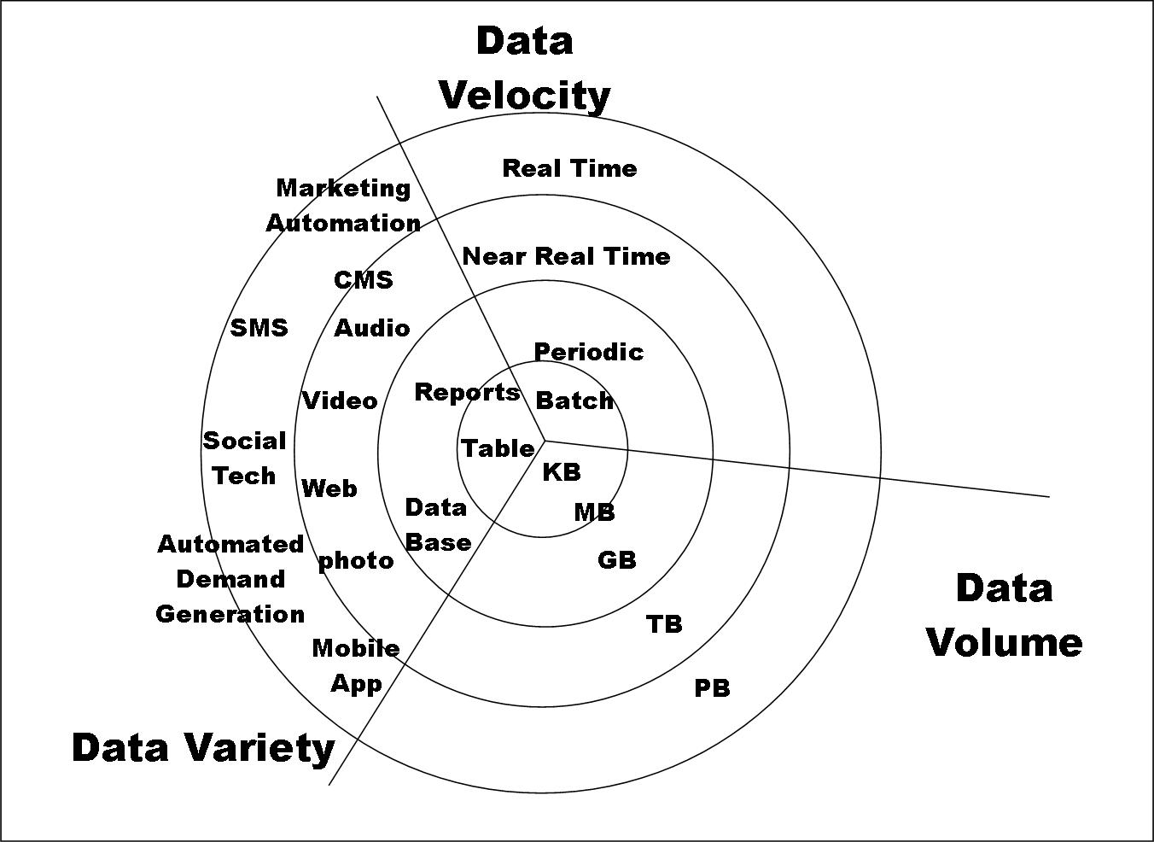
Big Data

Slide 7
Types of Data We Have
Relational Data (Tables/Transaction/Legacy Data)
Text Data (Web)
Semi-structured Data (XML)
Graph Data
Social Network, Semantic Web (RDF), …
Streaming Data
You can afford to scan the data once

Slide 8
What To Do With These Data?
Aggregation and Statistics
  Data warehousing and OLAP
Indexing, Searching, and Querying
  Keyword based search
  Pattern matching (XML/RDF)
Knowledge discovery
  Data Mining
  Statistical Modeling

Slide 9
Big Data and Data Science
“… the sexy job in the next 10 years will be statisticians,” Hal Varian, Google Chief Economist
The U.S. will need 140,000-190,000 predictive analysts and 1.5 million managers/analysts by 2018. McKinsey Global Institute’s June 2011
New Data Science institutes being created or repurposed – NYU, Columbia, Washington, UCB,...
New degree programs, courses, boot-camps:
  e.g., at Berkeley: Stats, I-School, CS, Astronomy…
  One proposal (elsewhere) for an MS in “Big Data Science”

Slide 10
What is Data Science?
An area that manages, manipulates, extracts, and interprets knowledge from tremendous amount of data
Data science (DS) is a multidisciplinary field of study with goal to address the challenges in big data
Data science principles apply to all data – big and small
https://hbr.org/2012/10/data-scientist-the-sexiest-job-of-the-21st-century/

Slide 11
What is Data Science?
Theories and techniques from many fields and disciplines are used to investigate and analyze a large amount of data to help decision makers in many industries such as science, engineering, economics, politics, finance, and education
  Computer Science
    Pattern recognition, visualization, data warehousing, High performance computing, Databases, AI
  Mathematics
    Mathematical Modeling
  Statistics
    Statistical and Stochastic modeling, Probability.

Slide 12
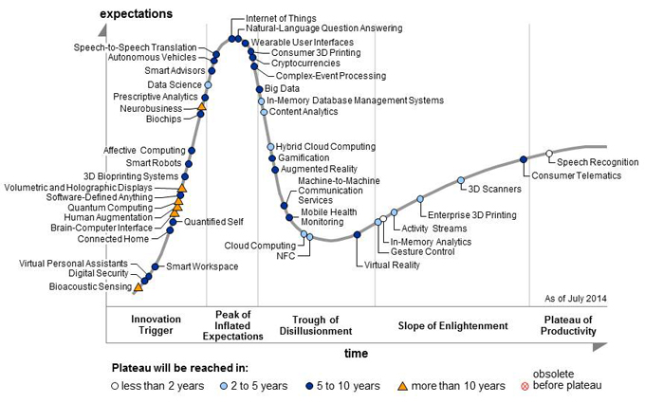
Why is it sexy?
Gartner’s 2014 Hype Cycle

