Slide 1
Effective Business Communication
The structure of effective Presentations and Reports.

Slide 2
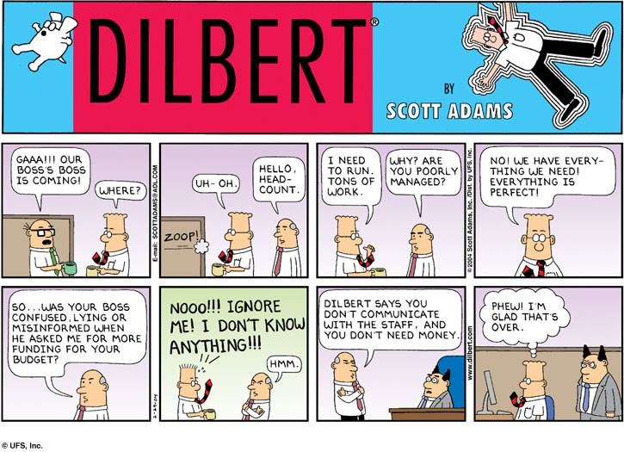

Slide 3
Communication Checklist
How do you construct an effective presentation or report?
Who is your audience?
What are they interested in?
What do you want them to remember?

Slide 4
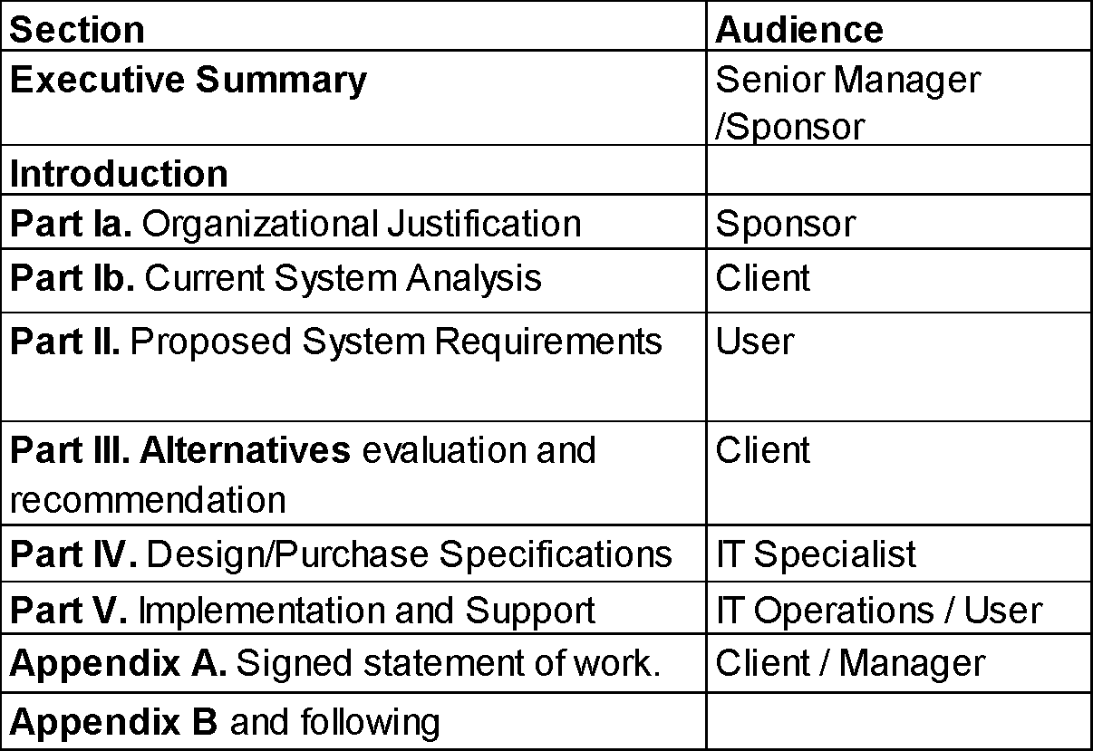
Example: Audience for Field Project Report Sections

Slide 5
Key points
Introduction and summary for each chapter.
Direct, simple sentences.
Short paragraphs.
White space, bullets and graphics.
Tables and figures stand on their own.
Text stands on its own.
There is nothing too obvious to say.

Slide 6
Components of an Effective Presentation
Purpose
Format
Data
Conclusion
So What
Restate
Tag Ending

Slide 7
PURPOSE:
Define task.
"The purpose of this presentation is ... “
Describe what the original problem was and what you were asked to do.

Slide 8
FORMAT:
What is the presentation going to do?
"This presentation recommends
o ...
o ... "
Tell them what you are going to say. This is the agenda. Effective presentations use this to outline the critical things that will be covered, not copy the grading sheets.

Slide 9
DATA:
Information and data about the problem.
"You should note the following facts in support of these recommendations...”
This is background. Spend only the time here that you absolutely need.

Slide 10
CONCLUSION:
What does the data tell you?
"The conclusions to be drawn from these facts are ..."
This is the setup, not the final conclusion.

Slide 11
SO WHAT:
What should the audience do?
"This means that we must ..."
What do these recommendations mean to the audience? This is the part of the presentation that your audience cares most about. Try to spend most of your time here.

Slide 12
RESTATE:
Summarize, preferably in action terms.
"In summary ...”
Wrap up the meeting.
Repeat your critical points.
List any action items.
Indicate what happens next.
Thank your clients.

Slide 13
TAG ENDING:
Verbal hook for your audience.
"In one sentence we say ..."
This is generally not done in formal written communication. It is very important in oral presentations.

Slide 14

Presentation Keys
Time the sections. Focus on “So What?”
Customize the presentation with logos or names for your audience.
Use graphics effectively. Graphics stick in people’s mind, but too much is clutter.
Use motion sparingly and sound never.
Rehearse. Try to use the same equipment and room you will use.

Slide 15
It’s not what you said but what they heard.

