Slide 1
ENTERPRENEURIAL DEVLOPEMENT

Slide 2
UNIT I
Entrepreneurship meaning
is the process of designing and running a new business venture for earning profits. It is a process that brings innovation that is new ideas, products, and services in the market. Entrepreneurship is the ability to create, manage and operate a new business and bears all of its risk with a view to earn profits.
Objectives
To make the students to understand the concept of Entrepreneurship and there work in life.
To enable the students to know the effectiveness of the Manpower in Entrepreneurship.
entrepreneurial opportunities
Developing a business plan
Hiring human resources
Acquiring financial and material resources
Providing leadership
Being responsible for both the venture's success or failure
Risk aversion

Slide 3
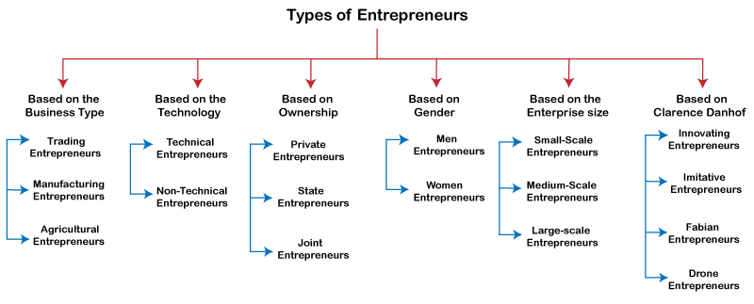

Slide 4
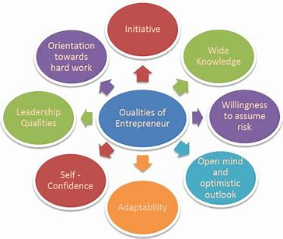
QUALITIES OF ENTREPRENEUR

Slide 5

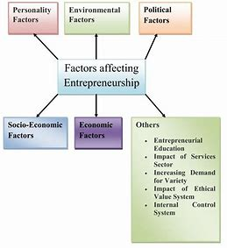
FACTOR INFLUENCING IN ENTREPRENEURSHIP

Slide 6
UNIT –II
ENTREPRENEURIAL DEVELOPMENT AGENCIES.
Commercial Banks - District Industries Centre - National Small Industries Corporation - Small Industries Development Organisation - Small Industries Service Institute. All India Financial Institutions. SIPCOT and its objectives. MSME Sector and its coverage- Objectives of Ministry of MSME. Role and Functions of MICRO Small and Medium Enterprises - Development Organisation (MSME - DO) - Objectives of SIDCO - Functions of Tamil Nadu SIDCO - IRBI and its Role. NABARD and its role in the Rural Development of India - Introduction to Micro Units Development Refinance Agency (MUDRA).
Commercial Bank
Is A Financial Institution Which Performs The Functions Of Accepting Deposits From The General Public And Giving Loans For Investment With The Aim Of Earning Profit Role Of Commercial Banks: Commercial Banks Play The Most Important Role In Entrepreneur Development Of The Nation.
THE NATIONAL SMALL INDUSTRIES CORPORATION (NSIC)
is a Public Sector Undertaking (PSU) that comes under the purview of the Ministry of Micro, Small & Medium Enterprises of India. It was set up by the Government of India in 1955 to foster, promote, and aid the growth of the micro, small, and medium enterprises (MSME) in India.
The National Small Industries Corporation Ltd (NSIC) was set up in 1955 as a central government undertaking, the main aim of which is to fulfill the requirement of machinery and equipment for the development of the small entrepreneurs. NSIC enhances the competitiveness of the MSMEs by facilitating specially customised schemes while also offering integrated support services in technology, marketing, support, and finance.

Slide 7
District Industries Centre
District Industries Centre Identifies The Entrepreneurs And Renders All Assistances By Co-ordinate Efforts With Line Departments To Commission The Small-scale Industrial Units Chosen By Them. The Motivation Conducted Yields The Result Of Desire By Changing The Students’ Population As Entrepreneurs. There Are Many Agencies Providing Avenue For Development Of Entrepreneurship Including Government.
For Example, The District Industries Centre, Thoothukudi Conducts Motivation Campaigns In All The Blocks With The Assistance Of Panchayat Presidents And Also For The Final Year Students Of Colleges Of Engineering And Arts, Polytechnics And Also Industrial Training Institutes.
All India Financial Institutions (Aifi)
India Financial Institutions (AIFI) Is A Group Composed Of Financial Regulatory Bodies And Development Finance Institutions That Play A Pivotal Role In The Financial Markets.
Also Known As "Financial Instruments", The Financial Institutions Assist In The Proper Allocation Of Resources, Sourcing From Businesses That Have A Surplus And Distributing To Others Who Have Deficits - This Also Assists With Ensuring The Continued Circulation Of Money In The Economy.
Possibly Of Greatest Significance, The Financial Institutions Act As An Intermediary Between Borrowers And Final Lenders, Providing Safety And Liquidity.

Slide 8
SMALL INDUSTRIES DEVELOMPENT CORPORATION, (SIDCO)TAMILNADU:
Tamilnadu, India, Small Industries Development Corporation (SIDCO) was set up in 1971. The prime function of SIDCO was to identify potential growth centres in various parts of Tamilnadu. There is a network of 76 industrial estates in the State which are maintained by SIDCO. 32 of these were formed by the government initially and subsequently handed over to SIDCO. The remaining 44 estates were set up by SIDCO itself. Source (SIDCO – TAMILNADU SMALL INDUSTRIES DEVELOPMENT CORPORATION LIMITED) It has set up these estates in rural and most backward areas to ensure balanced industrial development
INDUSTRIAL RECONSTRUCTION BANK OF INDIA (IRBI)
The Industrial Reconstruction Corporation of India Ltd., set up in 1971 for rehabilitation of sick industrial companies, was reconstituted as Industrial Reconstruction Bank of India in 1985 under the IRBI Act, 1984.
The Government of India set up the Industrial Reconstruction Corporation of India (IRCI) in April 1971, under the Indian Companies Act mainly to look after special problems of sick units’ and provide assistance for their speedy reconstruction and rehabilitation, if necessary, by undertaking the management of the units and developing infrastructure facilities like those of transport, marketing etc.

Slide 9
UNIT IV
ENTREPRENEURSHIP DEVELOPMENT PROGRAMME (EDP)
Entrepreneurship Development Programme (EDP) is a programme that aims to improve entrepreneurial skills. Through such a programme, the skills needed to properly run a company are learned among individuals. Often, people can have knowledge, but polishing and incubation is necessary that are provided by the EDP
In economics, entrepreneurship connected with land, labour, natural resources and capital can generate a profit. The entrepreneurial vision is defined by discovery and risk-taking and is an indispensable part of a nation’s capacity to succeed in an ever-changing and more competitive global marketplace.
OBJECTIVES OF EDP:
The major objectives of the Entrepreneurship Development Programmes (EDPs) are to:
a. Develop and strengthen the entrepreneurial quality, i.e. motivation or need for achievement.
b. Analyse environmental set up relating to small industry and small business.
c. Select the product.
d. Formulate proposal for the product.
e. Understand the process and procedure involved in setting up a small enterprise.
f. Know the sources of help and support available for starting a small scale industry.
g. Acquire the necessary managerial skills required to run a small-scale industry.
h. Know the pros and cons in becoming an entrepreneur.

Slide 10
EDP – Relevance of EDP
“No EDP, no economic development.” Entrepreneurial development plan can be framed and implemented without its relevance to the political, economic, social and legal environment.
Following are the relevance of entre­preneurial development programme:
1. They should be meeting the main object of development such as generating employment, set up ancillary, small and medium sized industry, and introduction of new entrepreneur and maintain stability etc.
2. There should be proper arrangement of training and education such as setting of technical and electrical institute, handicraft making institute.
3. There should be promotion to entrepreneurial skill such as technical and managerial skill. The main aim is to import management and technical know-how required by the participants to operate their business entrepreneur.
CRITERIA FOR EVALUATING EDP S:
1.Activity level of the respondents
2.New enterprise creation
3.Empolyment generation in quantifiable terms
4.Creation of job opportunities both direct and indirectly
5.Increase in sales and profit
6.Enterprise expansion
7.Enterprise transformation
8.Improvement in quality of products or service

Slide 11
UNIT V
ENTREPRENEUR IN ECONOMIC GROWTH
Everything you need to know about the role of entrepreneurs in economic development. Economic development essentially means a process of upward change whereby the real per capita income of a country increases over a period of time.
Entrepreneur plays a vital role in economic development. Entrepreneurs serve as the catalysts in the process of industrialization and economic growth.
Technical progress alone cannot lead to economic development, unless technological breakthroughs are put to economic use by entrepreneurs.
SOME OF THE ROLES OF ENTREPRENEURS ARE:-
Capital Formation
Improvement in Per Capita Income
Generation of Employment
Balanced Regional Development
Improvement in Living Standards
Economic Independence
Backward and Forward Linkages
Inspire Others towards Entrepreneurship
Create Knowledge Spillovers
Augment the Number of Enterprises

Slide 12
SELF-HELP GROUPS AND EMPOWERMENT OF WOMEN IN INDIA
Self Help Group Scheme In India, Self Help Group Scheme was initiated by NABARD main rural development body emphasizing self employment generation for the women living in rural and semi – rural areas. Self-help groups (SHGs) movement has triggered off revolution in the rural credit delivery system in India by proving an effective medium for delivering credit to rural poor for their socio-economic empowerment. A self-help group (SHG) is a village-based financial intermediary committee usually composed of 10-20 local women or men. Self-help groups are started by non-governmental organizations (NGOs) that generally have broad anti-poverty agendas. In India two broad approaches prevail in case of micro financing viz. self help group –bank linkage and micro finance institutions. NABARD has been supporting the SHG-Bank
About Pradhan Mantri Jan Dhan Yojana
The scheme was launched in August 2014, and according to the Ministry of Finance, over 4 crore banks accounts have been opened till September 2014. Under the PMJDY scheme, some of the financial services that are offered to individuals are pension, insurance, and banking.
Under PMJDY zero balance account can be opened by individuals. However, in case individuals would like to have access to the cheque facility, maintenance of a minimum balance is mandatory. No charges will be levied on the individual to open an account under the PMJDY scheme.
The Indian Government launched the Pradhan Mantri Jan Dhan Yojana (PMJDY) in order to provide financial services and products to individuals who do not have access to a bank account.
No minimum balance to be maintained
As per bank’s saving’s account interest rate
Transfer of money is simple
Overdraft facility available

