Slide 1
FUNCTIONS

Slide 2
Functions
Block of code which only runs when it is called
Pass data, known as parameters, into a function
Used to perform certain actions
Important for reusing code: Define the code once, and use it many times.

Slide 3
Pre-defined functions, such as main(), which is used to execute code
You can also create your own functions to perform certain actions
Syntax
void myFunction() {
// code to be executed
}
myFunction() is the name of the function
void means that the function does not have a return value.
inside the function (the body), add code that defines what the function should do

Slide 4
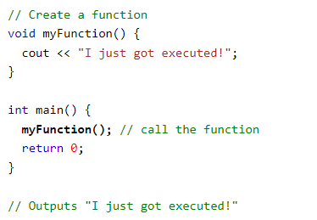
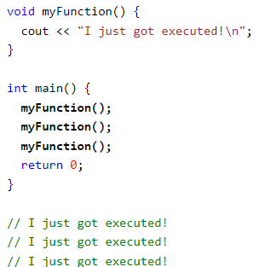
Call a Function
To call a function, write the function's name followed by two parentheses () and a semicolon ;

Slide 5
C++ Function Parameters
Parameters and Arguments
Information can be passed to functions as a parameter.
Parameters act as variables inside the function
Syntax
void functionName(parameter1
, parameter2, parameter3) {
// code to be executed
}
Example
void myFunction(string fname) {
cout << fname << " Refsnes\n";
}
int main() {
myFunction("Liam");
myFunction("Jenny");
myFunction("Anja");
return 0;
}
// Liam Refsnes
// Jenny Refsnes
// Anja Refsnes

Slide 6
Default Parameter Value
Example
void myFunction(string country = "Norway") {
cout << country << "\n";
}
int main() {
myFunction("Sweden");
myFunction("India");
myFunction();
myFunction("USA");
return 0;
}
// Sweden
// India
// Norway
// USA

Slide 7
Multiple Parameters
void myFunction(string fname, int age) {
cout << fname << " Refsnes. " << age << " years old. \n";
}
int main() {
myFunction("Liam", 3);
myFunction("Jenny", 14);
myFunction("Anja", 30);
return 0;
}
// Liam Refsnes. 3 years old.
// Jenny Refsnes. 14 years old.
// Anja Refsnes. 30 years old.

Slide 8
C++ Function Overloading
Multiple functions can have the same name with different parameters:
Example
int plusFuncInt(int x, int y) {
return x + y;
}
double plusFuncDouble(double x, double y) {
return x + y;
}
int main() {
int myNum1 = plusFuncInt(8, 5);
double myNum2 = plusFuncDouble(4.3, 6.26);
cout << "Int: " << myNum1 << "\n";
cout << "Double: " << myNum2;
return 0;
}
Example
int myFunction(int x)
float myFunction(float x)
double myFunction(double x, double y)

Slide 9
Recursion
Recursion is the technique of making a function call itself.
Break complicated problems down into simple problems
Example
int sum(int k) {
if (k > 0) {
return k + sum(k - 1);
} else {
return 0;
}
}
int main() {
int result = sum(10);
cout << result;
return 0;
}

