Slide 1
Nazareth College of Arts and Science
DEPARTMENT OF COMMERCE FINANCIAL ACCOUNTING TOPIC: FINAL ACCOUNTS
BY
P. PUNITHA VINODHINI LAKSHMI ASSISTANT PROFESSOR

Slide 2
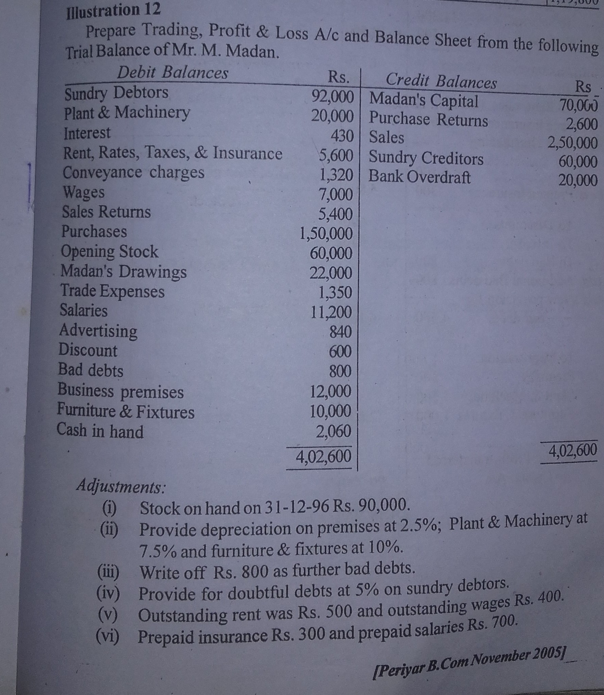

Slide 3
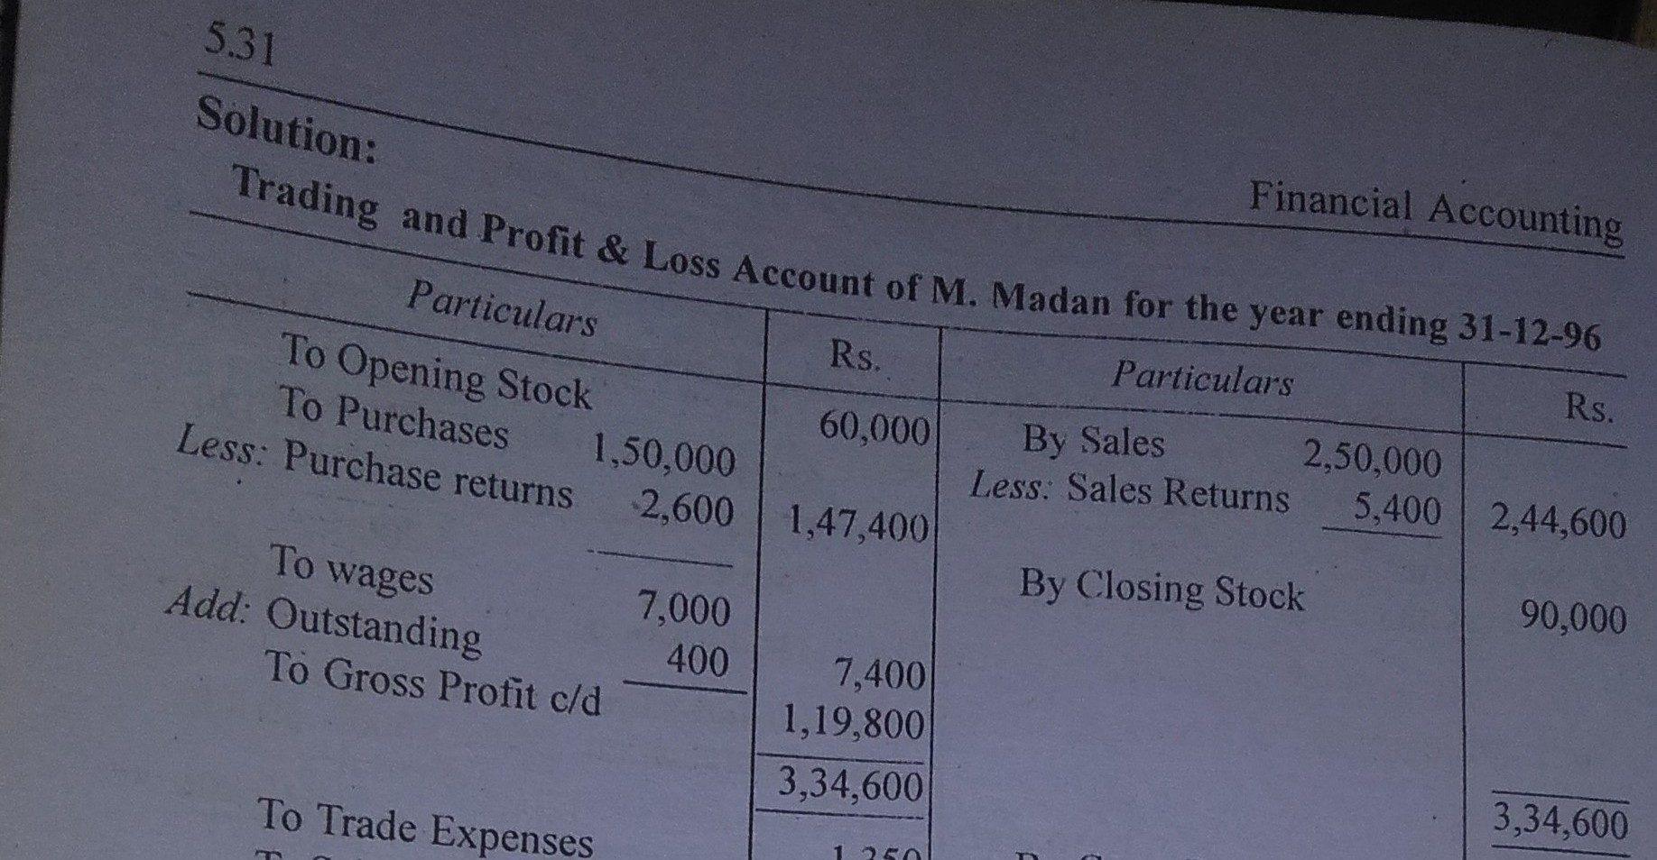

Slide 4
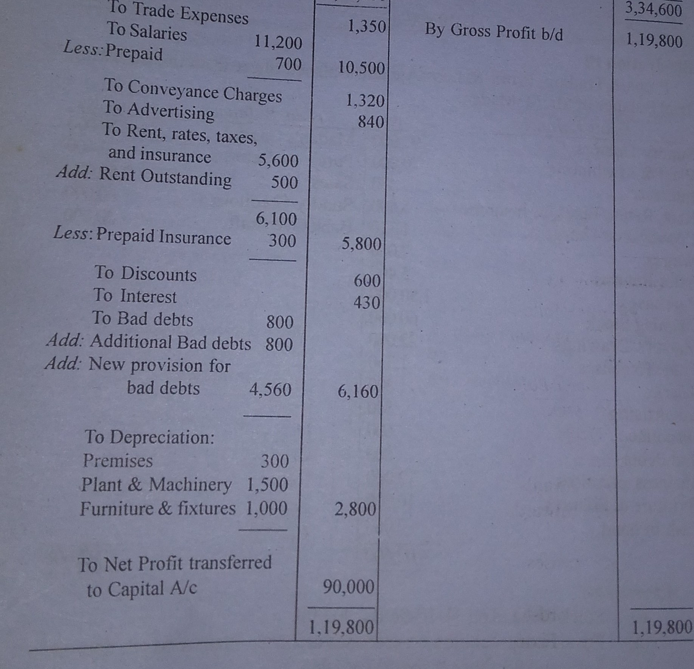

Slide 5
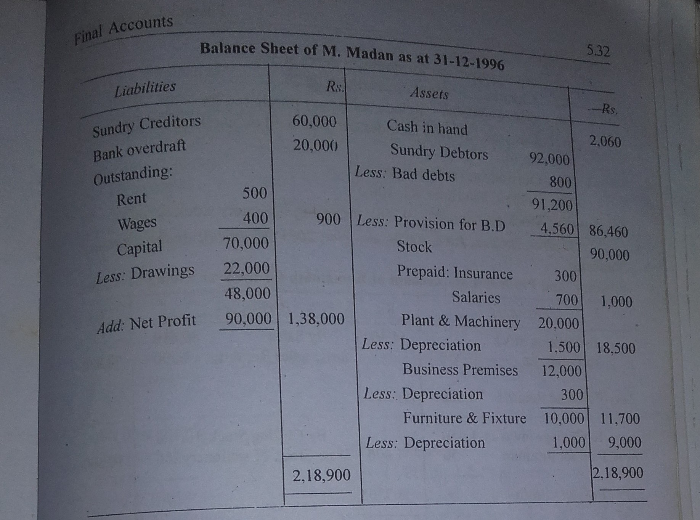

Slide 6
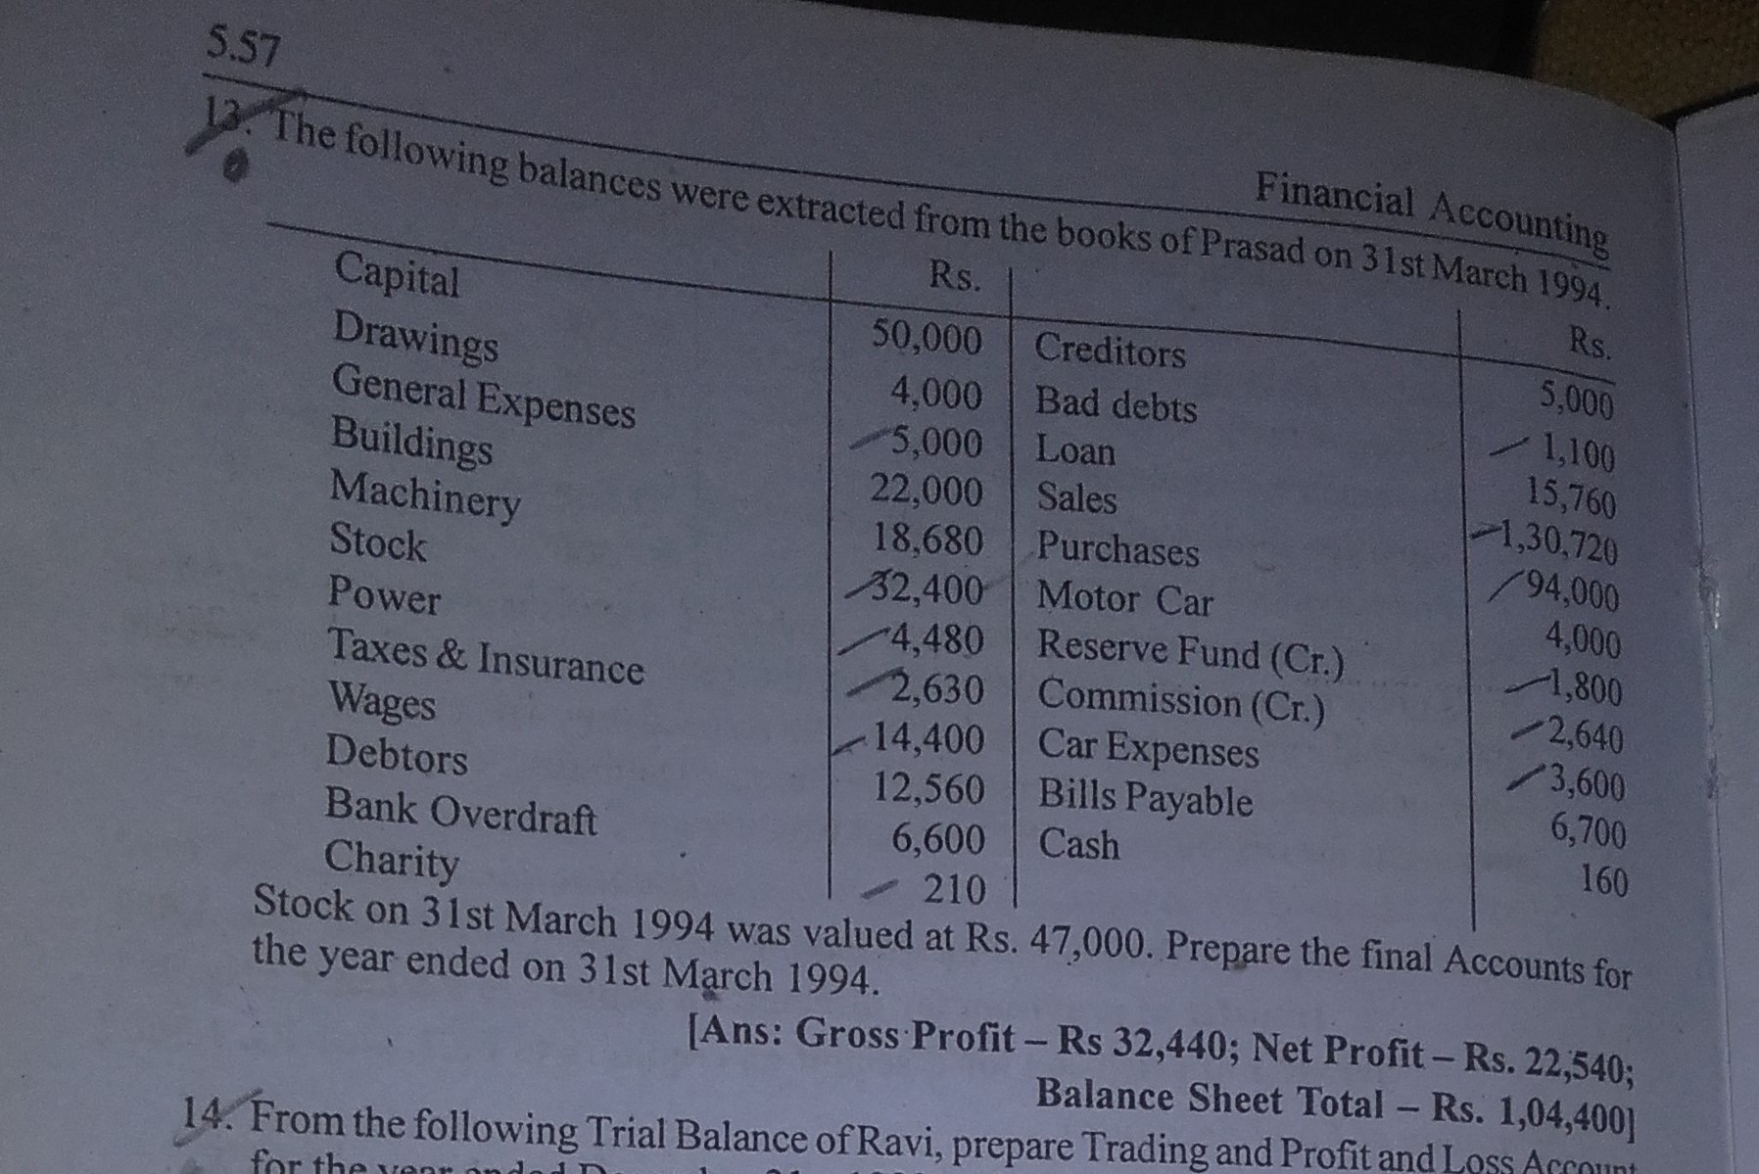
Home work sums

Slide 7
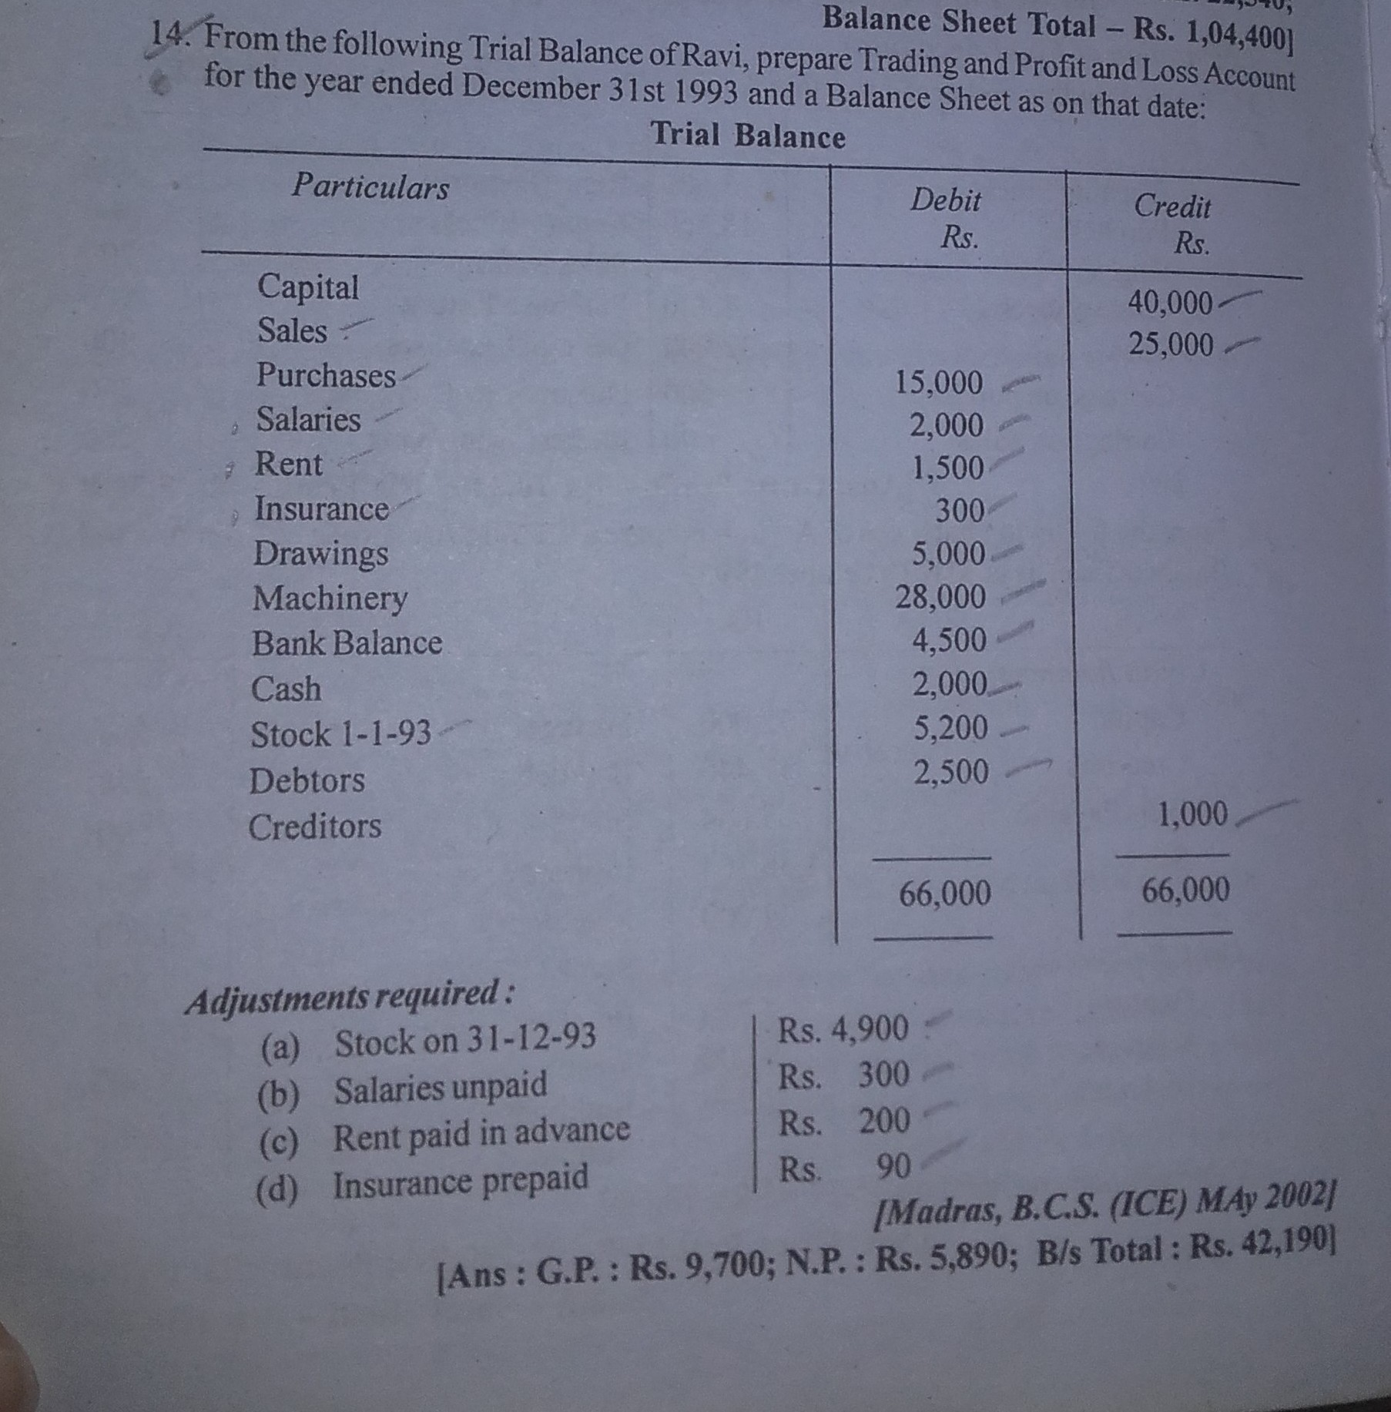
Home work sums

Slide 8
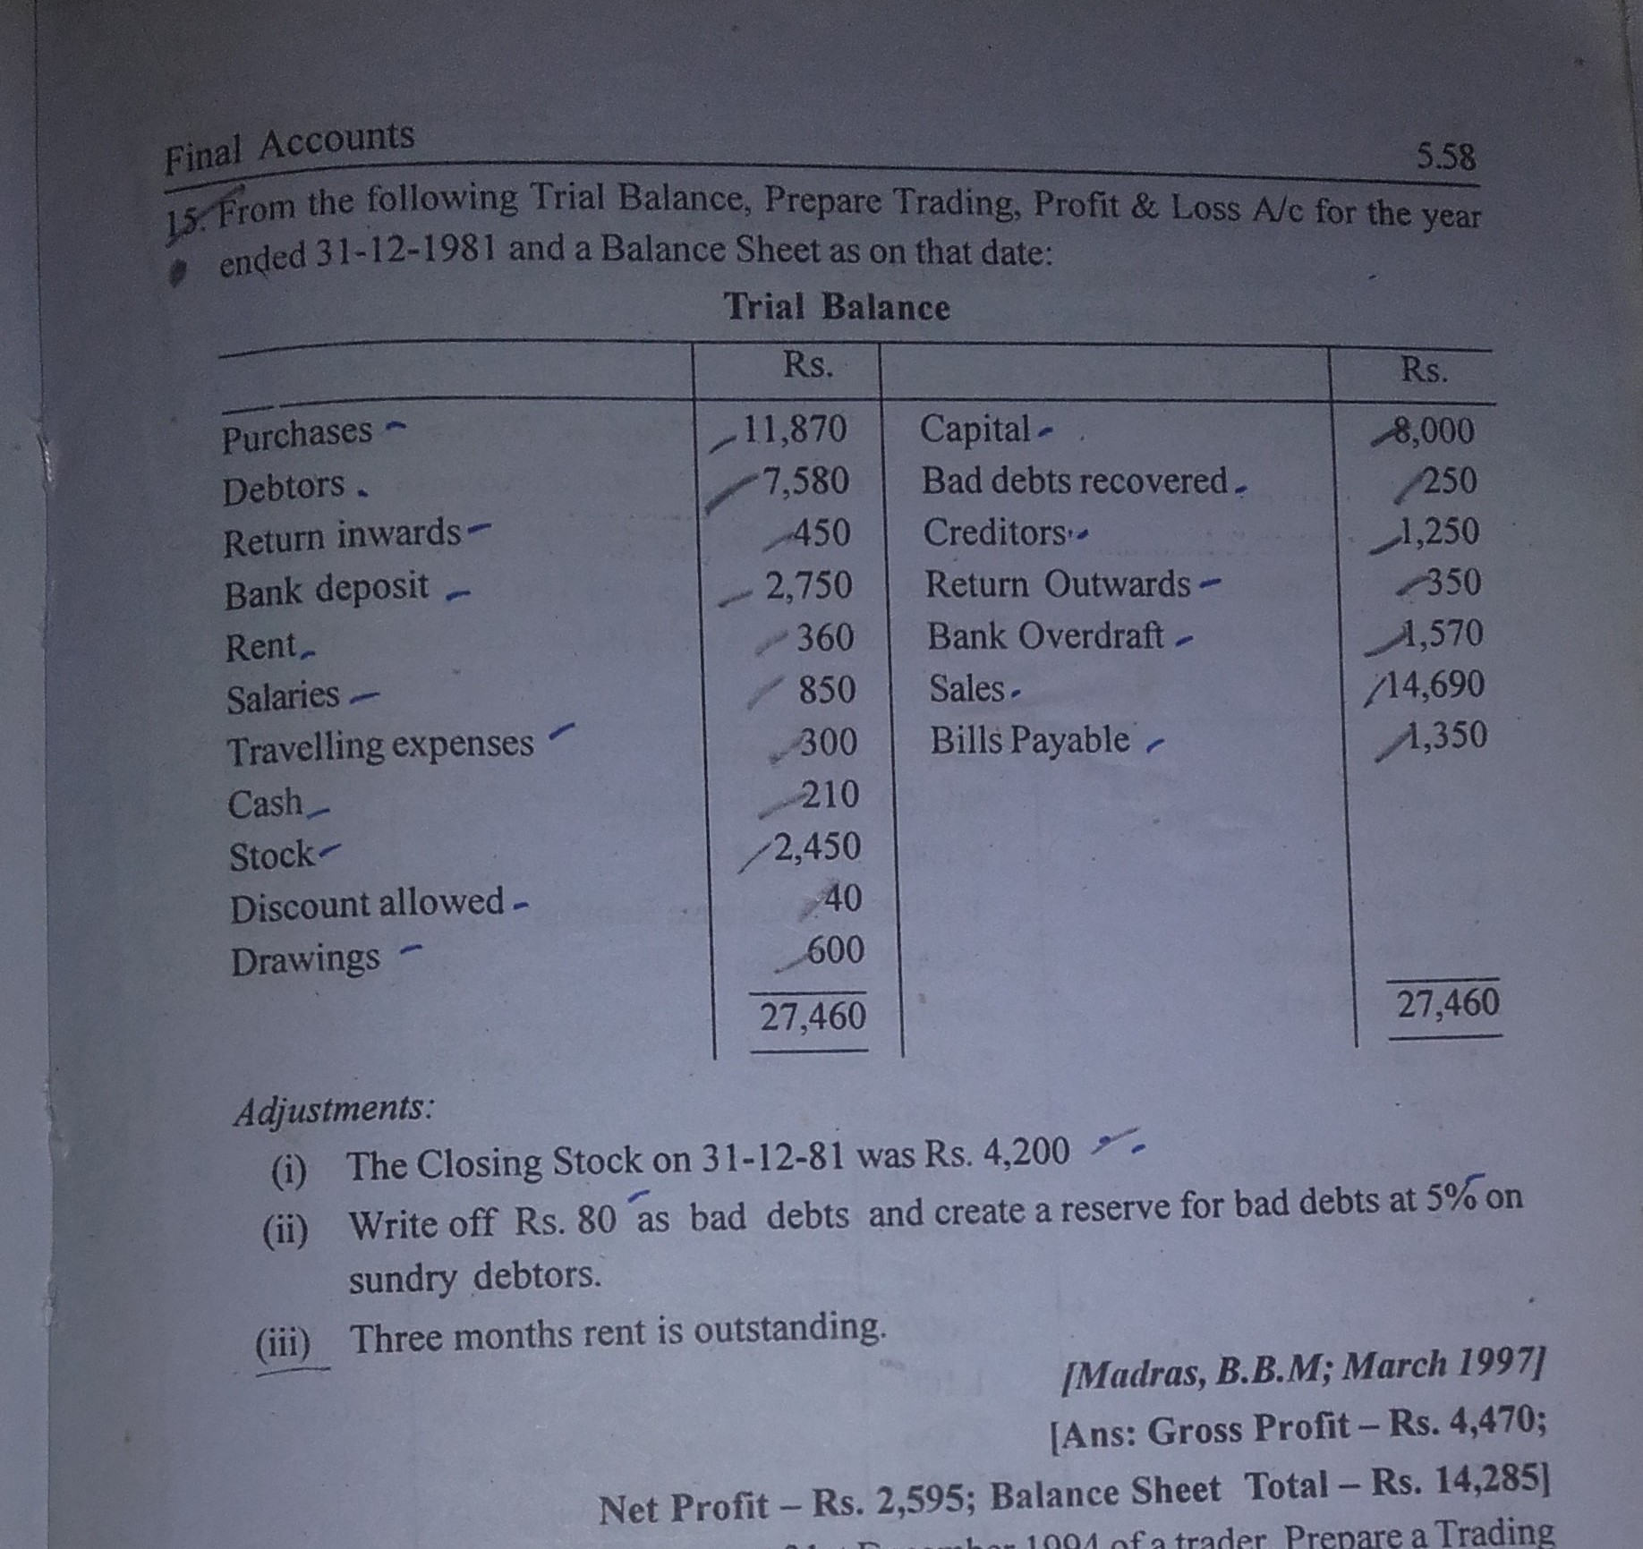
Home work sums

Slide 9
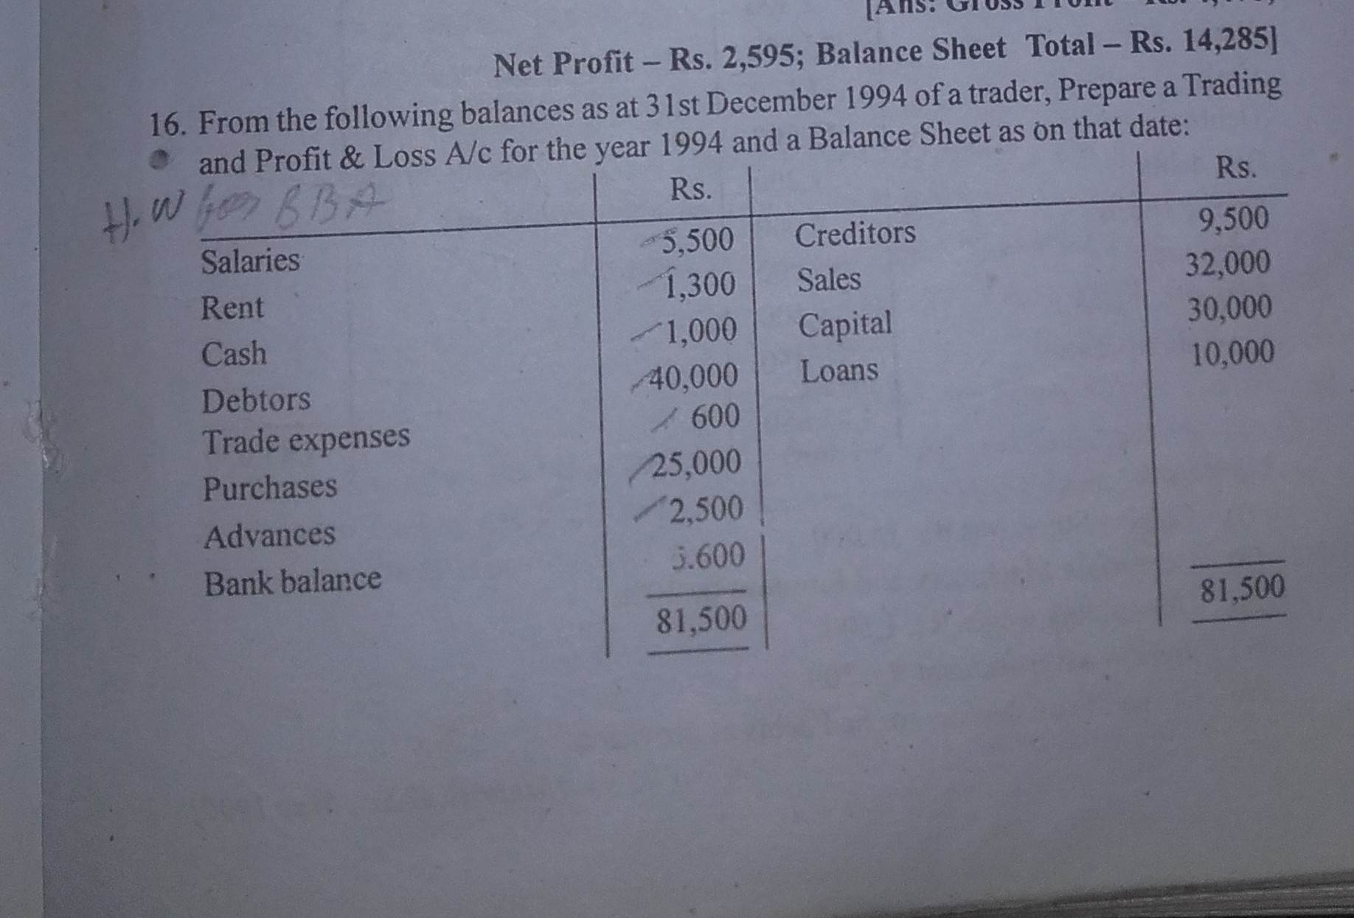
Home work sums

Slide 10
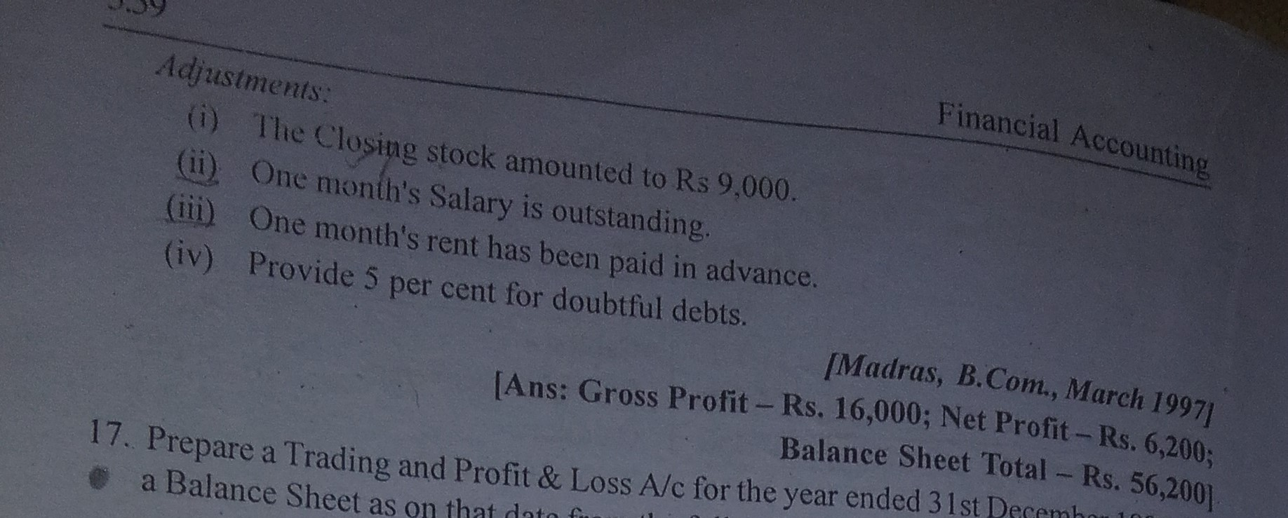
Cont. of sum number 16

Slide 11
Thank you

