Slide 1

GROUP DISCUSSION
- EBENEZER P

Slide 2

A group discussion is a discussion between a group of participants on a given subject.

Slide 3
TOPICS
                INNOVATION
                CREATIVITY
                LATREL THINKING

Slide 4

INNOVATION:
Innovation can be described as a value addition to a product line, device and personality of the person..
Innovation is a complex process.

Slide 5

SIGNIFICANCE OF INNOVATION:
Innovation is a major contributor to the growth of a company.
Innovation attracts the best talent.
Innovation requires a variety of skills.
Innovation gives technical advantage.

Slide 6

creativity
Creativity, from the point of view of personal development, gives rise to people who can think for themselves. People who can create, rather than just produce or reproduce.

Slide 7

Characteristics of creativity
                Human capacity
                Creative thinking
                Combination of new ideas
                Creation of new methods
                New result orientation
                Inner motivation
                Brain activity

Slide 8
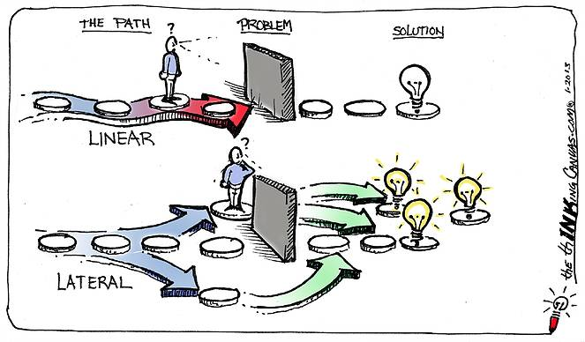
LATERAL THINKING
Lateral thinking often helps in resolving deadlocks. When the views of a group get sharply polarized, a person who offers an out-of-the-box perspective may help the group reach a common ground.

Slide 9

Lateral thinking techniques
                Alternative
                Focus
                Challenge
                Provocation and movement
                Harvesting
                Treatment of ideas

Slide 10
THANK YOU

