Slide 1
NAZARETH COLLEGE OF ARTS AND SCIENCE Affiliated To University Of Madras
Re-accredited by NAAC with ‘B’ grade
Graphics and Visualization
UNIT III
D Transformations
CLASS :III B.Sc. CS
SEMESTER: ODD(2022-2023)
STAFF NAME: Mrs. S. ABIRAMI
DEPARTMENT: COMPUTER SCIENCE

Slide 2
Agenda
Topics:
2D TRANSLATION
2D ROTATION
2D SCALING
2
Notes:
2

Slide 3
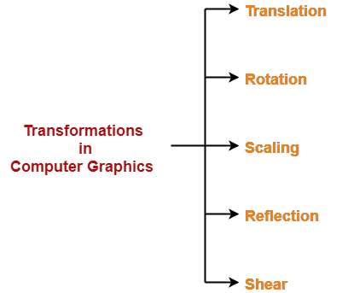
2D TRANSFORMATIONS
Transformation is a process of modifying and re-positioning the existing graphics.
2D Transformations take place in a two dimensional plane.
3
CompSci 230: WF

Slide 4
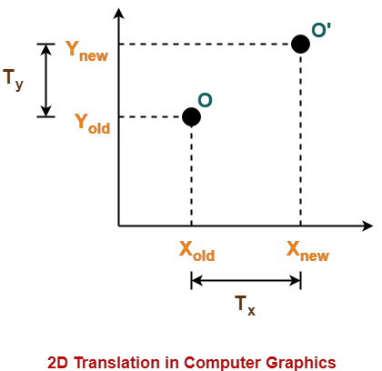
2D TRANSLATION
4

Slide 5
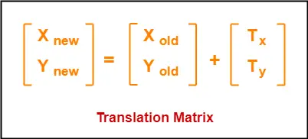
2D TRANSLATION
X_{new} = X_{old} + T_{x}(This denotes translation towards X axis)
Y_{new} = Y_{old} + T_{y}
5

Slide 6
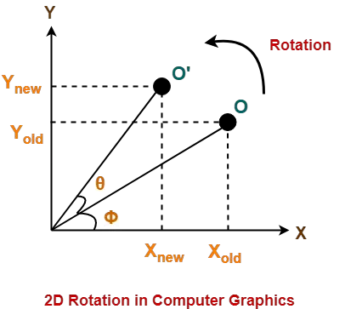
2D ROTATION
6

Slide 7
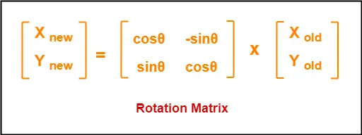
2D ROTATION
X_{new} = X_{old} x cosθ – Y_{old} x sinθ
Y_{new} = X_{old} x sinθ + Y_{old} x cosθ
7

Slide 8
2D SCALING
It is a process of modifying or altering the size of objects.
Scaling may be used to increase or reduce the size of object.
Scaling factor determines whether the object size is to be increased or reduced.
If scaling factor > 1, then the object size is increased.
If scaling factor < 1, then the object size is reduced.
8

Slide 9
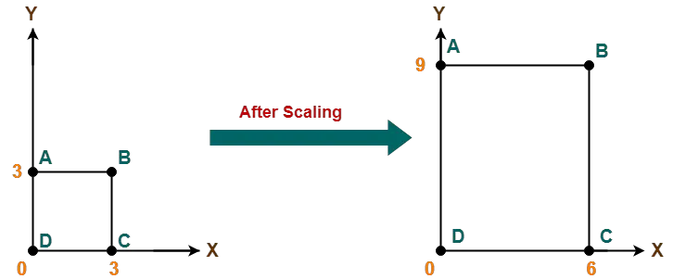
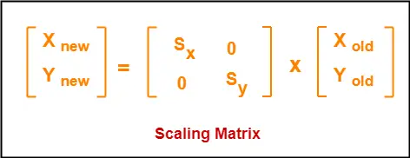
2D SCALING
X_{new} = X_{old} x S_{x}
Y_{new} = Y_{old} x S_{y}
9

Slide 10
Thank you

