Slide 1

HTML Basics

Slide 2



How the Web Works?
WWW use classical client / server architecture
HTTP is text-based request-response protocol
HTTP
Page request
HTTP
Server response
Server running Web Server Software (IIS, Apache, etc.)
Client running a Web Browser

Slide 3
What is a Web Page?
Web pages are text files containing HTML
HTML – Hyper Text Markup Language
A notation for describing
document structure (semantic markup)
formatting (presentation markup)
Looks (looked?) like:
A Microsoft Word document
The markup tags provide information about the page content structure

Slide 4
Creating HTML Pages
An HTML file must have an .htm or .html file extension
HTML files can be created with text editors:
NotePad, NotePad ++, PSPad
Or HTML editors (WYSIWYG Editors):
Microsoft FrontPage
Macromedia Dreamweaver
Netscape Composer
Microsoft Word

Slide 5
HTML Basics
Text, Images, Tables, Forms

Slide 6
HTML Structure
HTML is comprised of “elements” and “tags”
Begins with <html> and ends with </html>
When writing XHTML, must define a namespace
Elements (tags) are nested one inside another:
Tags have attributes:
HTML describes structure using two main sections: <head> and <body>

Slide 7
HTML Code Formatting
The HTML source code should be formatted to increase readability and facilitate debugging.
Every block element should start on a new line.
Every nested (block) element should be indented.
Browsers ignore multiple whitespaces in the page source, so formatting is harmless.
For performance reasons, formatting can be sacrificed.

Slide 8
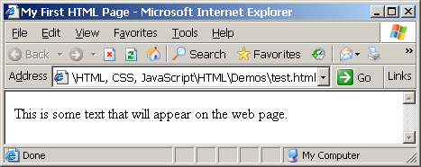
First HTML Page
<!DOCTYPE HTML>
<html>
<head>
<title>My First HTML Page</title>
</head>
<body>
<p>This is some text...</p>
</body>
</html>

Slide 9
First HTML Page: Tags
<!DOCTYPE HTML>
<html>
<head>
<title>My First HTML Page</title>
</head>
<body>
<p>This is some text...</p>
</body>
</html>

Slide 10
First HTML Page: Body
<!DOCTYPE HTML>
<html>
<head>
<title>My First HTML Page</title>
</head>
<body>
<p>This is some text...</p>
</body>
</html>
HTML body

Slide 11
Some Simple Tags
Hyperlink Tags
Image Tags
Text formatting tags
<a href="http://www.telerik.com/"
title="Telerik">Link to Telerik Web site</a>
<img src="logo.gif" alt="logo" />
This text is <em>emphasized.</em>
<br />new line<br />
This one is <strong>more emphasized.</strong>

Slide 12
Some Simple Tags – Example
<!DOCTYPE HTML>
<html>
<head>
<title>Simple Tags Demo</title>
</head>
<body>
<a href="http://www.telerik.com/" title=
"Telerik site">This is a link.</a>
<br />
<img src="logo.gif" alt="logo" />
<br />
<strong>Bold</strong> and <em>italic</em> text.
</body>
</html>

Slide 13
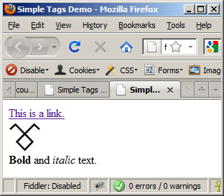
Some Simple Tags – Example (2)
<!DOCTYPE HTML>
<html>
<head>
<title>Simple Tags Demo</title>
</head>
<body>
<a href="http://www.telerik.com/" title=
"Telerik site">This is a link.</a>
<br />
<img src="logo.gif" alt="logo" />
<br />
<strong>Bold</strong> and <em>italic</em> text.
</body>
</html>

Slide 14
Some HTML Tags
Live Demo

Slide 15
Tags Attributes
Tags can have attributes
Attributes specify properties and behavior
Example:
Few attributes can apply to every element:
id, style, class, title
The id is unique in the document
Content of title attribute is displayed as hint when the element is hovered with the mouse
Some elements have obligatory attributes
Attribute alt with value "logo"
<img src="logo.gif" alt="logo" />

Slide 16
Headings and Paragraphs
Heading Tags (h1 – h6)
Paragraph Tags
Sections: div and span
<h1>Heading 1</h1>
<h2>Sub heading 2</h2>
<h3>Sub heading 3</h3>
<p>This is my first paragraph</p>
<p>This is my second paragraph</p>
<div style="background: skyblue;">
This is a div</div>

Slide 17
Headings and Paragraphs – Example
<!DOCTYPE HTML>
<html>
<head><title>Headings and paragraphs</title></head>
<body>
<h1>Heading 1</h1>
<h2>Sub heading 2</h2>
<h3>Sub heading 3</h3>
<p>This is my first paragraph</p>
<p>This is my second paragraph</p>
<div style="background:skyblue">
This is a div</div>
</body>
</html>

Slide 18
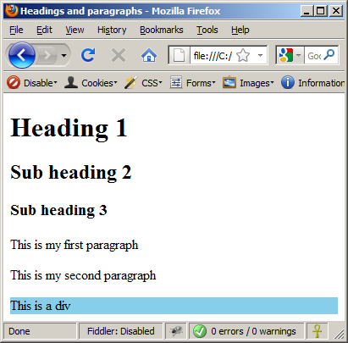
Headings and Paragraphs – Example (2)
headings.html
<!DOCTYPE HTML>
<html>
<head><title>Headings and paragraphs</title></head>
<body>
<h1>Heading 1</h1>
<h2>Sub heading 2</h2>
<h3>Sub heading 3</h3>
<p>This is my first paragraph</p>
<p>This is my second paragraph</p>
<div style="background:skyblue">
This is a div</div>
</body>
</html>

Slide 19
The <head> Section
Contains information that doesn’t show directly on the viewable page
Starts after the <!doctype> declaration
Begins with <head> and ends with </head>
Contains mandatory single <title> tag
Can contain some other tags, e.g.
<meta>
<script>
<style>
<!–- comments -->

Slide 20
<head> Section: <meta>
Meta tags additionally describe the content contained within the page
<meta name="description" content="HTML tutorial" />
<meta name="keywords" content="html, web design, styles" />
<meta name="author" content="Chris Brewer" />
<meta http-equiv="refresh" content="5; url=http://www.telerik.com" />

Slide 21

<head> Section: <title> tag
Title should be placed between <head> and </head> tags
Used to specify a title in the window titlebar
Search engines and people rely on titles
<title>Telerik Academy – Winter Season 2009/2010 </title>

Slide 22
<head> Section: <meta>
Meta tags additionally describe the content contained within the page
<meta name="description" content="HTML tutorial" />
<meta name="keywords" content="html, web design, styles" />
<meta name="author" content="Chris Brewer" />
<meta http-equiv="refresh" content="5; url=http://www.telerik.com" />

Slide 23
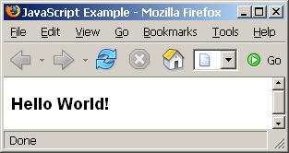
The <script> Tag – Example
<!DOCTYPE HTML>
<html>
<head>
<title>JavaScript Example</title>
<script type="text/javascript">
function sayHello() {
document.write("<p>Hello World!<\/p>");
}
</script>
</head>
<body>
<script type=
"text/javascript">
sayHello();
</script>
</body>
</html>

