Slide 1
HTML Forms

Slide 2
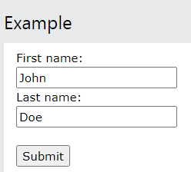
HTML FORM
An HTML form is used to collect user input.
The <form> element is a container for different types of input elements, such as: text fields, checkboxes, radio buttons, submit buttons, etc.
<form> . form elements . </form>

Slide 3
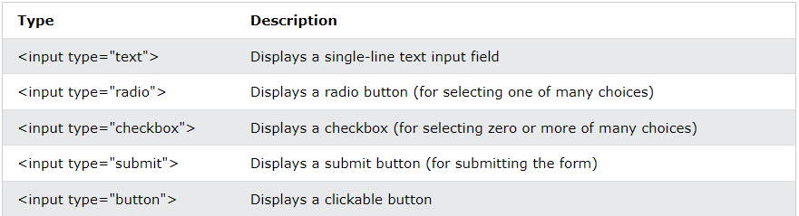
The <input> Element
Displayed in many ways, depending on the type attribute.

Slide 4
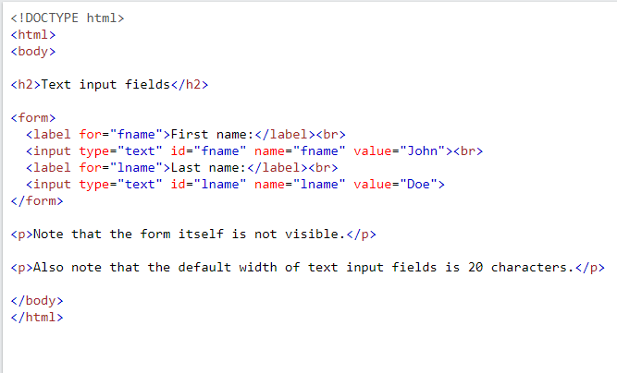
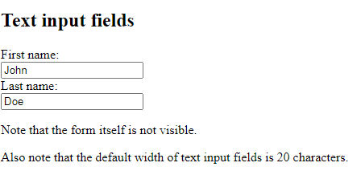
Text Fields
The <input type="text"> defines a single-line input field for text input.

Slide 5
The <label> Element
The <label> tag defines a label for many form elements.
when the user clicks the text within the <label> element, it toggles the radio button/checkbox.
The for attribute of the <label> tag should be equal to the id attribute of the <input> element to bind them together.

Slide 6
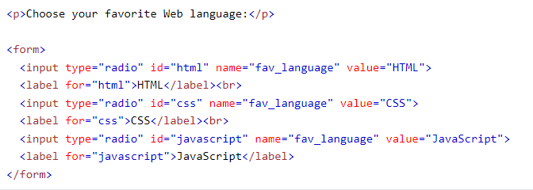
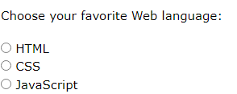
Radio Buttons
Let a user select ONE of a limited number of choices

Slide 7
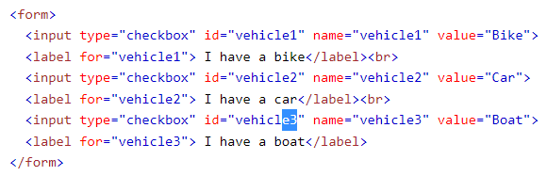
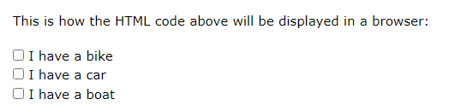
Checkboxes
Let a user select ZERO or MORE options of a limited number of choices.

Slide 8
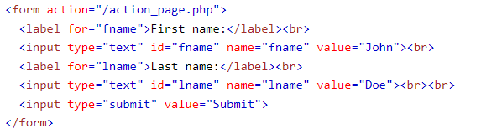
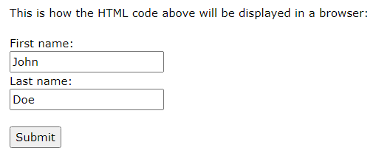
The Submit Button
Defines a button for submitting the form data to a form-handler.

Slide 9
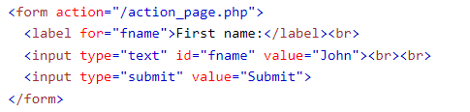
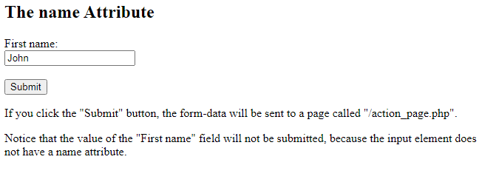
The Name Attribute for <input>
Each input field must have a name attribute to be submitted
If the name attribute is omitted, the value of the input field will not be sent at all

