Slide 1
EFFECTS ON GST ON ECONOMIC GROWTH
The GST bill will unify at least 10 types of indirect taxes into one. It helps to fix final tax rates in to 4 categories 5,12,18 and 28 percent.

Slide 2
The following are the effects
Financial super power= Gives growth to economic development
Vital Role of GST= Bringing all tax under single umbrella
Destination Principle= Destination Principle' states that the supply of goods and services would be taxed at the point of consumption
Common market=the Narendra Modi government has finally introduced a uniform Goods and Services Tax (GST) regime that converts the country into a single market.
Efficient allocation of factors of production=efficiency in allocation of resources among production sectors, growth of income and ... opportunities and create more equal distribution of income.

Slide 3
Gains to GDP= With the help of GST, GDP is increased from 0.9 to 1.7 %
Economic of Scale= Output of manufacturing sectors will increase
Fall in tax incidence= It will help producers to sell their products at a lower price.
Rational tax system=Introduction of Goods and Services Tax (GST) will be a crucial step towards tax reforms in India. Abolishing several central and state taxes and replacing them by one single tax will mitigate the recurring problem of double taxation and for the first time, create a common national market.
GST= It will play important role in economic development

Slide 4
Scope of GST
GST is to cover all goods and service except alcoholic liquor for human consumption.
Petroleum and petroleum products will not come under Gst

Slide 5
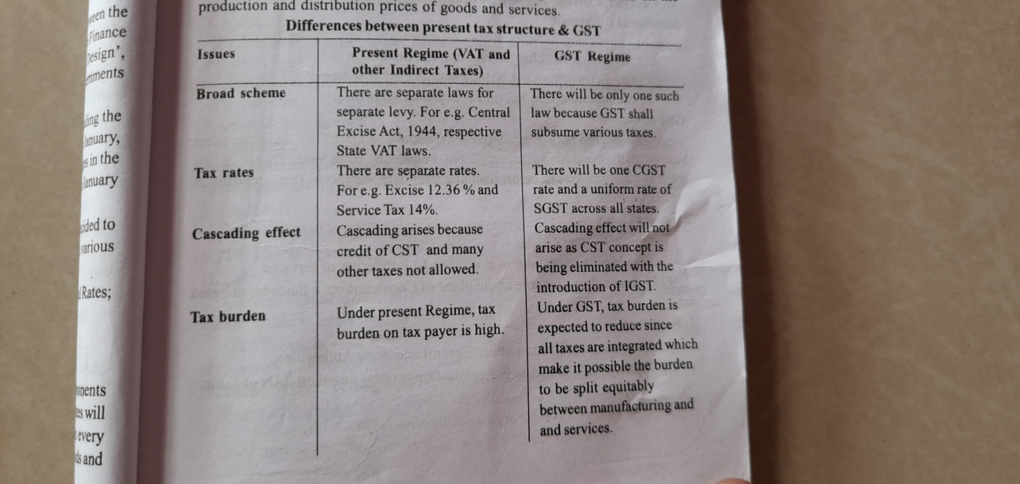
Differences between present tax structure and GST

Slide 6
