Slide 1
NAZARETH COLLEGE OF ARTS AND SCIENCE
Affiliated to University of Madras Re-accredited by NAAC with B Grade
DEPARTMENT OF MATHEMATICS

Slide 2
Academic Year: 2021 – 2022
Semester: ODD Subject Name: Analytical Geometry
Class: II B.SC Maths Topic Name: Introduction, Sphere Name of the Faculty: D.Femila Jayaseeli

Slide 3
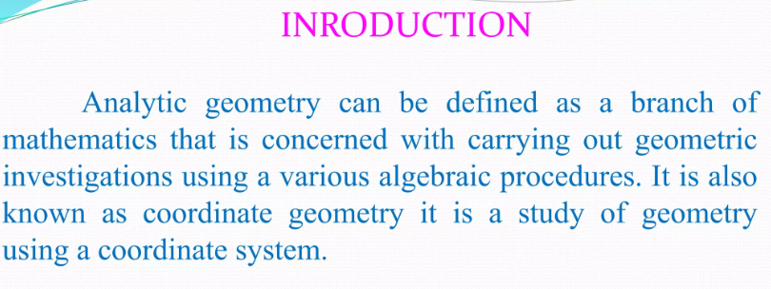
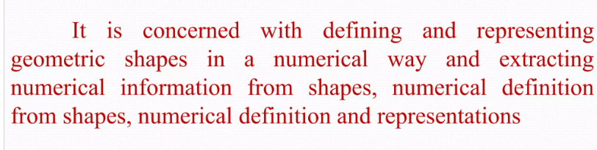

Slide 4
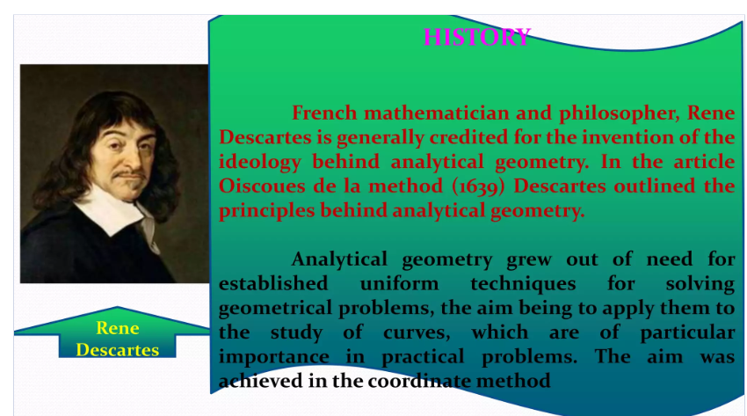

Slide 5
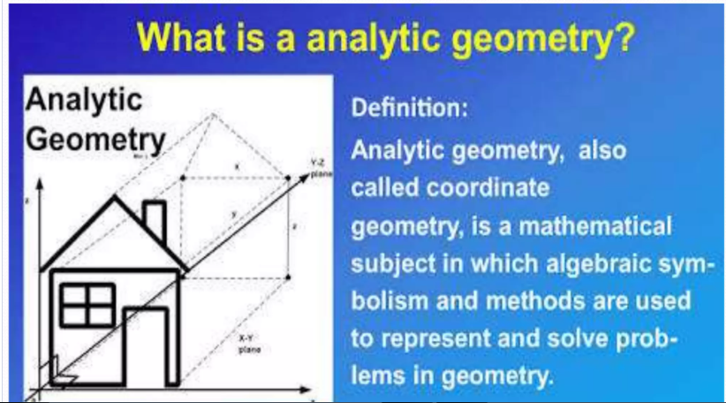

Slide 6
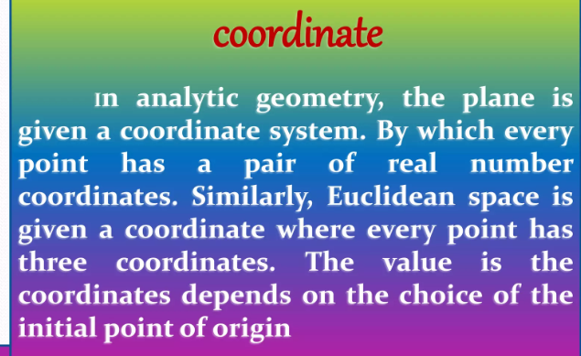

Slide 7
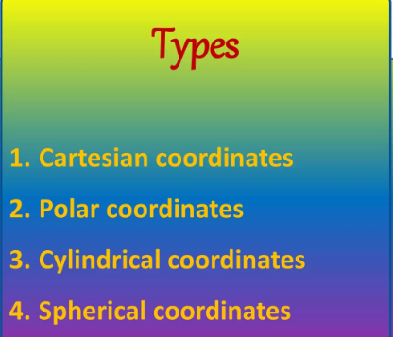

Slide 8
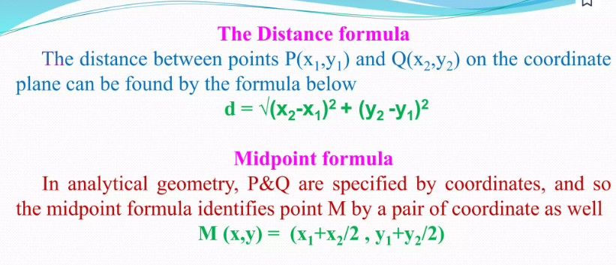
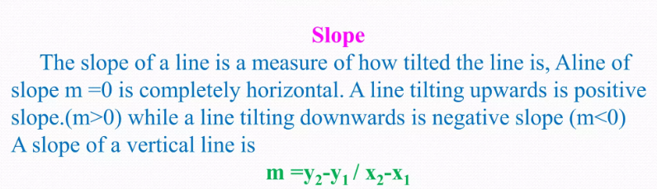

Slide 9
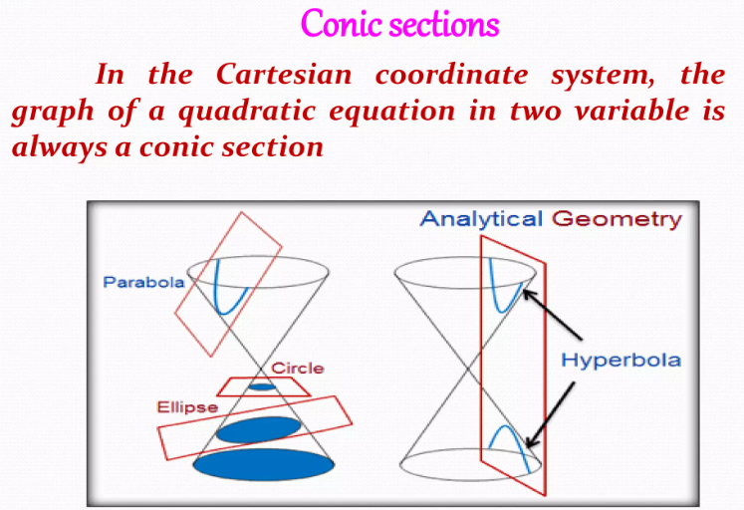

Slide 10
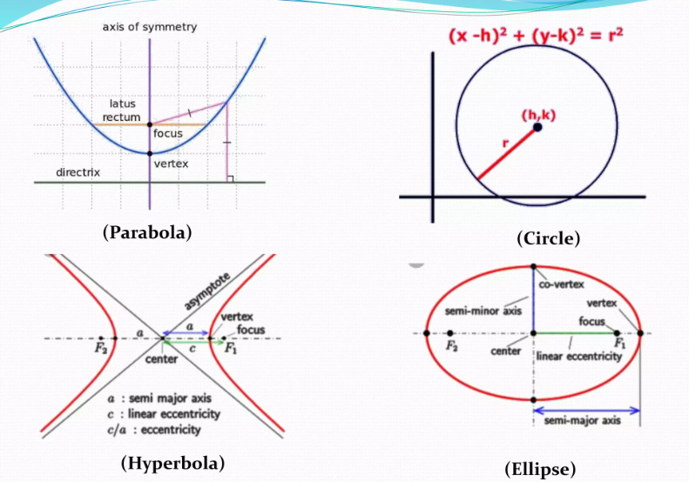

Slide 11
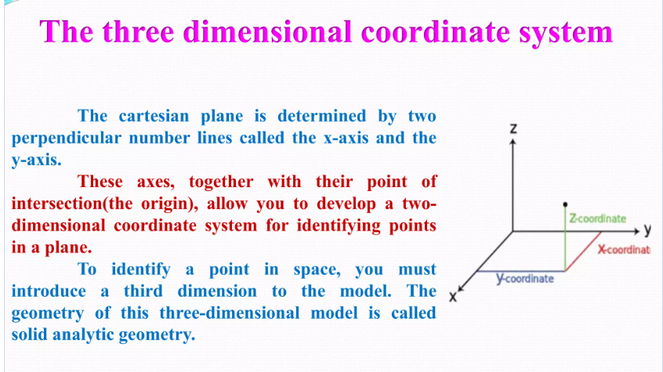

Slide 12
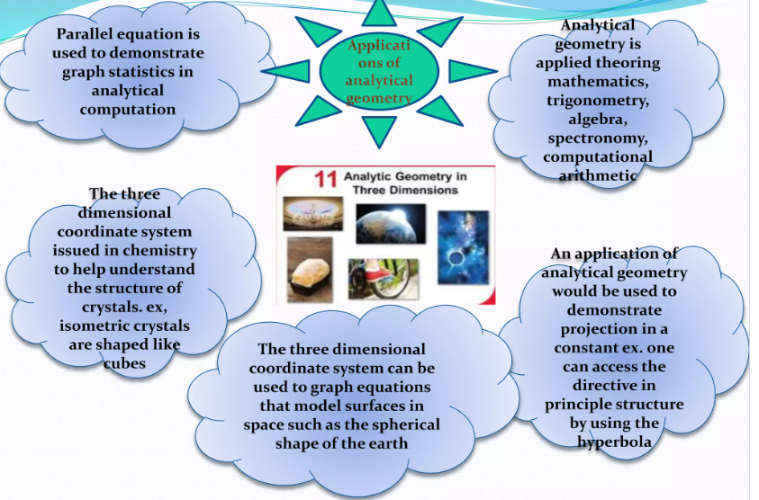

Slide 13
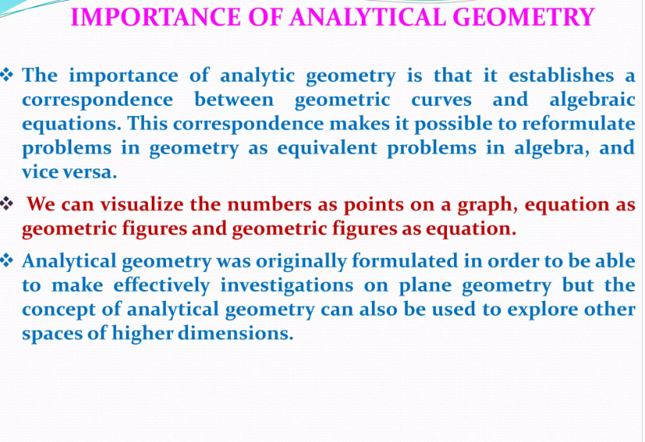

Slide 14
