Slide 1

IMAGE SENSING AND ACQUISITION
EBENEZER P

Slide 2
IMAGE SENSING AND AQUISITION
Images can be generated by the combination of an illuminating source and reflection or absorption of energy from that source by the elements of the scene being imaged.
The illuminating source could be sun or any other source of electromagnetic energy such as radar, IR rays or X-ray energy.
Depending upon the nature of source, illumination energy is reflected from or transmitted through object.
This reflected or transmitted energy is focused onto a photo converter which converts the energy into visible

Slide 3
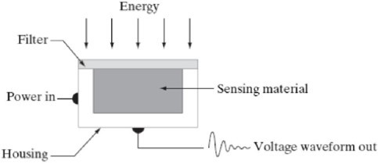
three principle sensor arrangements used to transform illumination energy into digital image

Slide 4
The incoming energy is transformed into a voltage by a combination of electrical energy and sensor material.
The output wave form is the response of the sensor and a digital image is obtained.

Slide 5
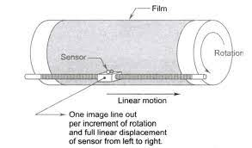
Image acquisition using single sensor
The most common sensor of this type is the photodiode, constructed using silicon materials.
Output voltage waveform is almost proportional to that of light.

Slide 6
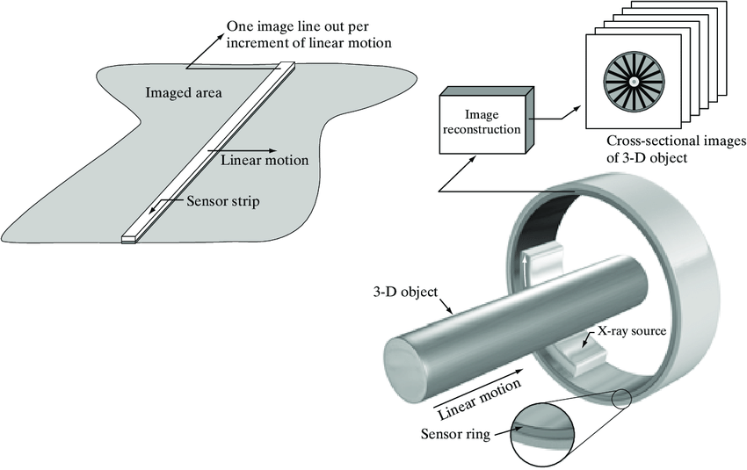
Image acquisition using sensor strips

Slide 7
This constitute inline arrangement of sensors in one direction – will capture image in one direction.
Motion perpendicular to the strip provides imaging in other direction.
This type of arrangement is mostly used in flat bed scanners.
Such inline sensors mostly have 4000 or more sensors in a line.
Sometimes there inline sensors are mounted on a ring and the object to be scanned can be placed in between the ring.
The slice image of the 3D objects can be captured in this method.
Mostly used in medicals.

Slide 8
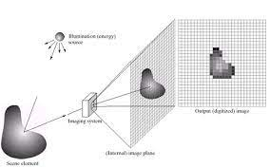
Image acquisition using sensor arrays

Slide 9
In this type sensors are arranged in the form of a 2D array.
4000 x 4000 elements or more are packed together.
Widely used in digital cameras and other light sensing instruments.
Since the arrangement has 2D set of array of sensors, movement is not required.
A complete image can be obtained by focusing the energy pattern onto the surface of the array

Slide 10


