Slide 1
INTRODUCTION TO BIG DATA AND HADOOP

Slide 2
TYPES OF DIGITAL DATA
What is Data?
Classification of Digital Data
Structured Data
Semi-Structured Data
Unstructured Data

Slide 3

WHAT IS DATA? Data -> Information Information -> Insights Data Present in Homogeneous Sources as well as in Heterogeneous Sources.

Slide 4
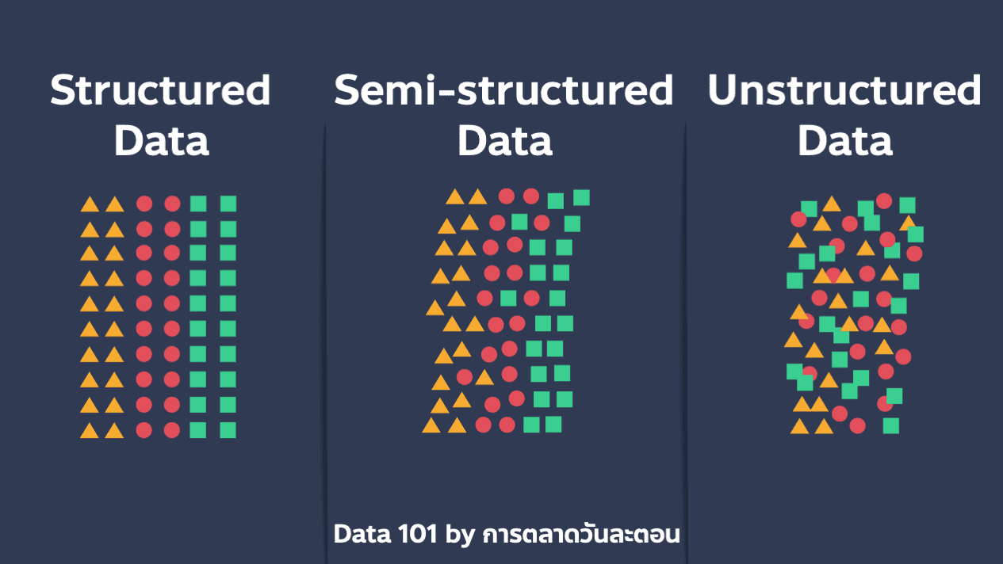
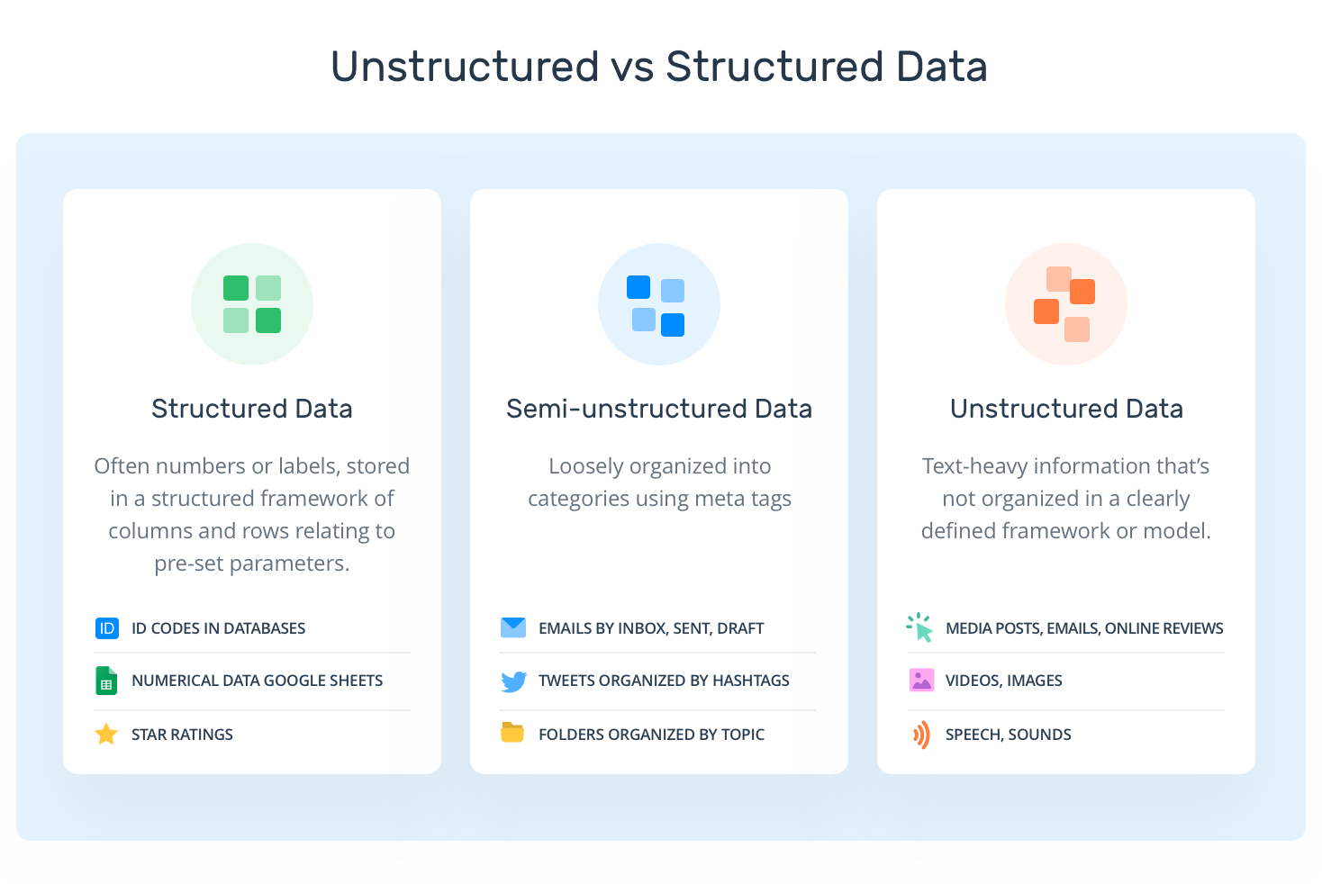
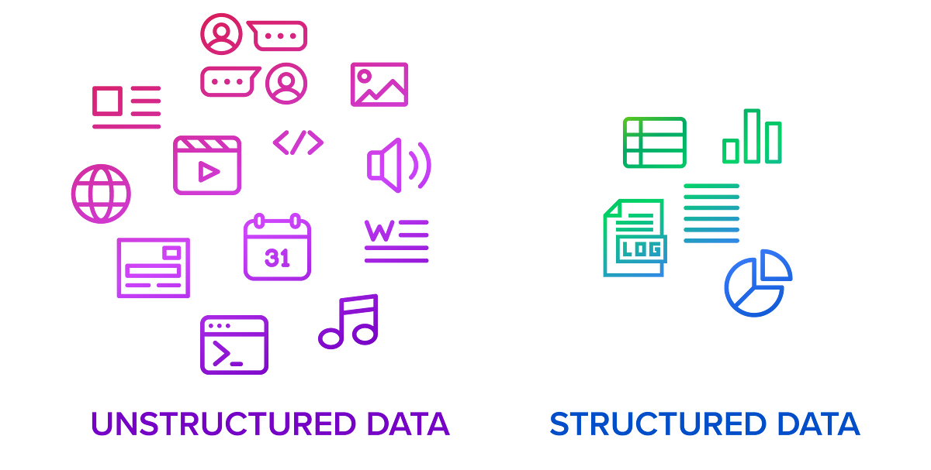
CLASSIFICATION OF DIGITAL DATA
Unstructured Data(80%)
Semi-Structured Data(10%)
Structured Data(10%)

Slide 5
STRUCTURED DATA
Data conforms to a pre-defined schema/structure
Example: The structure/schema of an “Employee” table in a RDBMS such as oracle
Column Name | Data Type | Constraints
EmpNo | Varchar(10) | PRIMARY KEY
EmpName | Varchar(50)
Designation | Varchar(25) | NOT NULL
DeptNo | Varchar(5)
ContactNo | Varchar(10) | NOT NULL
“DeptNo” is a depiction of referential integrity constraint(primary- foreign key) with the “Department” table being the referenced table and “Employee” table being the referencing table
EmpNo | EmpName | Designation | DeptNo | ContactNo
E101 | Ailen | Software Engineer | D1 | 09999999999
Sample records in the “Employee” Table

Slide 6
SOURCES OF STRUCTURED DATA
RDBMS [Oracle Corp.-Oracle, IBM – DB2, Microsoft – Microsoft SQL Server, EMC – Greenplum, Teradata - Teradata, MySQL(Open Source), PostgreSQL (Advanced Open Source), etc.]
The data of the On-Line Transaction Processing (OLTP) systems are generally quite structured.

Slide 7
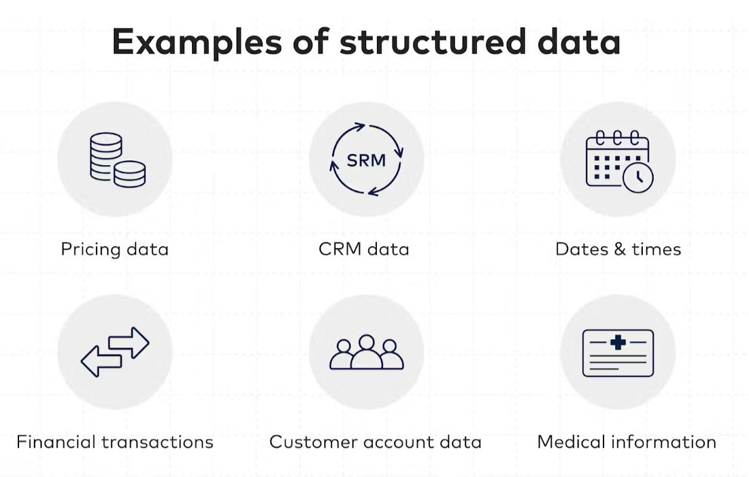
SOURCES OF STRUCTURED DATA
Database
Structured Data
Spreadsheets
OLTP systems
Notes:
What is the Main Difference Between Structured and Unstructured Data? | Encord

Slide 8
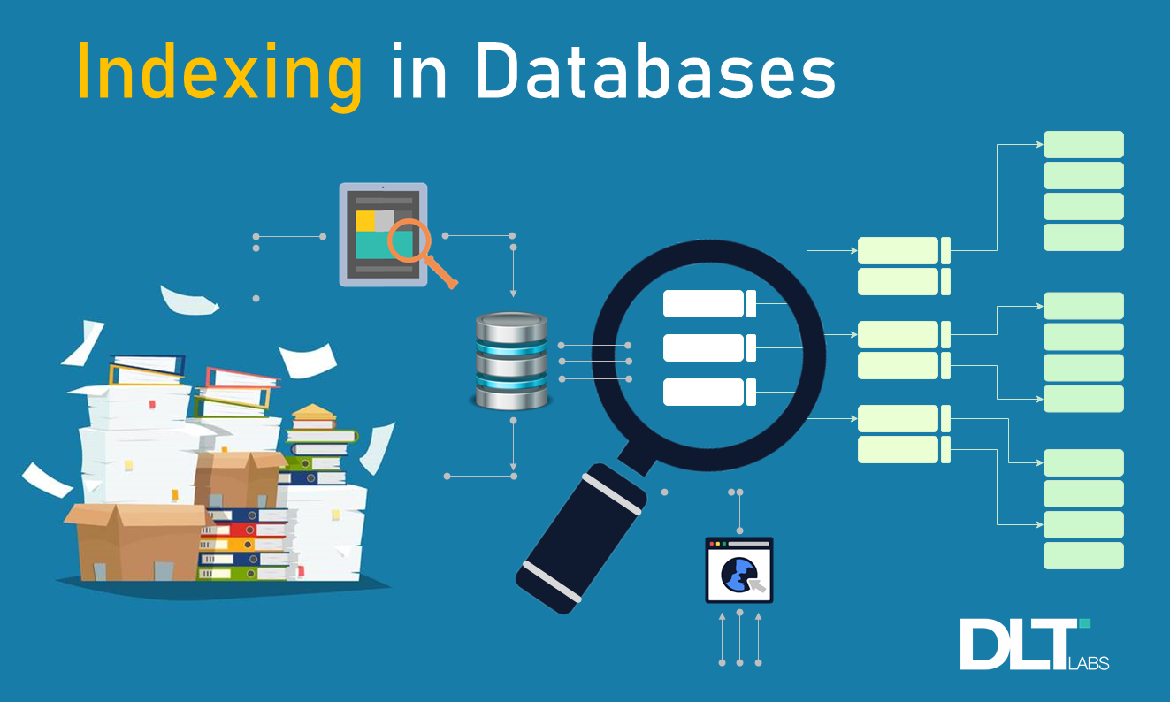
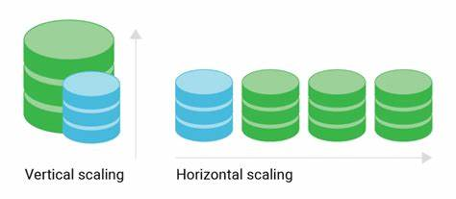
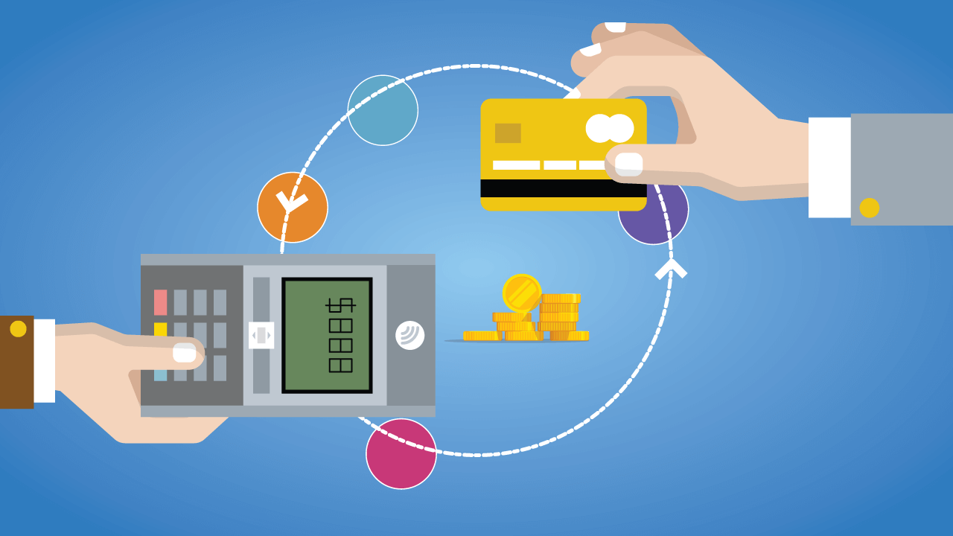
EASE OF WORKING WITH STRUCTURES DATA
Insert/update/delete
Security
Indexing
Scalability
Transaction processing
Transaction processing
Atomicity – either it happens in its entirely or non of it at all
Consistency – One consistent state to another consistent state.
Isolation – The transaction gets the impression that it is the only transaction happening in isolation
Durability – All changes made to the database during a transaction are permanent.

Slide 9
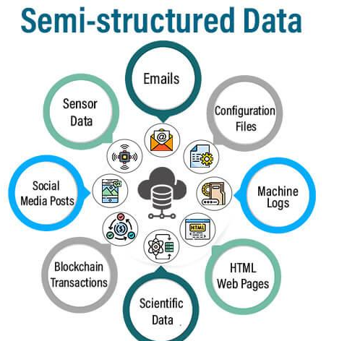
SEMI-STRUCTURED DATA
Self-describing structure
It does not conform to the data models that one typically associates with relational databases or any other form of data tables.
It uses tags to segregate semantic elements.
Tags are also used to enforce hierarchies of records and fields within data.
There is no separation between the data and the schema.
Data objects may have different attributes not known beforehand
Characteristics of semi-structured data
Inconsistent structure
Self-describing(label/value pairs)
Semi-structured data
Often schema information is blended with data values.
Data objects may have different attributes not known beforehand.

Slide 10
THANK YOU
Mrs. B. Devimano
Head, PG Department of Computer Science
NCAS

