Slide 1

PG DEPARTMENT OF COMMERCE
M.COM

Slide 2
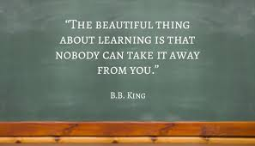

Slide 3

MASTER OF COMMERCE

Slide 4
Programme Specifications:
Department: Commerce
Programme: M.Com.
Mode of Study: Full time (Semester system):
Class room teaching; experiential learning, blended learning, Project assignments.
PURPOSE OF THE COURSE:
Studying M.com improves Logical reasoning, analytical skills, communication skills, mathematical and statistical knowledge, business management skills, teaching and research skills.

Slide 5
PROGRAMME OBJECTIVES:
This Programme aims to develop Commerce professionals with specialized skills and applied competencies in theoretical and practical knowledge of Finance and Marketing that will cater the contemporary needs of industry and academia by providing student-centric learning ambience backed with critical thinking and problem solving capabilities.
And the foremost objective is to train the student to develop conceptual, applied and research skills

Slide 6
SKILLS:
The students after completing the program should inculcate the following skills:
The techniques of managing the business with special focus on marketing and finance.
Application oriented research through research for business decisions.
Effective use of Statistical methods for analysis of business data.
Adopt a suitable corporate tax planning and management for the growth of business within the legal framework.
Investment and portfolio management skill to examine different investment schemes with respect to risk and return and to construct optimum portfolio.
Adopt a reflective approach to personal development and embrace the philosophy of continual professional development.
Plan and undertake independent research in a chosen discipline.

Slide 7
M.COM SPECIALIZATION:
The M.Com course offers a large number of specializations that includes streams such as finance, accounting and finance, marketing, computer application, business management etc. the different specialization improves the job prospect.

Slide 8
Course Objectives & Outcomes
s.no | subjects name | Course objective
1 | Organisational Behaviour | Course objective: This course aims at imparting knowledge about human being behaviour and perception with respect to business organisation
2 | Corporate Accounting | Understand the important concepts of corporate accounting viz. Amalgamation of companies as per Accounting Standard -14 &Ind AS – 103, and liquidation of company
3 | Statistical Analysis | This course is to equip students with some important statistical techniques for decision making and to provide ground for learning advanced statistical tools used in research.
4 | Corporate Governance & Business Ethics | This Course will bring conceptual clarity about different principles, theories, models and emerging trends in good governances practices adopted in the global and Indian context.

Slide 9
Course Objectives & Outcomes
s.no | subjects name | Course objective
1 | Research Methodology | The basic objective of this course is to impart in students the core knowledge related to research and its processes so that they can identify appropriate research topics, select and define appropriate research problem and parameters.
2 | Project Report & Viva voce | The key objective of the Project work is to develop the analytical ability, problem solving skill with the help of necessary statistical tools and techniques to solve the organizational problems.

Slide 10


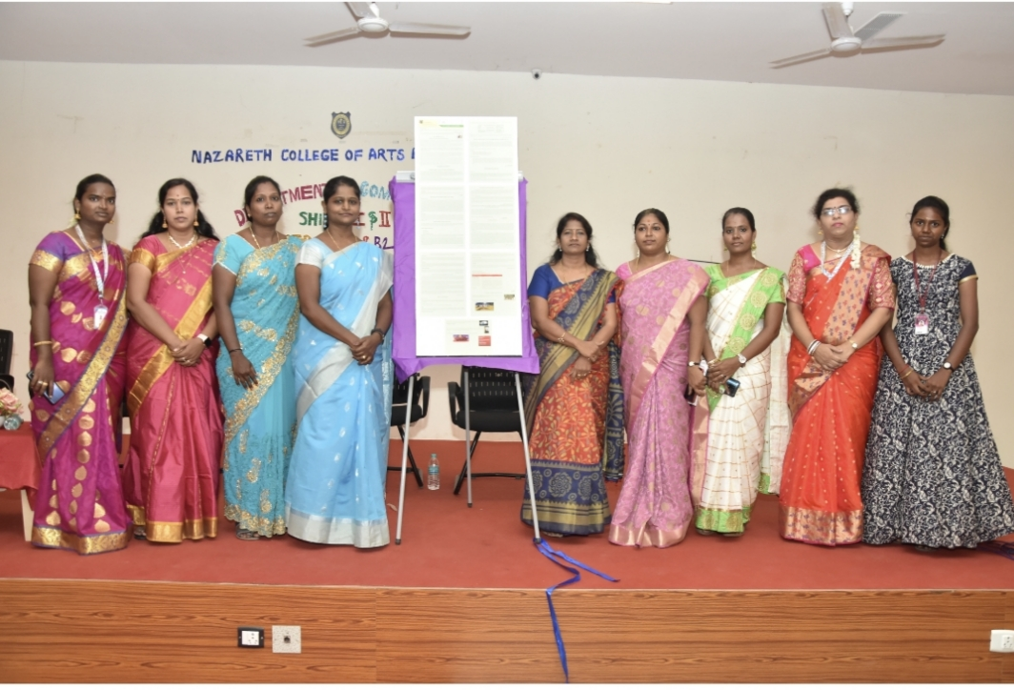
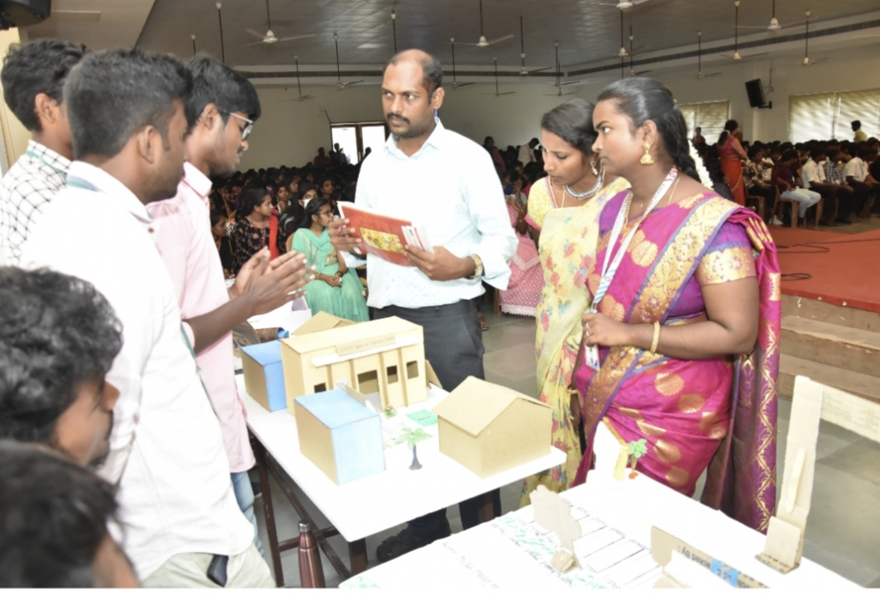
Our events 2021-2022
Combatt ’21 & B2C
MERX’22 & B2C

Slide 11

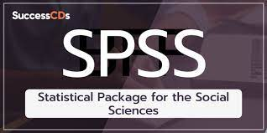
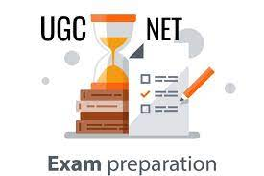

UPCOMING EVENTS FOR M.COM

Slide 12


