Slide 1

NAZARETH COLLEGE OF ARTS AND SCIENCE (Affiliated to University of Madras Re-Accredited by NAAC with ‘B’ Grade)
DEPARTMENT OF COMMERCE
SUBJECT - MARKETING
UNIT - III
BY
MS.A.BELSIA BRITTO
(ASSISTANT PROFESSOR)

Slide 2
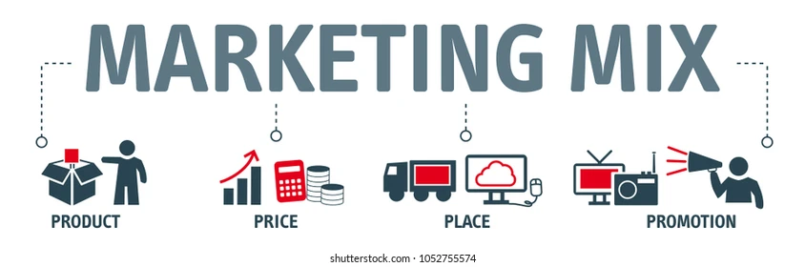
UNIT III

Slide 3
MEANING OF NEW PRODUCT
A product is anything that can be offered to a market to satisfy needs and wants. A New product is any product which is perceived by the customer as being new.
New product Categories…….
1: New to the world.
2: New to the product lines.
3: Additions to the existing product line.
4: Improvements & revisions of existing products.
5: Repositioning.
6: Cost reductions

Slide 4
7 Stage Process of New Product Development
1.Idea generation
2.Idea screening
3.Concept Testing
4.Business analysis
5.Product development
6.Market test
7.Comercialisation

Slide 5

1.Idea generation
Idea generation is continuous, systematic search for new product opportunities. Ideas form using creativity generating techniques and generated through firm’s
Internal Sources: Research and development, Employers.
external Sources: Customer, competitors, Suppliers, Distributors.

Slide 6


2.Idea screening
Filtering the ideas to pick out good ones & dropping the poor ones.
It involves a preliminary elimination process in which a large number of product ideas are screened in terms of the organization’s objectives, policies, technical feasibility, and financial viability.
Total ideas are categories into three group. They are, promising ideas, marginal ideas and rejected ideas.

Slide 7
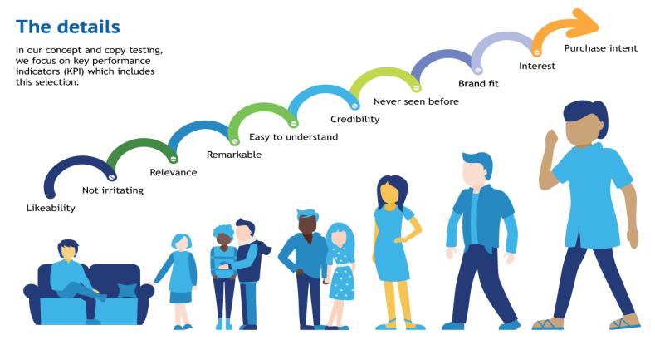

3.Concept Testing
the Product Idea is converted into product concept. Product Ideas means Possible product that company may offer to the market.
A product concept is a detailed version of the idea stated in meaningful consumer terms When developing product concept following criteria should be consider.
Who will use the product. What primary benefit should this product provide. When will this product be consumed.
Concept Testing means presenting the product concept to target consumers, physically or symbolically, and getting their reactions.

Slide 8

4.Business analysis
This stage will decide whether from financial as well as marketing point of view, the project is beneficial or not.
In Business Analysis ,
Estimate likely selling price based upon competition and customer feedback.
Estimate sales volume based upon size of market.
Estimate profitability and break-even point.
If above are match with the company's objectives, then the new product concept moves to product development stage.

Slide 9
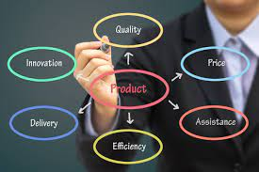
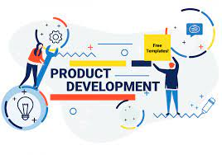
5.Product development
The product has existed only as a word description, a drawing.
The company will now determine whether the product idea can translate into a technically and commercially feasible product.
Produce a physical,
Prototype,
Test the product,
Conduct focus group customer,
Make adjustment .

Slide 10

6.Market test
Now the product is ready to be branded with a name, logo, and packaging and go into a preliminary market testing.
Marketing Testing involves placing a product for sale in one or more selected areas and observing its actual performance under the proposed marketing plan.
Methods for market testing:
Sales wave research.
Simulated test marketing.
Controlled testing marketing.
Test markets.

Slide 11
7.Comercialisation
After successful market testing, new product comes to commercialisation stage.
During this stage, production of new product on a commercial basis is rapidly built up and implementing a total marketing plan. υ
For formally launching a New Product, the following decisions to be taken:
When to launch (Timing)
Where to launch (Geographic Strategy)
To Whom (Target-Market Prospects)
How to launch (Introductory Market Strategy)

Slide 12
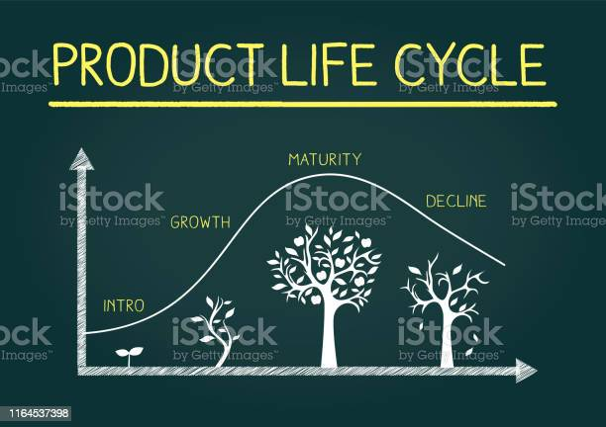

Slide 13
What is Product Life Cycle?
All products have certain length of life during which they pass through certain identifiable stages. The PLC is a conceptual representation of product ageing process.
Like your life is divided into stages same as life of a product is also divided.
Product start with introduction in the market for the purpose of sale. The demand of that product is gradually increased in the market & it reach to its maximum, from where it starts declining. It is effective lifespan of a product.

Slide 14
Definitions of Product Life Cycle
According to Philip Kotler : “The PLC is an attempt to recognise the distinct stages in the sales history of the product.”
According to William J. Stanton : “The Product life cycle concept is the explanation of the product from its birth to death as a product exists in different stages and in different competitive environments.”

Slide 15
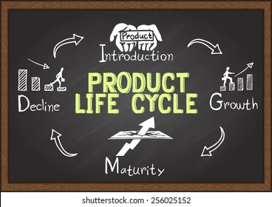
Stages Of Product Life Cycle
There are four stages of product life cycle 1. Introduction Stage 2. Growth Stage 3. Maturity Stage 4. Decline Stage

Slide 16
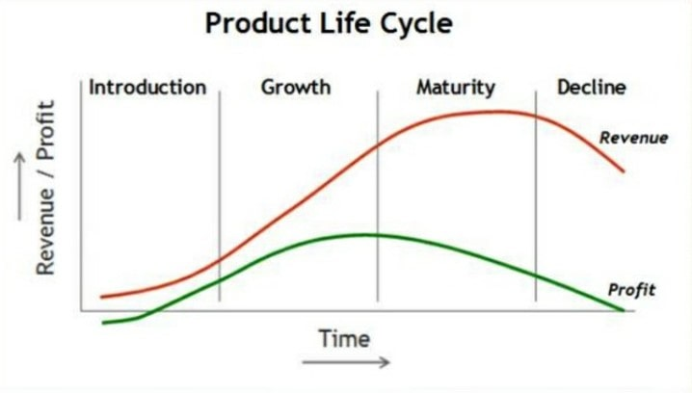

Slide 17
1. Introduction Stage
It is the first stage, wherein the product is launched in the market with full scale production and marketing programme. The product is a new one.
It means “a product that opens up an entirely new market, replaces an existing product or significantly broadens the market for an existing product. "In this stage sales grow at a very low rate because it is not an effective demand.
Characteristics 1. Low and slow sales 2. High product price 3. Heavy promotional expenses 4. Lack of knowledge 5. Low profits 6. Narrow product lines

Slide 18
2. Growth Stage
Once the market has accepted the product, sales begin to rise and product enter it’s 2nd stage.
The product achieves considerable and widespread approval in the market. The sales and profit increases at an accelerated rate.
In this effective distribution, advertising and sales promotion are considered as the key factors.
Characteristics 1. Rapid increase in sales 2. Product improvements 3. Increase in competition 4. Increase in profits 5. Reduction in price 6. Strengthening the distribution channel

Slide 19
3. Maturity Stage
Market becomes saturated because the household demand is satisfied and distribution channels are full.
The product has to face keen competition which brings pressure on prices.
Though the sales of the product rises but at a lower rate. Profit margin however declines due to keen competition.
Characteristics 1. Sales increases at decreasing rate 2. Normal promotional expenses 3. Uniform and lower prices 4. Product modifications 5. Dealer’s support 6. Profit margin decreases

Slide 20
4. Decline Stage
This is the final stage, sooner or later actual sales begin to fall under the impact of new product competition and changing consumer behaviour.
The sales and profits fall down sharply and the promotional expenditure has to be cut down drastically.
Characteristics 1. Rapid decrease in sales 2. Further decrease in prices 3. No promotional expenses 4. Suspension of production work

Slide 21
Features of Product Life Cycle
1. Every product has the life cycle as every human being has.
2. Every product cycle starts from an introduction of the product in the market and it is ceased after passing through the market growth and market stages.
3. It denotes that the product passes from different stages at different speed in course of completing the whole cycle.
4. The profit of business firm grow rapidly in the stage of growth and starts declining due to competitive conditions at the stage of maturity.

Slide 22
5. However the sales volume go on increasing.
6. The duration of each stage is different for different products. It depends upon the factors (nature of products, technological advancements, competition pressure, etc.)
7. It is not necessary that all products go through all stages, some fall at the initial stage, other may reach at maturity stage after a long time.
8. It provides a useful framework for developing effective marketing strategies in different stages of the product life cycle.

Slide 23
Importance
1. It is helpful in sales forecasting. 2. Helpful as a predictive tool. 3. It is Helpful as a planning tool. 4. Helpful as a control tool. 5. Helps in framing marketing programme. 6. Helpful in price determination. 7. Development of new product. 8. Comparison of different products

Slide 24
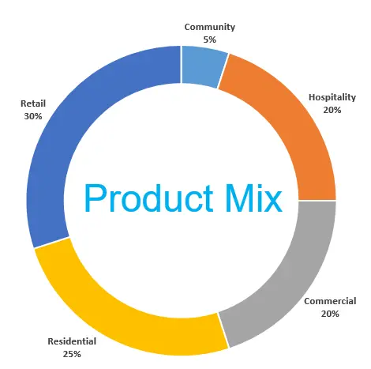

Slide 25
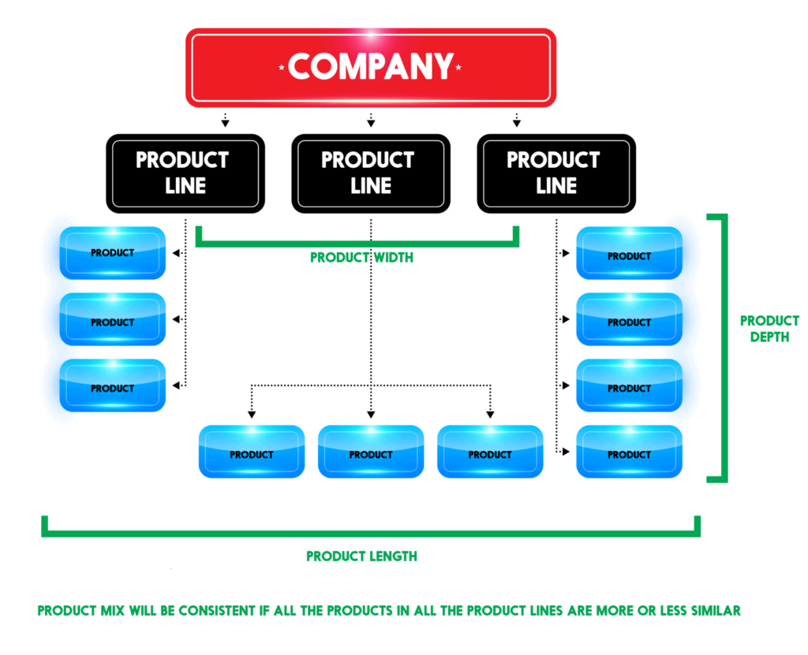

Slide 26


Slide 27
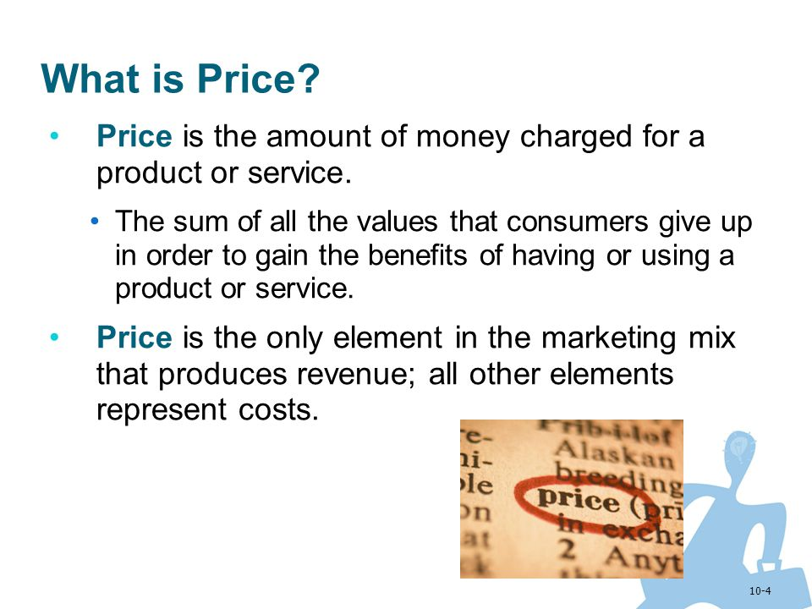

Slide 28
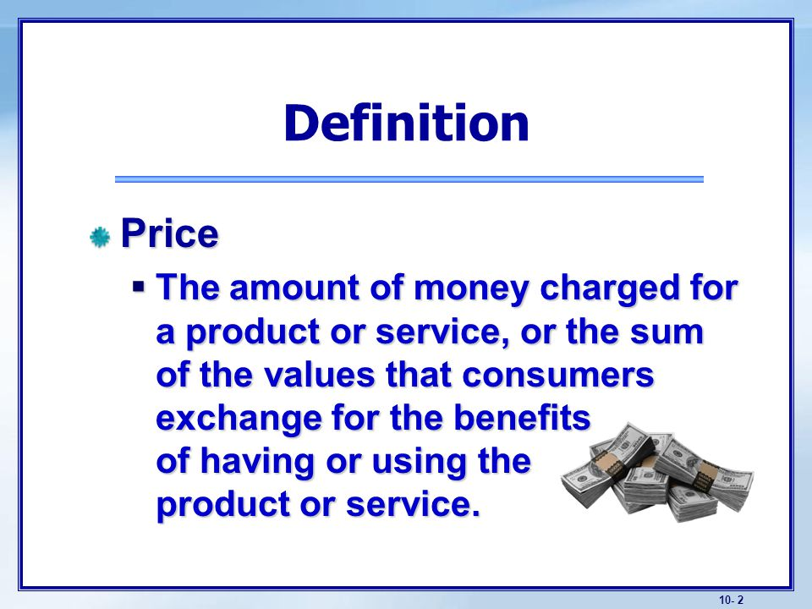

Slide 29
FACTORS INFLUENCING PRICING DECISIONS
INTERNAL FACTORS
1. Cost
2. Company Objectives
3. Organisational Factors
4. Marketing Mix
5. Product Differentiation
EXTERNAL FACTORS
1. Competition
2. Demand
3. Suppliers
4. Economic conditions
5. Consumers
6. Government

Slide 30
I. INTERNAL FACTORS
The internal factors are factors that can be control, determine and process by the organisation.
This factors are mostly in relation with the organisation business level strategy and greatly influenced by the nature of business.

Slide 31
1. Cost
Major factor that determine price.
This is the cost (TC= FC+VC) incurred by the organisation in the production of goods or service.
The cost of production is largely influence by the supplier cost, macroeconomic trends and the nature of business.
In an economy with high inflation rate, the cost of production will rise except where the organisation has monopoly of its supply.

Slide 32
2. Company Objectives
Some organisation set a cost plus pricing. In such case, a percentage is added to the cost of production in order to arrive at the price.
The argue here is that, the company’s objective is profit maximization and therefore a pricing decision must be that will consider that profit maximization objective.
When pricing decisions are made, they must be in line with the overall company objectives, as this is what will inform what the pricing objective really is, so that the pricing decisions made will not be against the company objective.

Slide 33
3. Organisational Factors
Pricing decisions occur on two levels in the organisation. Over- all price strategy is dealt with by top executives. They determine the basic ranges that the product falls into in terms of market segments.
The actual mechanics of pricing are dealt with at lower levels in the firm and focus on individual product strategies. Usually, some combination of production and marketing specialists are involved in choosing the price.

Slide 34
4. Marketing Mix
Price is the important element in marketing mix.
A shift in any one of the elements has an immediate effect on the other three - Production, Promotion and Distribution.
The effort for implementing strategies will not succeed unless the price change is combined with a total marketing strategy that supports it.

Slide 35
5. Product Differentiation
The price of the product also depends upon the characteristics of the product.
In order to attract the customers, different characteristics are added to the product, such as quality, size, colour, attractive package, alternative uses etc.
Generally, customers pay more prices for the product which is of the new style, fashion, better package etc.

Slide 36
II. EXTERNAL FACTORS
The external factors are those factors that are not within reach of the organisation. They are external because there are many parties that determine and control these factors.
The business organisation is a party to the external factor and cannot control or determine the aggregate indicators of these factor.

Slide 37
1. Competition
Competition is a crucial factor in price determination.
A firm can fix the price equal to or lower than that of the competitors, provided the quality of product, in no case, be lower than that of the competitors.

Slide 38
2. Demand
For a new product, there is need to price such product strategically in such a way that it penetrates the market, even if it will be at par with the total cost, while for a highly demanded product, an increase in price may not really have a high effect on the demand for such products, so is the need for management when making pricing decisions to consider the demand for the product.
Some companies who receive order from customers may decide to reduce their price per unit or increase their discount, when it is noted that demand from a customer is high, and this may be on the other way round, depending on other factors considered by the management.

Slide 39
3. Suppliers
Suppliers of raw materials and other goods can have a significant effect on the price of a product.
The price of a finished product is intimately linked up with the price of the raw materials.
Scarcity or abundance of the raw materials also determines pricing.

Slide 40
4. Economic Conditions
The inflationary or deflationary tendency affects pricing.
The prices are increased in boom period to cover the increasing cost of production and distribution. To meet the changes in demand, price etc.

Slide 41
5. Consumers/ Customers
The various consumers and businesses that buy a company’s products or services may have an influence in the pricing decision.
Their nature and behaviour for the purchase of a particular product, brand or service etc. affect pricing when their number is large.

Slide 42
6. Government
Price discretion is also affected by the price-control by the government through enactment of legislation, when it is thought proper to arrest the inflationary trend in prices of certain products.
The prices cannot be fixed higher, as government keeps a close watch on pricing in the private sector. The marketers obviously can exercise substantial control over the internal factors, while they have little, if any, control over the external ones.

