Slide 1
NAZARETH COLLEGE OF ARTS AND SCIENCE Affiliated To University Of Madras Re-accredited by NAAC with ‘B’ grade
WEB TECHNOLOGY
HTML
INTRODUCTION
CLASS : II B.SC CS
SEMESTER: EVEN
2022-2023
STAFF NAME: MS.R.KAVIYARASI
DEPARTMENT: COMPUTER SCIENCE

Slide 2
1.1 Web Basics: Concept of WWW.
WWW is stands for World Wide Web.
The World Wide Web (WWW) is a global information medium which users can read and write via computer connected to the internet.
The Web, or World Wide Web, is basically a system of Internet servers that support specially formatted documents. The documents are formatted in a markup language called HTML (Hypertext Markup Language) that supports links to other documents, as well as graphics, audio, and video files.

Slide 3
In short, World Wide Web (WWW) is collection of text pages, digital photographs, music files, videos, and animations you can access over the Internet.
There are several applications called Web browsers that make it easy to access the World Wide Web; For example: Firefox ,Microsoft's Internet Explorer, Chrome Etc.

Slide 4
1.2 What is The Internet?
The Internet is a global system of interconnected computer networks.
It is a collection of text documents and other resources, linked by hyperlinks and URLs, usually accessed by web browsers, from web servers.
The Internet is a massive network of networks, a networking infrastructure.
It connects millions of computers together globally, forming a network in which any computer can communicate with any other computer as long as they are both connected to the Internet.
Information that travels over the Internet does so via a variety of languages known as protocols.
So we can says that Internet is network of computer which connect to together and any computer communicate with any other computer.

Slide 5
What is The Web (World Wide Web)?
The World Wide Web, or simply Web, is a way of accessing information over the medium of the Internet.
It is an information-sharing model that is built on top of the Internet.
The Web uses the HTTP protocol, only one of the languages spoken over the Internet, to transmit data.
The Web also utilizes browsers, such as Internet Explorer or Firefox, to access Web documents called Web pages that are linked to each other via hyperlinks. Web documents also contain graphics, sounds, text and video.

Slide 6
1.3 Web Browser and Web Server.
Web server and web browser are the terms which are commonly used for website.
The basic purpose of both is to develop a platform for internet web directory. So that any users can anytime access any kind of website.
Major difference between them is on their function and how they perform their functions.

Slide 7
Web Browser
Web browser is a client, program, software or tool through which we sent HTTP request to web server.
The main purpose of web browser is to locate the content on the World Wide Web and display in the shape of web page, image, audio or video form.

Slide 8
We can also call it a client server because it contacts the web server for desired information. If the requested data is available in the web server data then it will send back the requested information again via web browser.
Microsoft Internet Explorer, Mozilla Firefox, Safari, Opera and Google Chrome are examples of web browser and they are more advanced than earlier web browser because they are capable to understand the HTML, JavaScript, AJAX, etc.
Now days, web browser for mobiles are also available, which are called micro browser.

Slide 9
Web Server
Web server is a computer system, which provides the web pages via HTTP (Hypertext Transfer Protocol). IP address and a domain name is essential for every web server.
Whenever, you insert a URL or web address into your web browser, this sends request to the web address where domain name of your URL is already saved. Then this server collects the all information of your web page and sends to browser, which you see in form of web page on your browser.

Slide 10
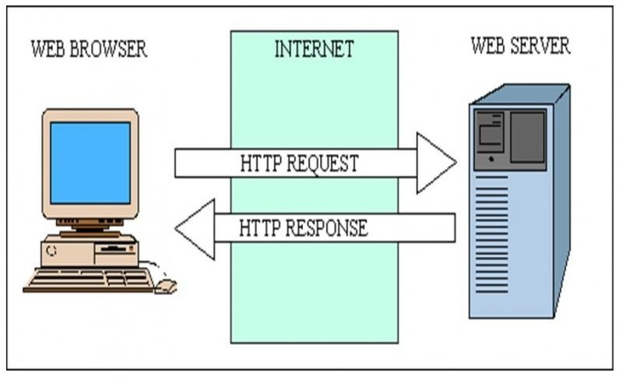
Lot of web server software is available in the market in shape of NCSA, Apache, Microsoft and Netscape.
Storing, processing and delivering web pages to clients are its main function.
All the communication between client (web browser) and server takes place via HTTP.
Here, we can easily understand concept of web browser and web server by following figure

Slide 11
1.4 Web Page
A web page or webpage is a document, commonly written in HTML, that is viewed in an Internet browser.
A web page can be accessed by entering a URL address into a browser's address bar. A web page may contain text, graphics, and hyperlinks to other web pages and files.
The first web page was created at CERN by Tim Berners-Lee on August 6, 1991.

Slide 12
Types of Web Pages
Static Web page
Static web pages are also known as flat or stationary web page.
They are loaded on the client’s browser as exactly they are stored on the web server.
Such web pages contain only static information.
User can only read the information but can’t do any modification or interact with the information.
Static web pages are created using only HTML. Static web pages are only used when the information is no more required to be modified.

Slide 13
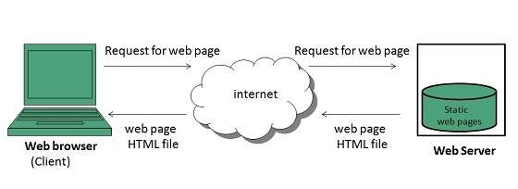
Static Web Page

Slide 14
Dynamic Web page
Dynamic web page shows different information at different point of time.
It is possible to change a portion of a web page without loading the entire web page.
It has been made possible using Ajax technology.

Slide 15
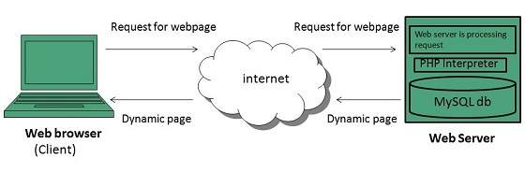
Dynamic Web Page

Slide 16
Thank you

