Slide 1
NAZARETH COLLEGE OF ARTS AND SCIENCE
Affiliated To University Of Madras Re-accredited by NAAC with ‘B’ grade
RELATIONAL DATABASE MANAGEMENT SYSTEMS
AGGREGATION AND COMPOSITION
CLASS :III B.SC CS
SEMESTER: ODD(2022-2023)
STAFF NAME: MS.R.KAVIYARASI
DEPARTMENT: COMPUTER SCIENCE

Slide 2
ASSOCIATIONS AND RELATIONSHIPS
An important step in designing databases is identifying associations or relationships among entities. Details about these relationships represent the business rules.
Associations or relationships represent business rules.
Associations can be named: UML refers to the association role.
Each end of a binary association may be labeled. It is often useful to include a direction arrow to indicate how the label should be read.

Slide 3
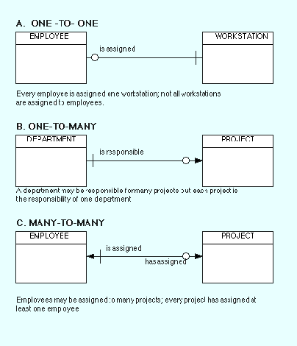
ASSOCIATIONS AND RELATIONSHIPS

Slide 4
ASSOCIATION DETAILS: N-ARY ASSOCIATIONS
Many-to-many associations between classes cause problems in the database design
Figure shows that the three main entities (Employee, Product, and Component) are actually related to each other through an Assembly association. When more than two classes are related, the relationship is called an n-ary association and is drawn as a diamond.
In this example an entry in the assembly list would contain an EmployeeID, a ComponentID, and a ProductID. In total, many employees can work on many products, and many components can be installed in many products.

Slide 5
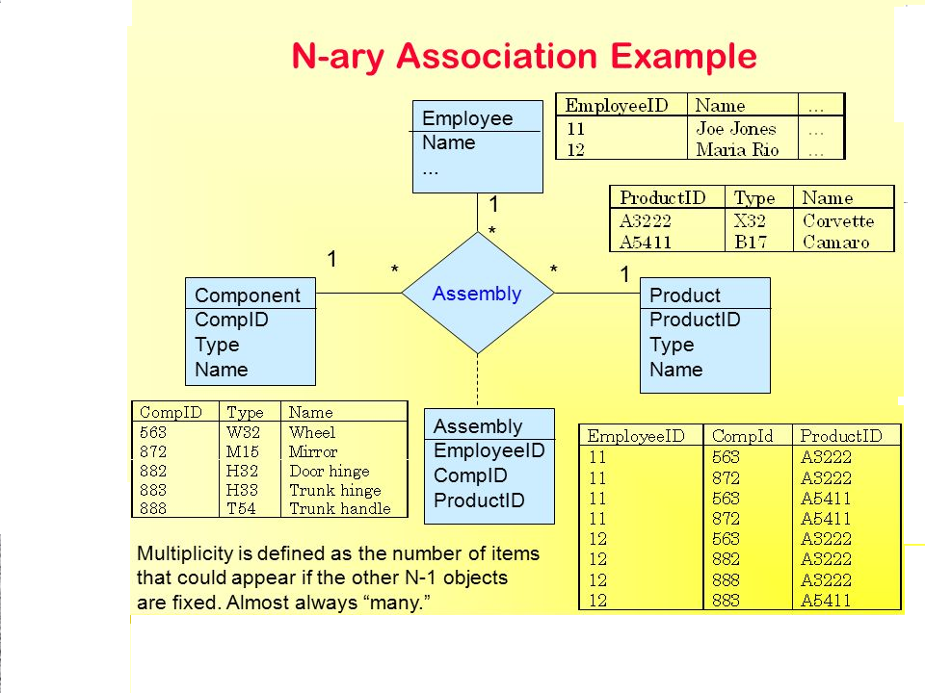
ASSOCIATION DETAILS: N-ARY ASSOCIATIONS

Slide 6
ASSOCIATION DETAILS: AGGREGATION
An aggregation is a collection.
For example, a Sale consists of a collection of Items being purchased.
As shown in Figure , aggregation is indicated by a small diamond on the association line next to the class that is the aggregate.
In the example, the diamond is next to the Sale class.
Association aggregation. A Sale contains a list of items being purchased. A small diamond is placed on the association to remind us of this special relationship.

Slide 7
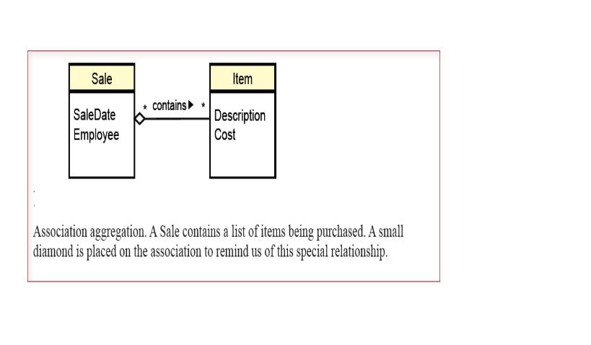
ASSOCIATION DETAILS: AGGREGATION

Slide 8
ASSOCIATION DETAILS: COMPOSITION In a composition, the individual items become the new object marked with a filled diamond.
The simple aggregation indicator is not used much in business settings.
In a composition, the individual items become the new object.
Consider a bicycle, which is built from a set of components (wheels, crank, stem, and so on). UML provides two methods to display composition.
In Figure the individual classes are separated and marked with a filled diamond.

Slide 9
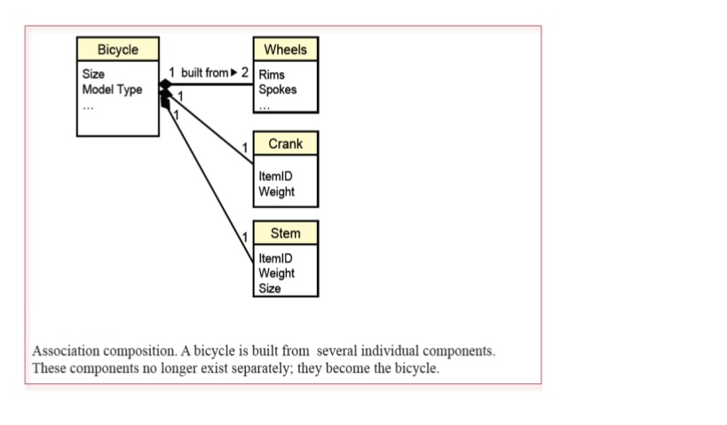
ASSOCIATION DETAILS: COMPOSITION In a composition, the individual items become the new object marked with a filled diamond.

Slide 10
ASSOCIATION DETAILS: GENERALIZATION
Another common association that arises in business settings is generalization. This situation generates a class hierarchy.
The most general description is given at the top, and more specific classes are derived from it.
FigureEach animal has certain generic properties (e.g., DateBorn, Name, Gender, ListPrice), contained in the generic Animal class. But specific types of animals require slightly different information.
A small, unfilled triangle is used to indicate a generalization relationship.
You can connect all of the subclasses into one triangle as in Figure or you can draw each line separately
An important characteristic of generalization is that lower-level classes inherit the properties and methods of the classes above them.
Inheritance means that objects in the derived classes include all of the properties from the higher classes, as well as those defined in their own class.
Defining properties and methods within a class is known as encapsulation.
Encapsulation also provides some security and control features because properties and functions can be protected from other areas of the application.
Polymorphism is a useful tool for application builders.

Slide 11
ASSOCIATION DETAILS: GENERALIZATION
An important characteristic of generalization is that lower-level classes inherit the properties and methods of the classes above them.
Inheritance means that objects in the derived classes include all of the properties from the higher classes, as well as those defined in their own class.
Defining properties and methods within a class is known as encapsulation.
Encapsulation also provides some security and control features because properties and functions can be protected from other areas of the application.
Polymorphism is a useful tool for application builders.

Slide 12
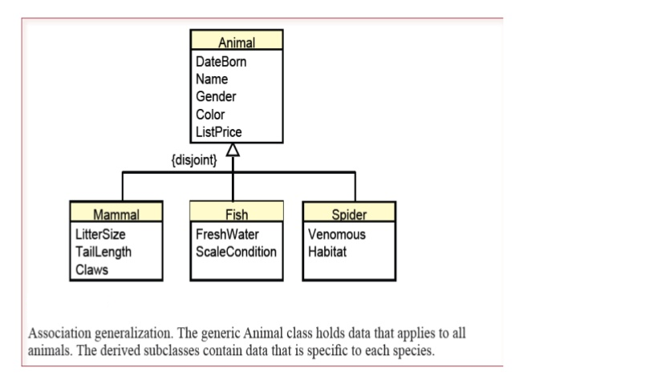
ASSOCIATION DETAILS: GENERALIZATION Inheritance means that objects in the derived classes include all of the properties from the higher classes, as well as those defined in their own class. A small, unfilled triangle is used to indicate a generalization relationship.

Slide 13
ASSOCIATION DETAILS: REFLEXIVE ASSOCIATION A reflexive association is a relationship from one class back to itself.
A reflexive relationship is another situation that arises in business that requires special handling. A reflexive association is a relationship from one class back to itself.
The most common business situation is shown in Figure . most employees (worker) have a manager. Hence there is an association from Employee (the worker) back to Employee (the manager).

Slide 14
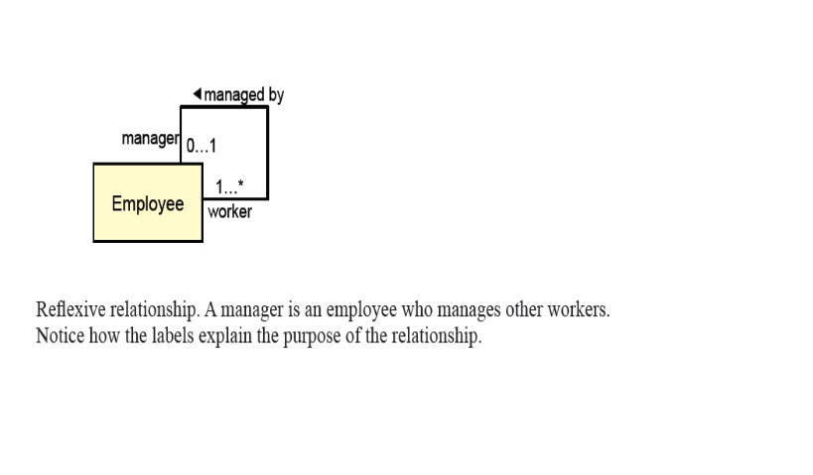
ASSOCIATION DETAILS: REFLEXIVE ASSOCIATION A reflexive association is a relationship from one class back to itself.

Slide 15
Thank you

