Slide 1
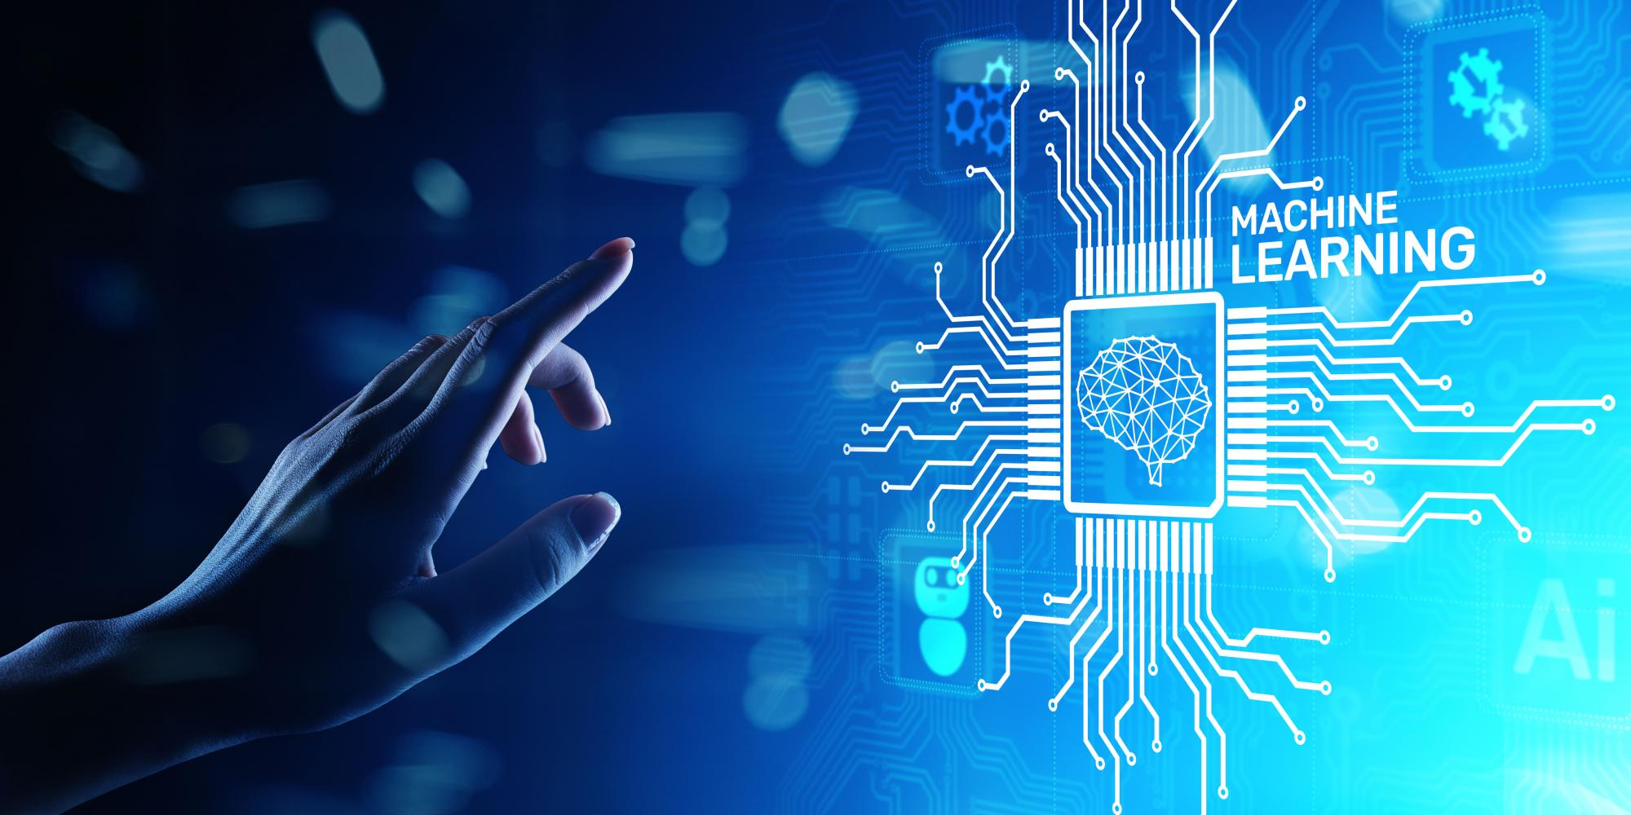
USING MACHINE LEARNING TO CONVERT IMAGES INTO HTML CODE
DATE:26.06.2023
PRASAD.B
MSC.CS

Slide 2
AGENDA:
Introduction
Understanding HTML
Image Recognition Techniques
Preprocessing Images
Building the Image-to-HTML Model
HTML Tag Generation
Performance Optimization
Evaluation and Validation
Use Cases and Applications
Conclusion and Future Directions

Slide 3
Introduction:
The purpose of this project is to explore the fascinating intersection of image recognition and web development, leveraging the power of machine learning algorithms to convert images into HTML code. By harnessing the capabilities of deep learning and image recognition techniques, we aim to streamline the process of transforming visual content into structured HTML elements.
Over the following pages, we will delve into the fundamentals of HTML, examine various image recognition techniques used in machine learning, discuss the preprocessing steps necessary for optimizing image data, and construct a robust machine learning model capable of generating HTML code from input images. Additionally, we will address challenges associated with different image types and complex layouts, and explore potential applications and future directions for this innovative technology.

Slide 4
Understanding HTML :
HTML (Hypertext Markup Language) is the standard markup language used for creating web pages and applications. It provides a structure and defines the elements and content within a webpage. Let's explore the fundamental components of HTML, including tags, attributes, and the structure of an HTML document.
HTML Tags:
HTML tags are used to define different elements within a webpage. They are enclosed within angle brackets (< >) and come in pairs: an opening tag and a closing tag. The content placed between these tags represents the element and its functionality. Here's an example of a basic HTML tag structure:
<tagname>Content goes here</tagname>
Attributes:
HTML attributes provide additional information about an element. They are included within the opening tag and consist of a name and a value, separated by an equal sign (=). Attributes help modify the behavior, appearance, or functionality of an element. Here's an example of an HTML tag with attributes:

Slide 5
<tagname attribute="value">Content goes here</tagname>
Commonly Used HTML Tags:
<h1> to <h6>: Heading tags for creating headings of different levels. <p>: Paragraph tag for creating paragraphs of text.
<a>: Anchor tag used for creating hyperlinks.
<img>: Image tag for embedding images within a webpage.
<ul> and <ol>: Unordered and ordered list tags for creating bulleted and numbered lists, respectively.
<li>: List item tag used within <ul> or <ol> to define individual list items.
<div>: Division tag used to group and style content within a webpage.
<span>: Span tag used to apply styles to a specific part of text.
<table>: Table tag for creating tabular data.
<form>: Form tag for creating input forms on a webpage.
<input>: Input tag used within a form for accepting user input.
These examples represent just a fraction of the HTML tags available. Each tag serves a specific purpose and can be combined to create complex and interactive webpages.
Understanding HTML and its core elements is essential for converting images into HTML code. With this knowledge, we can proceed to explore how machine learning techniques can be employed to automate the conversion process effectively.

Slide 6
Image Recognition Techniques :
Convolutional Neural Networks (CNNs) are powerful deep learning models for image recognition. They consist of Convolutional layers that extract local features from images using filters.
Pooling layers reduce spatial dimensions, introducing translational invariance. Activation functions introduce non-linearity, enabling modeling of complex relationships.
Fully connected layers perform high-level feature combination and transformation.
CNNs are trained through forward propagation, backpropagation, and optimization algorithms. Transfer learning leverages pre-trained models for faster and more accurate training. CNNs can perform object localization by extending the architecture with additional layers.
Data augmentation enhances generalization by applying random transformations to training images. Techniques like CAM and saliency maps aid interpretability and visualization. CNNs excel in image recognition tasks and find applications in various domains.
Understanding CNNs is essential for image-to-HTML conversion using machine learning techniques.

Slide 7
Image preprocessing is crucial for preparing images for machine learning models. It standardizes images, extracts features, and optimizes data for efficient training. Resizing ensures uniformity and compatibility by adjusting image dimensions. Normalization standardizes pixel values, mitigating variations in brightness and contrast.
Data augmentation introduces diversity by applying transformations to increase dataset size.
Cropping selects a region of interest, removing irrelevant or noisy parts. Grayscale conversion simplifies data and reduces computational complexity. Histogram equalization enhances contrast for better visibility of details.
Filtering and smoothing techniques reduce noise and artifacts in images. Preprocessing improves model performance, convergence, and generalization. Applying appropriate techniques depends on dataset characteristics and model requirements.
Image preprocessing is a vital step in machine learning workflows, particularly for tasks like image recognition. It enables standardization, feature extraction, and optimization of image data, ensuring that the models can effectively learn and make accurate predictions. Techniques such as resizing, normalization, data augmentation, cropping, grayscale conversion, histogram equalization, and filtering are commonly used to preprocess images.
Preprocessing Images :

Slide 8
By resizing images, we ensure that they have consistent dimensions, which is essential for compatibility and efficient processing. Normalization adjusts pixel values to a standardized range, reducing the impact of varying brightness and contrast.
Data augmentation introduces variations in the training data, making the model more robust and preventing overfitting.
Cropping focuses on relevant regions of interest, removing distractions and noise. Grayscale conversion simplifies data representation and reduces computational complexity. Histogram equalization enhances image contrast, improving visibility. Filtering techniques help reduce noise and artifacts.
The choice of preprocessing techniques depends on the characteristics of the dataset and the requirements of the model. It is important to strike a balance between enhancing features and maintaining the integrity of the original images.
Proper preprocessing leads to improved model performance, faster convergence, and better generalization.
In the future, advancements in image preprocessing techniques may focus on automated feature extraction, adaptive preprocessing based on image content, and more sophisticated noise reduction algorithms. Additionally, with the increasing popularity of deep learning, integrating preprocessing steps within the neural network architecture itself may be explored to optimize the end-to-end learning process.

Slide 9
Building the Image-to-HTML Model :
The image-to-HTML model combines computer vision techniques with NLP components. It typically consists of a CNN for image feature extraction, RNNs for HTML template encoding, fusion of image features and HTML encoding, and a decoder network for HTML code generation.
The training process involves preparing a dataset with paired images and corresponding HTML code. Images are preprocessed by resizing and normalizing pixel values, while HTML code is tokenized. The model is trained using forward propagation, calculating loss (e.g., cross-entropy), and backpropagation to update parameters.
Optimization includes selecting appropriate algorithms (e.g., Adam, SGD) and tuning hyperparameters like learning rate and batch size. Evaluation on a separate validation set measures the model's performance using metrics such as accuracy or BLEU scores.
Here's a simplified code snippet for the training loop using PyTorch:

Slide 10
# Assuming the model architecture has been defined and initialized
# Define the loss function and optimizer
criterion = nn.CrossEntropyLoss()
optimizer = optim.Adam(model.parameters(), lr=0.001)
# Training loop
for epoch in range(num_epochs):
running_loss = 0.0
for images, html_codes in train_dataloader:
optimizer.zero_grad()
output = model(images)
loss = criterion(output, html_codes)
loss.backward()
optimizer.step()
running_loss += loss.item()
# Print training loss after each epoch
print(f"Epoch {epoch+1} - Loss: {running_loss/len(train_dataloader)}")
This summarizes the architecture and training process for the image-to-HTML model, emphasizing the key components and steps involved in its construction.

Slide 11
HTML Tag Generation :
During image-to-HTML conversion, the model recognizes objects in the image and generates HTML tags based on that information. It associates visual features with corresponding HTML elements, producing the desired HTML structure. Here are the key steps and examples:
Object Recognition: The model identifies objects in the image using a CNN and predicts their categories.
Feature Extraction: Additional visual features like colors, shapes, or textures are extracted, providing more detailed information.
HTML Tag Mapping: The model learns associations between recognized objects/features and HTML elements, attributes, and styles.
Tag Generation: Based on the recognized objects/features, the model generates HTML tags and their attributes using predefined templates/rules.

Slide 12
Input Image: Cat Image
Output HTML Code:
<div>
<h1>Cat Image</h1>
<img src="cat.jpg" alt="A beautiful cat">
</div>
Example 2:
Input Image: Car Image
Output HTML Code:
<div>
<h1>Car Image</h1>
<img src="car.jpg" alt="A stylish car">
</div>
In these examples, the model recognizes objects and generates appropriate HTML tags. It associates the "cat" object with a <div> element encapsulating an <img> tag with relevant attributes. Similarly, the "car" object is associated with a different image source and alternative text.

Slide 13
Performance Optimization :
To optimize the performance of the image-to-HTML conversion process, you can employ the following techniques:
Model Optimization:
Consider using lightweight architectures like MobileNet or EfficientNet for faster processing and reduced memory usage.
b. Apply model quantization techniques to reduce the memory footprint without significant accuracy loss.
c. Use pruning techniques to remove unnecessary connections or parameters from the model, reducing its size and inference time.
Hardware Acceleration:
Utilize GPUs for parallel processing and faster computations during inference.
b. Explore specialized hardware accelerators or TPUs designed for efficient deep learning workloads.
Preprocessing Techniques:
Optimize image resizing by selecting appropriate dimensions and maintaining aspect ratio.
b. Process images in batches during inference to leverage parallelism and minimize overhead.

Slide 14
Caching and Memoization:
Implement caching mechanisms to store preprocessed images, intermediate results, or generated HTML code.
b. Utilize memoization techniques to store and reuse computations performed during the conversion process.
Data Pipeline Optimization:
Use efficient data streaming techniques for parallel loading and preprocessing of images.
b. Apply data augmentation techniques during training to increase dataset size and improve generalization.
Quantitative Evaluation:
Regularly evaluate the model's performance metrics to identify areas for improvement and fine-tune the model accordingly.
By implementing these techniques, you can optimize the performance of the image-to-HTML conversion process, achieving faster processing times, improved accuracy, and efficient memory usage. It's important to find the right balance between performance and accuracy based on the specific requirements and constraints of your deployment environment.

Slide 15
Evaluation and Validation :
Accuracy: Measures the percentage of correctly generated HTML code compared to the ground truth.
Precision: Calculates the ratio of correctly generated HTML tags to the total number of generated tags.
Recall: Determines the ratio of correctly generated HTML tags to the total number of ground truth tags.
F1 Score: Balances precision and recall to provide a comprehensive evaluation metric.
Importance of Validation and Testing:
Generalization: Validate the model on diverse datasets to assess its ability to handle various image types, layouts, and content.
Robustness: Test the model on different images to identify potential issues and improve its performance and reliability.
Error Analysis: Evaluate the model's performance on diverse datasets to identify areas for improvement and refine the training process.
Real-World Scenario Simulation: Validate and test the model to ensure it meets performance standards and user expectations.
Validation and testing on diverse datasets are crucial to ensure the model's reliability, generalization, and suitability for real-world scenarios. Regular evaluation and validation enable the identification of areas for improvement and ensure the model consistently generates accurate and semantically meaningful HTML code.

Slide 16
Use Cases and Applications :
Image-to-HTML conversion has various use cases and applications in web development, content management systems (CMS), and web design tools. Here's an overview of the prominent use cases and the benefits and limitations of using machine learning for image-to-HTML conversion:
Use Cases:
Automating Website Creation
Content Management Systems (CMS)
Web Design Tools
Rapid Prototyping
Responsive Web Design
Benefits of Using Machine Learning:
Efficiency: Automation reduces the time and effort required to code web layouts manually.
Accuracy: Properly trained models generate accurate HTML code, capturing the image's structure and content effectively.
Flexibility: Machine learning models can handle diverse image types and complex

Slide 17
Scalability: Trained models can be deployed at scale, providing consistent and reliable image-to-HTML conversion capabilities.
Limitations of Using Machine Learning:
Training Data Limitations: Model accuracy relies on the quality and diversity of training data.
Complex Layouts: Extremely intricate or unconventional designs may pose challenges for accurate HTML generation.
Contextual Understanding: Models may struggle to grasp the semantic context or user intentions behind specific design choices.
Dependency on Preprocessing: Proper preprocessing techniques are essential for effective image-to-HTML conversion.
Machine learning-based image-to-HTML conversion offers benefits in automating website creation, CMS integration, and web design. However, limitations such as training data quality, complex layouts, contextual understanding, and preprocessing requirements should be considered for optimal utilization.

Slide 18
Conclusion :
In this guide, we explored the process of converting images into HTML code using machine learning techniques. We covered the basics of HTML, image recognition with CNNs, preprocessing techniques, model training, and generating HTML tags. We addressed challenges like handling different image types and complex layouts. We discussed evaluation metrics, the importance of validation and testing, and provided potential use cases and applications.
Future research directions include improving semantic context understanding, enhancing handling of complex layouts, interactive user interfaces, integrating with design software, cross-domain adaptation, and considering accessibility guidelines. These advancements will contribute to automating web development, improving CMS and web design tools, and enhancing the accuracy and usability of image-to-HTML conversion models.

