Slide 1

Personality development
- Kanimozhi p

Slide 2
Mapping the different
personality types

Slide 3

What is personality?
The combination of characteristics or qualities that form an individuals distinctive character
Unique pattern of behaviour
Determining by heredity and environment

Slide 4
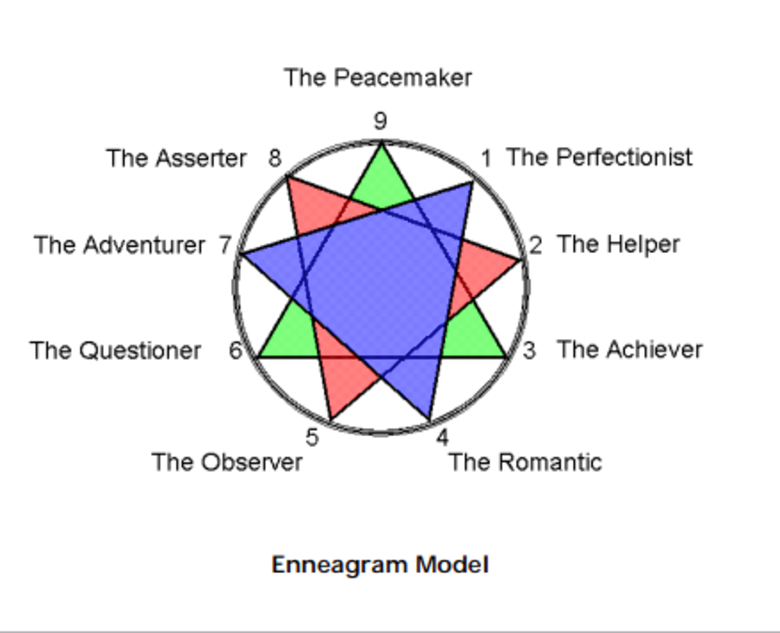
Types of personality

Slide 5
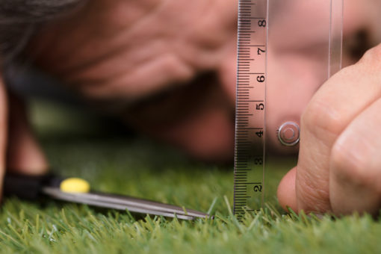
perfectionist
A person who always does things as well as he/she possibly can and who expects others to do the same.

Slide 6
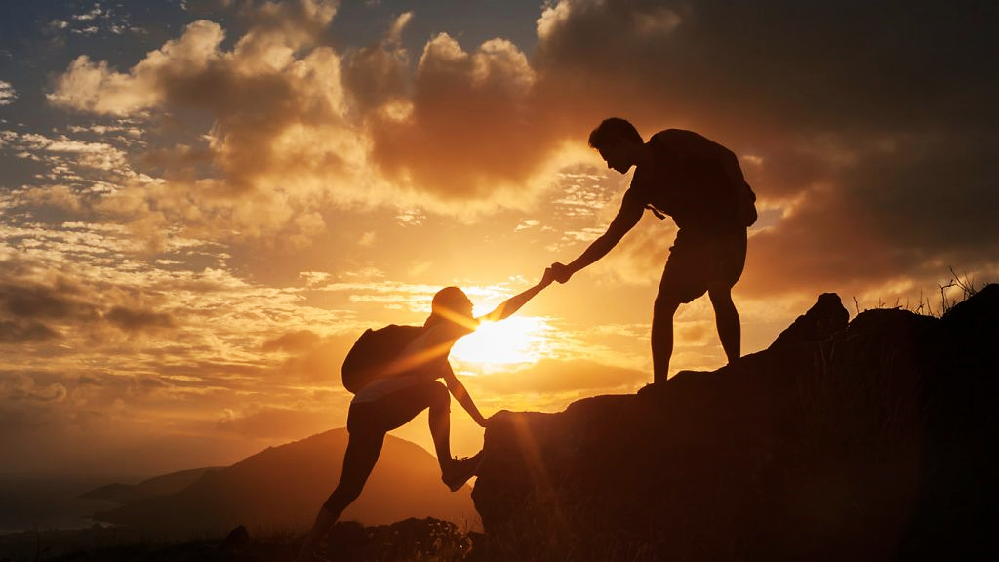
The helper
They are kind, generous, warm-hearted, and loving at their best

Slide 7

The Achiever
A person who achieves a high or specified level of success.

Slide 8

The Romantic
Having a quality that strongly affects your emotions or makes you think about love; showing feelings of love.

Slide 9

The observer
A person who watches somebody/something.

Slide 10

The Questioner
A person who asks questions, especially in an official context.

Slide 11
Thank you

