Slide 1
VFX in Movies
by
Mr.S.SUBRAMANIAN

Slide 2
What is VFX ?
Visual effects (VFX) is a term used to describe imagery created, manipulated, or enhanced for any film, or other moving media that doesn't take place during live-action shooting. VFX often involves the integration between actual footage and this manipulated imagery to create realistic looking environments for the context. These environments created are either too dangerous to actually shoot, or worlds that just don’t exist. They use computer-generated imagery (CGI), and particular VFX software to make it happen. VFX producers communicate with directors and cinematographers to determine which scenes require them to shoot with green screens.
Visual effects are different from special effects because visual effects require a computer and are added in after shooting. Special effects, or SFX are realized on set — they are things like purposeful and controlled explosions, fake gunshot wounds, etc.
An example of VFX would be the dragons flying through the sky in Game of Thrones, or a spaceship flying through space in Star Wars.

Slide 3
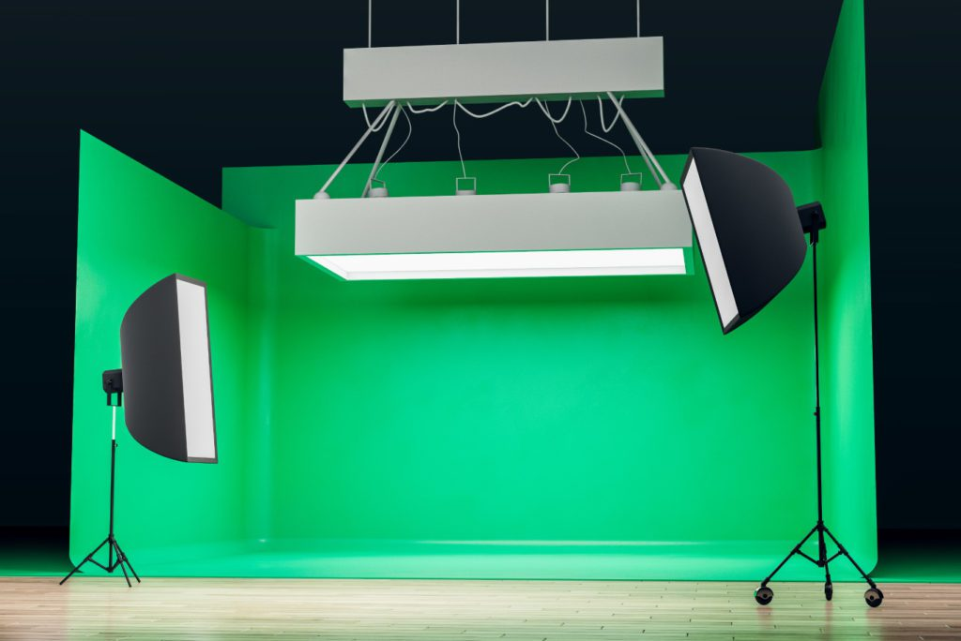
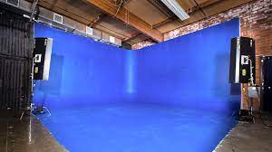
Green Screen Blue Screen

Slide 4
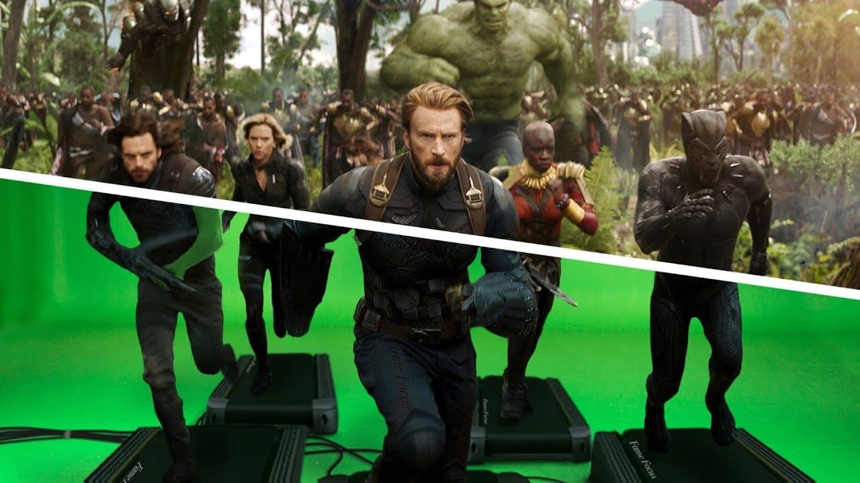

Slide 5






Learn how to use
green screen technology

Slide 6
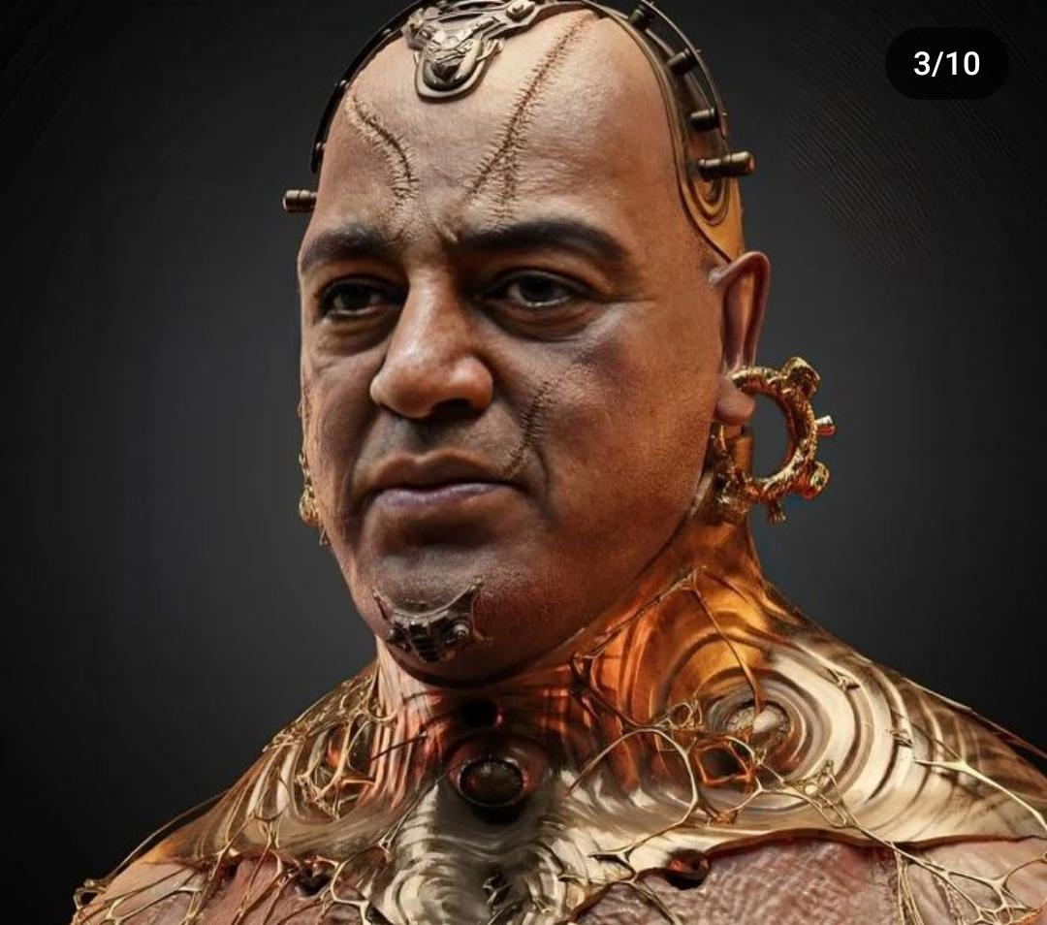
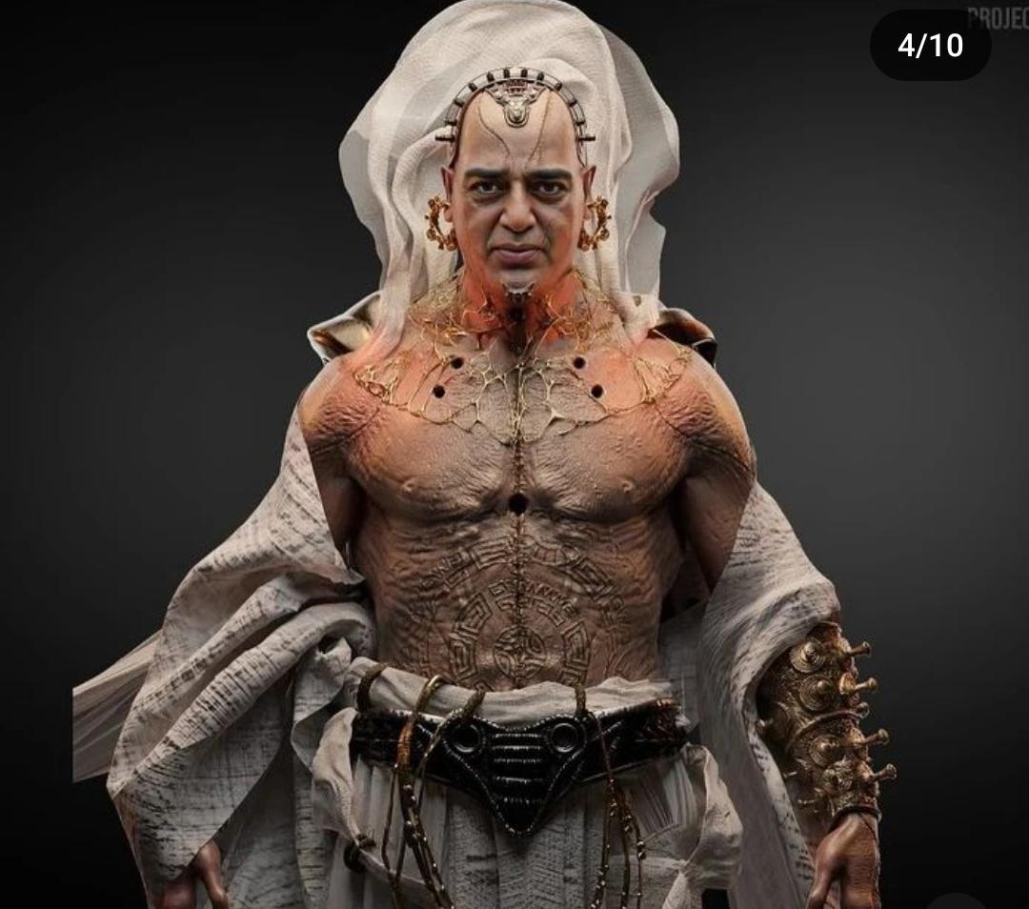

Slide 7
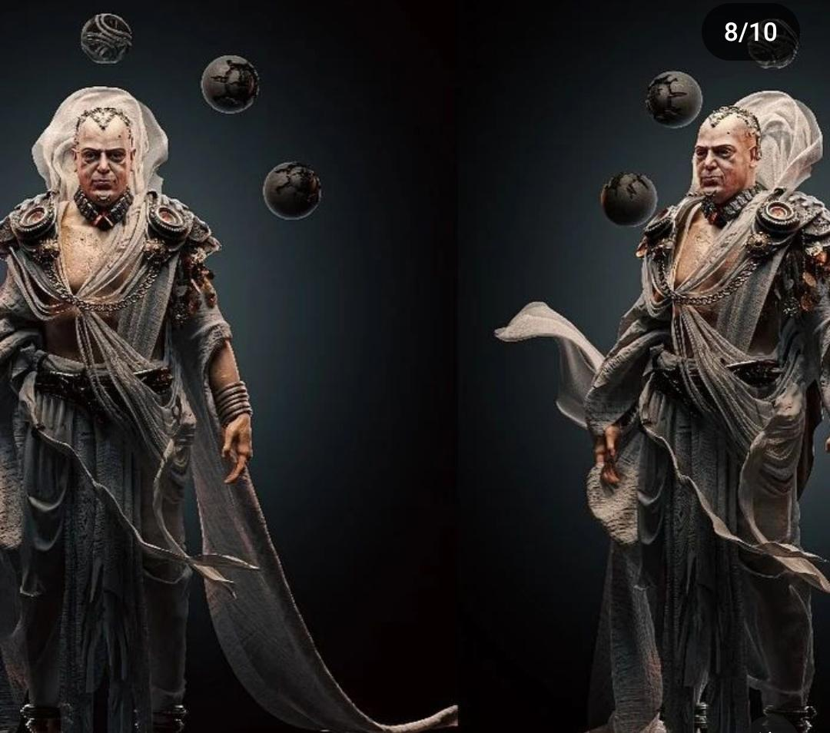
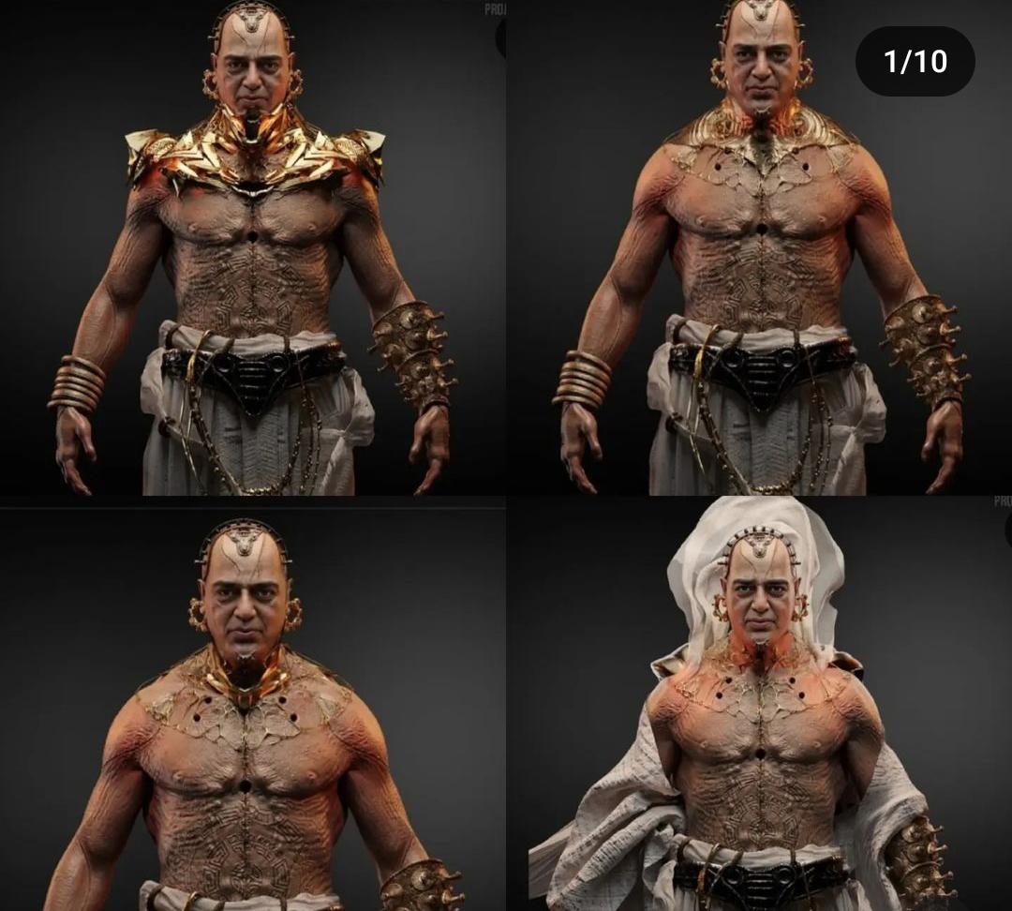

Slide 8
Softwares used for VFX
Adobe After Effects.
Blackmagic Design: Fusion.
Apple Final Cut Pro Motion.
HitFilm Pro.
Filmora Pro.
Blender.
Autodesk Maya.

Slide 9
Jobs in VFX we have scope
Multimedia specialist.
Advertising art director.
Music producer.
Production designer.
Film director.
Film/video editor.
TV production coordinator/producer.

Slide 10
Thank you

