Slide 1

INRODUCTION TO CONTROL CHARTS

Slide 2
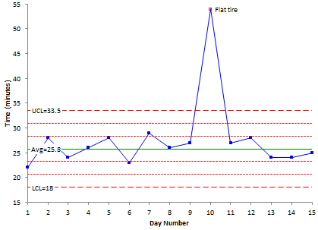
WHAT ARE CONTROL CHARTS?
A control chart is used to monitor a process variable over time. That variable can be in any type of company or organization - service, manufacturing, non-profit and, yes, healthcare.

Slide 3
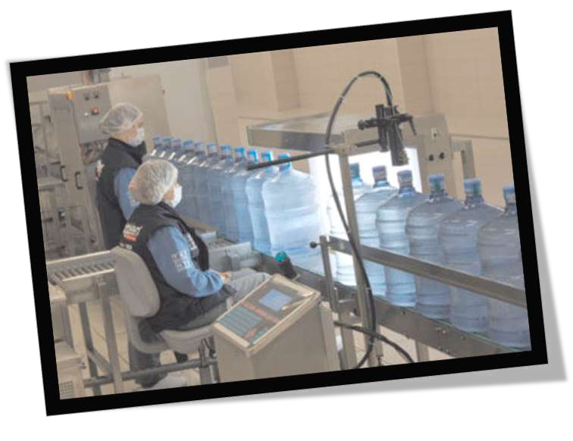
INSPECTION BEING DONE IN INDUSTRIES TO FIND THE PROCESS CAPABILITY OF THE PROCESS

Slide 4
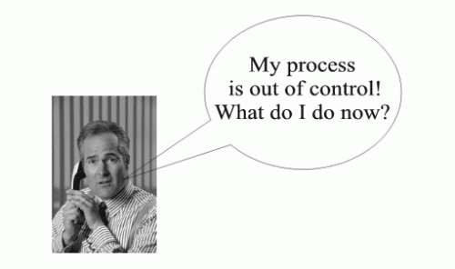
WHAT DO CONTROL CHARTS TELL US???
When our control charts show us that there is an out-of- control situation, it is the responsibility of those people closest to the process to find the cause for the out-of- control situation and eliminate the cause from the process. This prevents the cause from occurring again.

Slide 5
WHY USE CONTROL CHARTS?
Monitor process variation over time
Differentiate between special cause and common cause variation
Assess effectiveness of changes
Communicate process performance

Slide 6

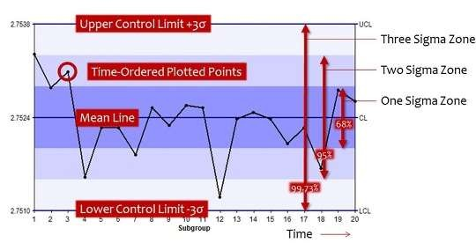
CONTROL CHART CONTAINS:-

Slide 7
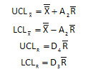
BASIC COMPONENTS OF CONTROL CHARTS:-
A centerline, usually the mathematical average of all the samples plotted.
Lower and upper control limits defining the constraints of common cause variations.
Performance data plotted over time.

Slide 8
CONSTRUCTING A CONTROL CHART:-
Select the process you would like to chart
Determine your process sampling plan
Collect data from your process
Calculate the control chart specific statistics
Calculate your control limits
Construct your control chart

Slide 9

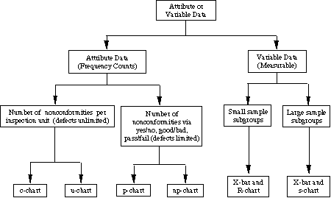
TYPES OF CONTROL CHARTS?

Slide 10
Variables Data:
This category of Control Chart displays values resulting from the measurement of a continuous variable. Examples of variables data are elapsed time, temperature, and radiation dose.
Attribute Data:
This category of Control Chart displays data that result from counting the number of occurrences or items in a
single category of similar items or occurrences. These “count” data may be expressed as pass/fail, yes/no, or
presence/absence of a defect.

Slide 11
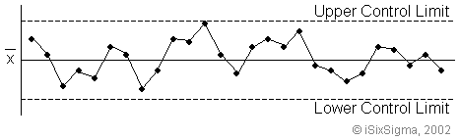

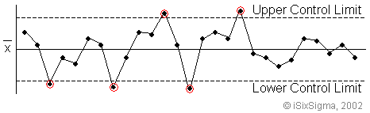
In Control Process Control Chart
Out Of Control Process Control Chart

Slide 12
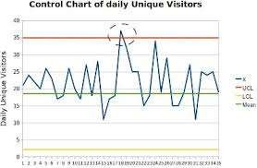


Find the cause for out of control process and eliminate cause from process.
Out Of Control Process Chart:-

Slide 13
TYPES OF CAUSES FOR VARIATIONS:-
Common Causes
Measurement error.
Vibration in industrial processes.
Ambient temperature and humidity.
Insufficient training.
Normal wear and tear.
Variability in settings.
Computer response time
Special Causes
Operator absent.
Poor adjustment of equipment.
Operator falls asleep.
Faulty controllers.
Machine malfunction.
Computer crashes.
Poor batch of raw material.

Slide 14
THANK YOU

