Slide 1

Python - Matplotlib
EBENEZER.p

Slide 2
Matplot Library
Matplotlib is a python library used to create 2D graphs and plots by using python scripts. It has a module named pyplot which makes things easy for plotting by providing feature to control line styles, font properties, formatting axes etc. It supports a very wide variety of graphs and plots namely - histogram, bar charts, power spectra, error charts etc. It is used along with NumPy to provide an environment that is an effective open source alternative for MatLab.

Slide 3
Matplotlib Example
The following script produces the sine wave plot using matplotlib.
import numpy as np
import matplotlib.pyplot as plt
# Compute the x and y coordinates for points on a sine curve
x = np.arange(0, 3 * np.pi, 0.1)
y = np.sin(x)
plt.title("sine wave form")
# Plot the points using matplotlib
plt.plot(x, y)
plt.show()

Slide 4

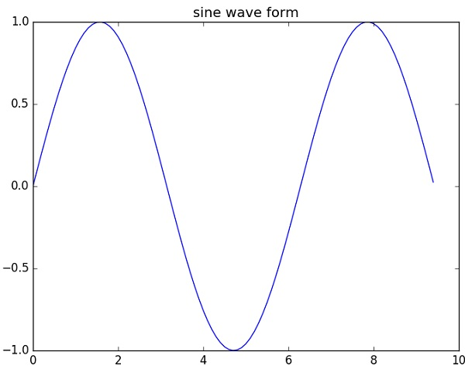
output is as follows;

