Slide 1
A PRIVACY PRESERVING REMOTE DATA INTEGRITY CHECKING PROTOCOL WITH DATA DYNAMICS AND PUBLIC VERIABILITY

Slide 2
A PRIVACY PRESERVING REMOTE DATA INTEGRITY CHECKING PROTOCOL WITH DATA DYNAMICS AND PUBLIC VERIABILITY
DONE BY
E. MONISHA
II MSC.Computer science

Slide 3
ABSTRACT
Storing data in the cloud has become a trend. An increasing number of clients store their important data in remote servers in the cloud, without leaving a copy in their local computers. Sometimes the data stored in the cloud is so important that the clients must ensure it is not lost or corrupted.
While it is easy to check data integrity after completely downloading the data to be checked, downloading large amounts of data just for checking data integrity is a waste of communication bandwidth. Hence, a lot of works have been done on designing remote data integrity checking protocols, which allow data integrity to be checked without completely downloading the data.
Remote data integrity checking is first introduced in which independently propose RSA-based methods for solving this problem. After that propose a remote storage auditing method based on pre-computed challenge-response pairs.
Recently many works focus on providing three advanced features for remote data integrity checking protocols: data dynamic, public verifiability and privacy against verifiers.
The system in support data dynamics at the block level, including block insertion, block modification and block deletion. It supports data append operation. In addition, can be easily adapted to support data dynamics.Can be adapted to support data dynamics by using the techniques.
On the other hand, Itsupport public verifiability, by which anyone (not just the client) can perform the integrity checking operation. The system in support privacy against third party verifiers. Compare the proposed system with selected previous system.

Slide 4
EXISTING SYSTEM
In existing system, the clients store the data in server that server is trustworthy and after the third party auditor can audit the client files. So, the third party auditor can stolen the files.
DISADVANTAGE:
Existing system can support both features with the help of a third party auditor.

Slide 5
PROPOSED SYSTEM
Consider a cloud storage system in which there are a client and an untrusted server. The client stores their data in the server without keeping a local copy. Hence, it is of critical importance that the client should be able to verify the integrity of the data stored in the remote untrusted server. In case a third party verifier verifies the integrity of the client’s data, the data should be kept private against the third party verifier.
ADVANTAGES:
Proposed system has the following main contributions:
Remote data integrity checking protocol for cloud storage. The proposed system inherits the support of data dynamics, and supports public verifiability and privacy against third-party verifiers, while at the same time it doesn’t need to use a third-party auditor.
Security analysis of the proposed system, which shows that it is secure against the untrusted server and private against third party verifiers.

Slide 6
PROBLEM DEFINITION AND SOLUTION
There is no secure from the third party auditor it may chance to access the user’s data.we can secure data from server only. In this proposed system we can secure from third party auditor using security analysis and find the untrusted server with help of third party auditor.

Slide 7
SYSTEM ANALYSIS
HARDWARE REQUIREMENTS:
SYSTEM : Pentium IV 2.4 GHz.
HARD DISK : 40 GB.
MONITOR : 15 VGA Colour.
MOUSE : Touch Pad.
RAM : 512 Mb.

Slide 8
SOFTWARE REQUIREMENTS:
OPERATING SYSTEM : Windows 7 and above.
CODING LANGUAGE : ASP.Net with C#
DATA BASE : SQL Server 2008.
FRONT END : visual studio 2010

Slide 9
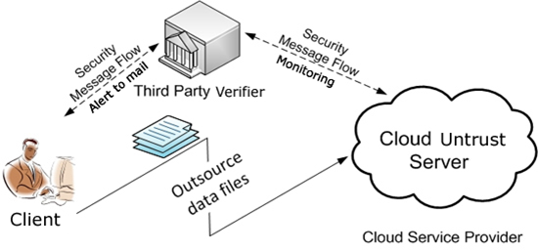
SYSTEM DESIGN
ARCHITECTURAL DIAGRAM
:

Slide 10
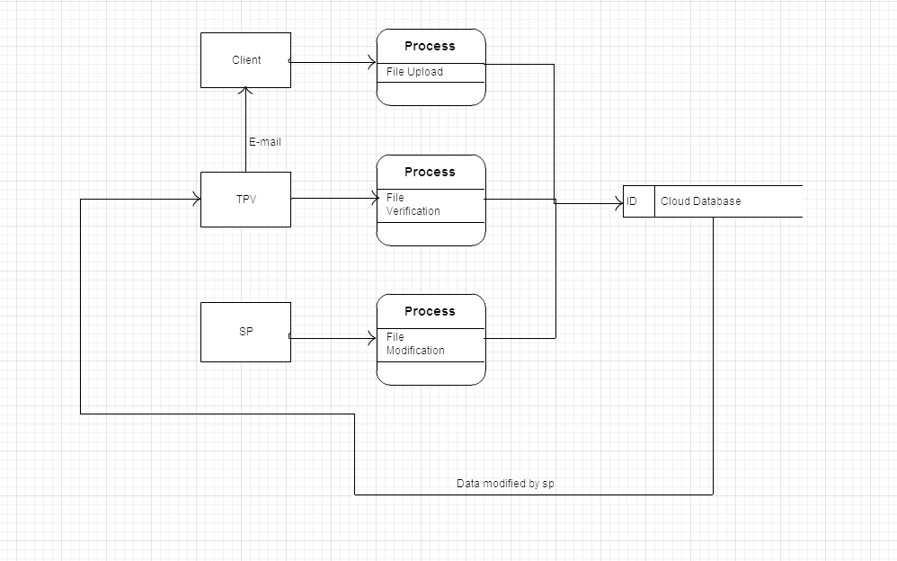
DATA FLOW DIAGRAM

Slide 11
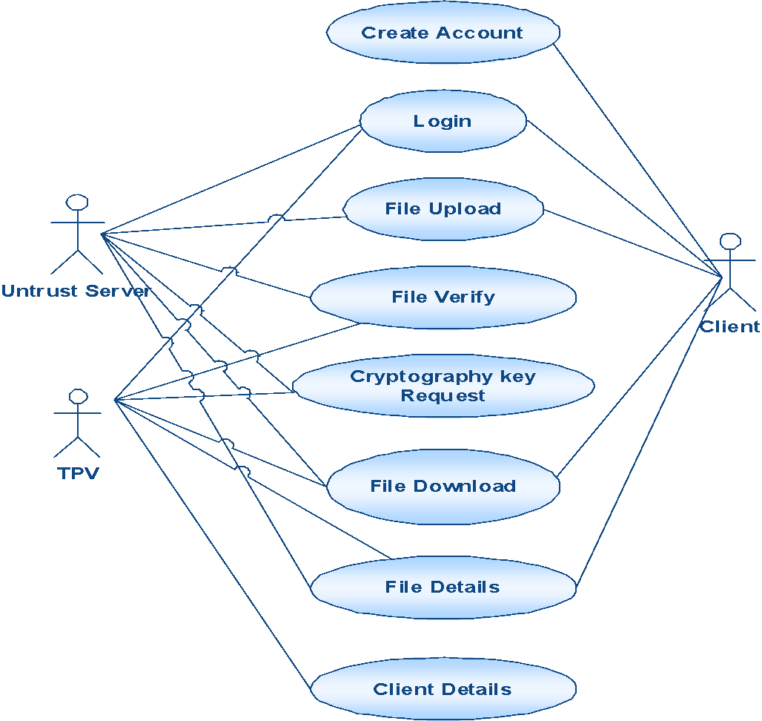
UML DIAGRAM

Slide 12
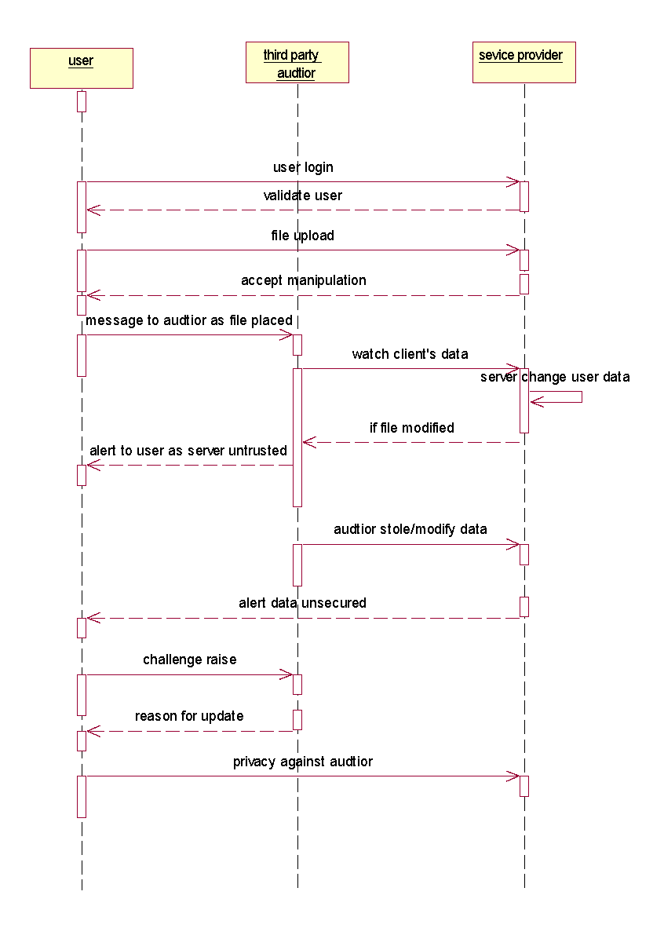
SEQUENCE DIAGRAM

Slide 13
MODULES EXPLANATION
Modules:
Data Dynamics
Block Insertion
Block Modification
Block Deletion
public verifiability
Metadata Generation
Privacy against Third Party Verifiers

Slide 14
Data Dynamics:
Data dynamics means after clients store their data at the remote server, they can dynamically update their data at later times. At the block level, the main operations are block insertion, block modification and block deletion.
Block Insertion:
The Server can insert anything on the client’s file.
Block Deletion:
The Server can delete anything on the client’s file.
Block Modification:
The Server can modify anything on the client’s file

Slide 15
2. Public verifiability:
Each and every time the secret key sent to the client’s email and can perform the integrity checking operation. In this definition, we have two entities: a challenger that stands for either the client or any third party verifier, and an adversary that stands for the untrusted server. Client doesn’t ask any secret key from third party.

Slide 16
3. Metadata key Generation:
Let the verifier V wishes to the store the file F. Let this file F consist of n file blocks. We initially preprocess the file and create metadata to be appended to the file. Let each of the n data blocks have m bits in them. A typical data file F which the client wishes to store in the cloud.
Each of the Metadata from the data blocks m_{i} is encrypted by using a suitable algorithm to give a new modified Metdata M_{i}. Without loss of generality we show this process. The encryption method can be improvised to provide still stronger protection for Client’s data. All the Metadata bit blocks that are generated using the procedure are to be concatenated together. This concatenated Meta data should be appended to the file F before storing it at the cloud server. The file F along with the appended Meta data with the cloud.

Slide 17
4. Privacy against Third Party Verifiers:
Under the semi-honest model, a third party verifier cannot get
Any information about the client’s data m from the protocol execution. Hence, the protocol is private against third party verifiers. If the server modifies any part of the client’s data, the client should be able to detect it; furthermore, any third Party verifier should also be able to detect it. In case a third party verifier verifies the integrity of the client’s data, the data should be kept private against the third party verifier.

Slide 18
CONCLUSION
The proposed system is suitable for providing integrity protection of customers important data. The proposed system supports data insertion, modification and deletion at the block level, and also supports public verifiability. The proposed system is proved to be secure against an untrusted server. It is also private against third party verifiers. Both theoretical analysis and experimental results demonstrate that the proposed system has very good efficiency in the aspects of communication, computation and storage costs. Currently are still working on extending the protocol to support data level dynamics. The difficulty is that there is no clear mapping relationship between the data and the tags. In the current construction, data level dynamics can be supported by using block level dynamics. Whenever a piece of data is modified, the corresponding blocks and tags are updated. However, this can bring unnecessary computation and communication costs.

