Slide 1
ORGANIZATIONAL CHANGE

Slide 2
ORGANISATION
Organization is a social system.
All parts of organization affect all other parts
Anything happening at one end is transmitted to the other end
Interrelationship between the elements & environment
Disturbance to this naturally exercises pressure
Evokes a reaction – acceptance/rejection

Slide 3
CHANGE
Alternation which occurs in the overall work environment of an organization
‘Change is the law of nature’
Nothing is permanent except change
  Change often results from the pressure of forces which are both outside and inside the organisation;
  The whole organisation tends to be affected by the change in any
part of it; and
  Change takes place in all parts of the organisation, but at varying rates of speed and degrees of significance.

Slide 4
EXTERNAL & INTERNAL FORCES
External Forces
  Macro environment (PEST factors)
  Micro Environment (Consumers, Suppliers, Stake Holders)
  Opportunities & Threats (SWOT)
Internal Forces
  Internal Environment (Men, Money, Machinery, Materials, Minutes)
  Strengths & Weaknesses (SWOT)

Slide 5
CHANGE IN AN ORGANIZATION
It is in a constant interactional and interdependent relationship with its environment
  Change in its external environment, such as changes in consumer tastes and preferences, competition, economic policies of the Government, etc., make it imperative for an organisation to make changes in its internal system
Composed of a number of subsystems which are also in a dynamic relationship of interaction and interdependence with one another
  Any change in a subsystem creates a chain of changes throughout the entire system

Slide 6
CONCEPT OF ORGANISATIONAL CHANGE
‘Organisational change’ implies the creation of imbalances in the existing pattern of situation
Operations & Functions for a long time establishes structural set-up
Members evolve a tentative set of relations with the environment, adjustment with job, working conditions, friends and colleagues etc.
Change requires individuals to make new adjustments. Hence the fear of adjustment gives rise to the problem of change and resistance to change

Slide 7
FORCES FOR CHANGE
External Forces
  Demographic characteristics,
  Technological advances,
  Market changes, and
  Social and political pressures
Internal Forces
.
Human resource problems and Prospects
Managerial behavior/decisions

Slide 8
LEVELS OF CHANGE
(a) Individual Level Change
  Job assignment, physical Move, Change in maturity of a person
  Not significant on organisation, but significant on group
b) Group Level Changes
  Major effect because organizational activities are done in groups like departments or informal groups
  affect workflows, job design, social organisation, influence and
status systems, and communication patterns.
  Managers must consider group factors
(c) Organization Level Changes
  involves major programs that affect both individuals and groups
  Decisions regarding these changes are generally made by senior management and are seldom implemented by only a single manager

Slide 9
TYPES OF CHANGE
a) Strategic Change
  Change in the mission (when acquired)
b) Structural Change
  Decentralization
c) Process-oriented Change
  In manufacturing operations
d) People-oriented Change
  Self – actualization (Motivation, Loyalty, Training, Relationships)

Slide 10
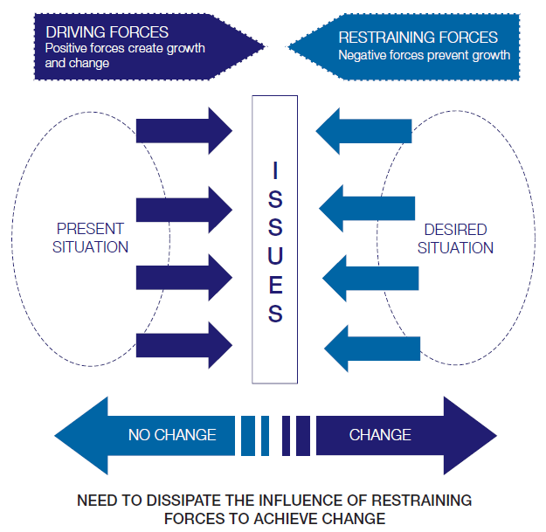
LEWIN – FORCE FIELD ANALYSIS

Slide 11
DRIVING & RESTRAINING FORCES FOR CHANGE
Force field analysis looks at the forces that are either driving movement towards a change or goal or are blocking (restraining) movement towards a change or goal.

Slide 12
FORCES FOR CHANGE
Driving forces
supportive culture
Participative management style
Communication
Restraining forces
Apathy
Hostility
Poor working conditions

Slide 13
IMPLEMENTING CHANGE SUCCESSFULLY
Successful implementation of change requires knowledge about the change process
The change process, propounded by Kurt Lewin,
consists of 3 stages:
  (1)unfreezing,
  (2) changing,
  (3) refreezing
Unfreezing
Changing
Refreezing
Recognising the need for change, casting aside old values, behaviour, or Organisational structures
New values, behaviours and structures replace old ones. Action oriented
Making change permanent . Practice what was learnt in the second stage

Slide 14
STEPS IN MANAGED CHANGE
Need for change can be identified either through internal factors or through external forces that may be in place. Once this need is identified, the following steps can be taken to implement such change:
  1. Develop new goals and objectives
  2. Select an agent for change
  3. Diagnose the problem
  4. Select methodology
  5. Develop a plan
  6. Strategy for implementation of the plan
  7. Implementation of the plan
  8. Receive and evaluate feedback

Slide 15
RESISTANCE TO CHANGE
Resistance to change - a natural phenomenon
Not all change is resisted
In organisation changes are accepted than resisted
Acceptance to change is Adaption
Resistance to change is Unnatural behavior
Failure to understand this characteristic of resistance can cause many managers to attempt to run through changes rather than try to understand the sources of the resistance.

Slide 16
SOURCES OF RESISTANCE TO CHANGE MAY BE
RATIONAL OR EMOTIONAL.
Rational resistance  Emotional resistance
occurs when people do not have the proper knowledge or information to evaluate the change.
Providing information (in the form of data, facts, or other types of concrete information) reduces the resistance
involves the psychological problems of fear, anxiety, suspicion, insecurity, and the like.
These feelings are evoked because of people’s perception of how the change will affect them.

Slide 17
(A) CAUSES OF RESISTANCE
All changes are not resisted. Some are wanted by the workers
Resistance to change is caused by individual’s attitudes which are influenced by:
  1. Economic Factors
    Workers apprehend technological unemployment.
  2. Psychological Factors
    Fear of psychological needs affected (sense of pride, achievement, self-fulfilment)
  3. Social Factors
    social needs like friendship, belongingness (informal groups)

Slide 18
(B) SYMPTOMS OF RESISTANCE
Hostility or aggression is the immediate reaction
Apathy towards his work
Absenteeism and tardiness
Anxiety and tension
Signs of resistance (strikes, “restriction of output”)

Slide 19
(C) BENEFITS OF RESISTANCE
Contrary to popular opinion, resistance to change is not bad.
Resistance can bring some benefits:
  Encourage the management to re-examine its change proposals
  Identify specific problem areas where change is likely to
cause difficulties
  Encouraged to do a better job of communicating the change
  Resistance also gives management information about the intensity of employee emotions on an issue
  Encourage employee to think and talk more about a change

Slide 20
IMPLEMENTING CHANGE SUCCESSFULLY
Successful implementation of change requires knowledge about the change process
The change process, propounded by Kurt Lewin,
consists of 3 stages:
  (1)unfreezing,
  (2) changing,
  (3) refreezing
Unfreezing
Changing
Refreezing
Recognising the need for change, casting aside old values, behaviour, or Organisational structures
New values, behaviours and structures replace old ones. Action oriented
Making change permanent . Practice what was learnt in the second stage

Slide 21
METHODS OF INTRODUCING CHANGE
Kotter and Schlisinger have suggested six methods of introducing change
  1. Education + Communication
  2. Participation + involvement
  3. Facilitation+ Support
  4. Negotiation + Agreement
  5. Manipulation + cooptation
  6. Explicit + implicit coercion

Slide 22
HOW TO MAKE THE CHANGE THE PERMANENT
Use of group forces,
Use of leadership,
Shared rewards,
Working with unions, and
Concern for employees.

Slide 23
THANK YOU……

