Slide 1
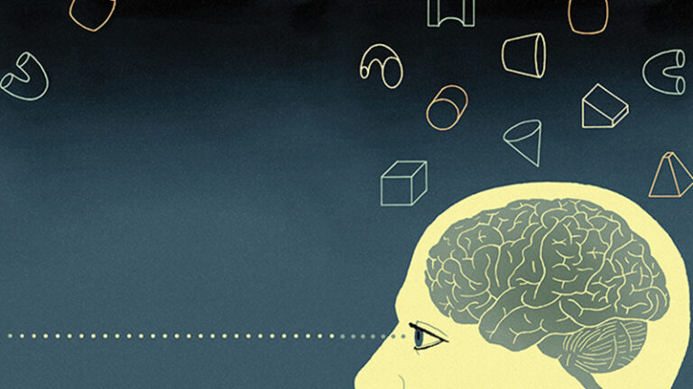
Neural Approach on Pattern Recognition.
EBENEZER

Slide 2

CONTENTS
Introduction
What is Pattern Recognition?
Features of Pattern Recognition
Training a Pattern Recognition system
How does it work?
Conclusion

Slide 3

INTRODUCTION
Machine Learning[ML] & Deep Learning[DL].
DL is a subset of ML
Mimics the human brain.
The system has enough computing power and enough data for processing.
Notes:
EXAMPLE : CANCER human will recognize it is only cancer but system will recognize what type of cancer it is

Slide 4

What is pattern recognition?
Process of finding regularities and similarities in data.
These similarities can be found based on statistical analysis, historical data.
A pattern is a regularity in the world or in abstract notions.
Example : Speech recognition, speaker identification, Automatic Medical Diagnosis.
Notes:
Youtube if we want any games videos or any dressing videos it will recognize our wishes and it will show the output this is also known as pattern recognition

Slide 5
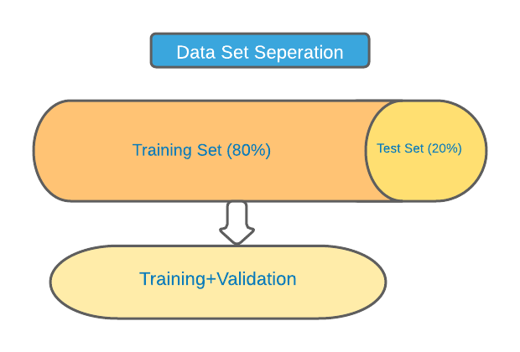

Training a pattern recognition system
Notes:
Data set separation - filter of data
The filtered data will take into training set it will complete 80% of function and it will decide the value will come or not it will decide in another 20%
And all the data will go into the validation process
And the desired output will come

Slide 6

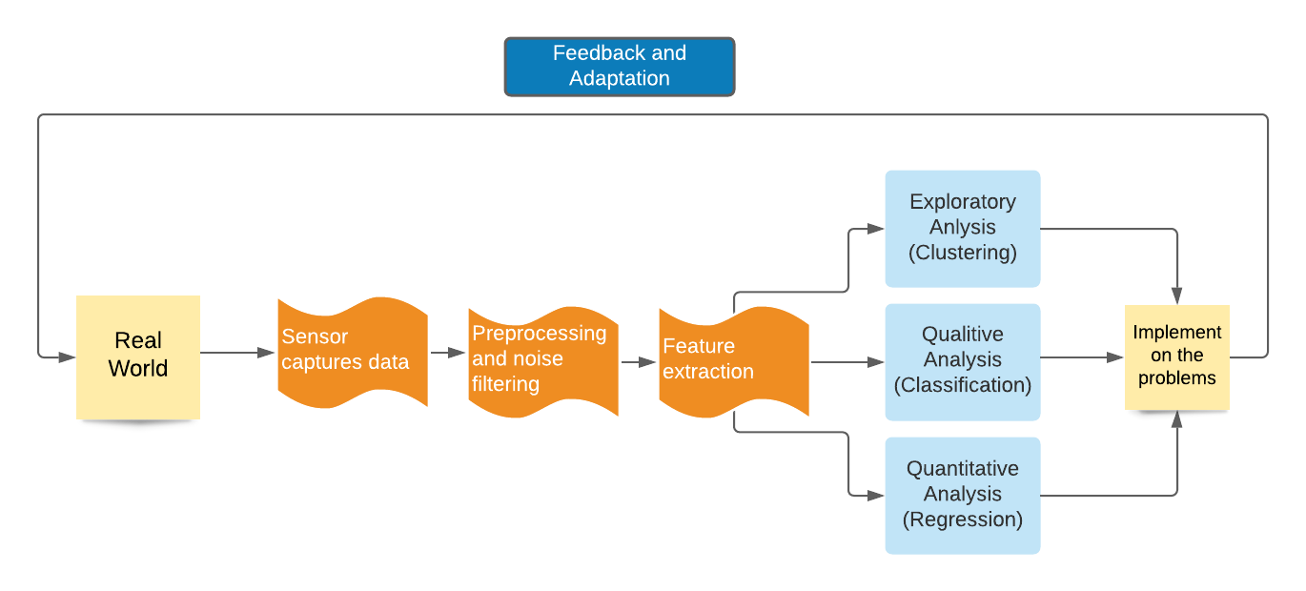
How does it work?

Slide 7

Conclusion
REFRENCE:
https://www.geeksforgeeks.org/pattern-recognition-introduction/
https://serokell.io/blog/pattern-recognition
https://ubiquity.acm.org/article.cfm?id=985625
Notes:
This is a vast subject if u want to learn further u guys can refer these website
If any querris or any suggestion you can give

Slide 8
THANK YOU

