Slide 1
Personality development
The Main body of The Resume
- Syed sathiq K

Slide 2
The Main body of The Resume
The body of the resume should include your
Work experience,
Educational background,
Skills,
Extracurricular activities,
Additional certificates and projects,
Awards and achievements.

Slide 3
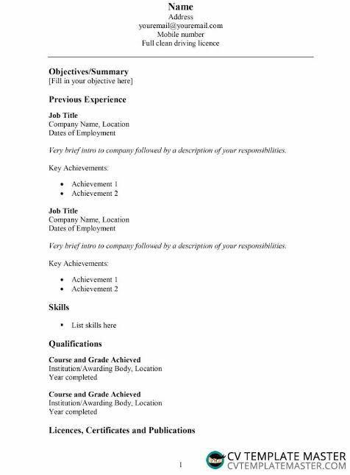

Slide 4
Work experience
Begin each item by stating the
Name of the place,
Location,
Dates,
Job title

Slide 5
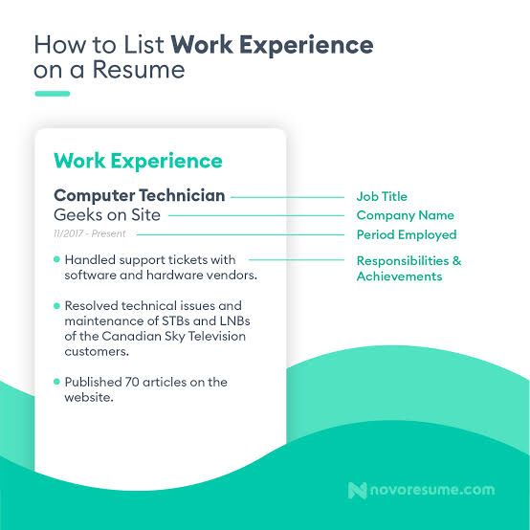

Slide 6
educational background
Your graduation,
Class 12th or equivalent qualification, and
Class 10th or equivalent qualification will all be mentioned in the bullet points (optional).

Slide 7
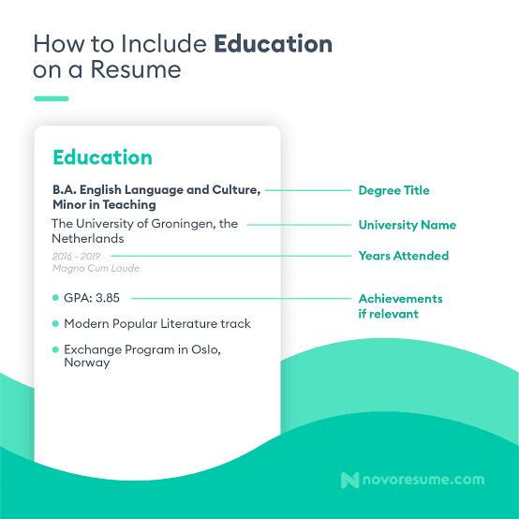

Slide 8
Skills
Self-motivation,
Flexibility and adaptability,
Creativity,
Public speaking skills,
Data analysis skills,
Project management skills.

Slide 9
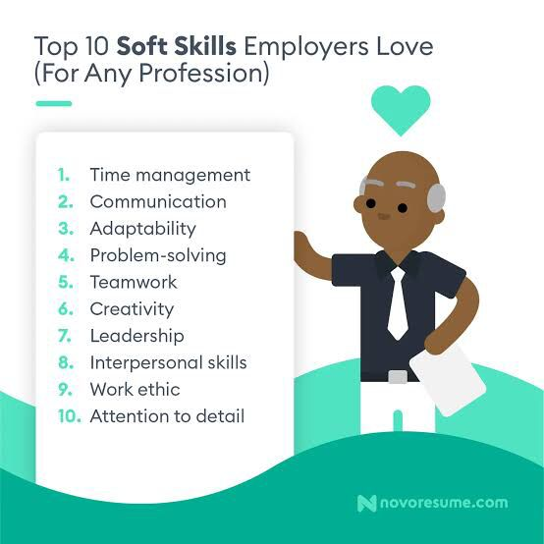

Slide 10
Extracurricular Activities
Great examples of extracurricular activities for your resume/CV
Student Council
Clubs/Societies
Multicultural Organizations
Foreign Languages
Study Abroad Experience
Sports Teams

Slide 11
Tutoring
Volunteer Activities/Organizations
(Non-)Academic Competitions
Government-Related Activities

Slide 12
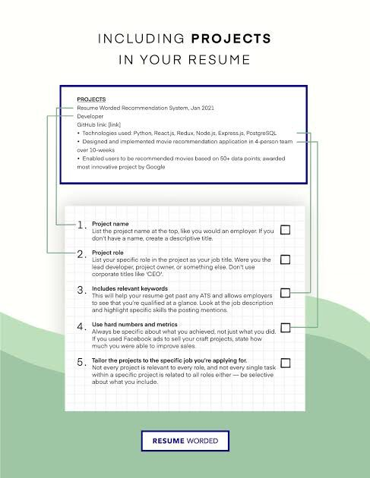
Projects & Certifications :

Slide 13
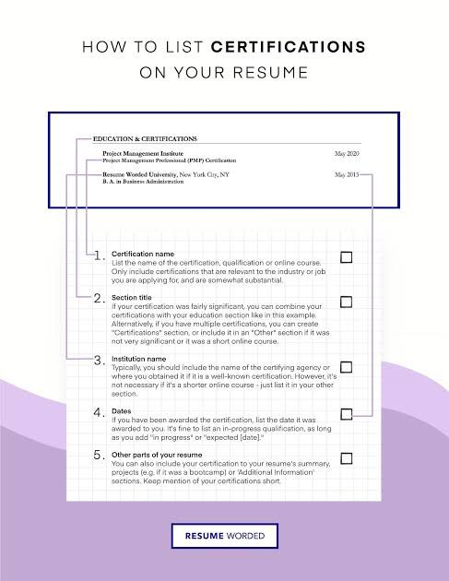

Slide 14
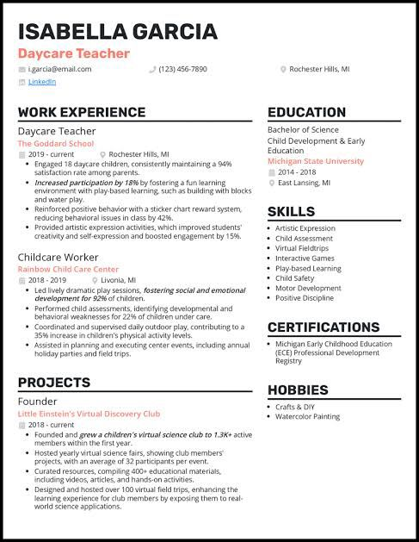
Example of Resume :

Slide 15
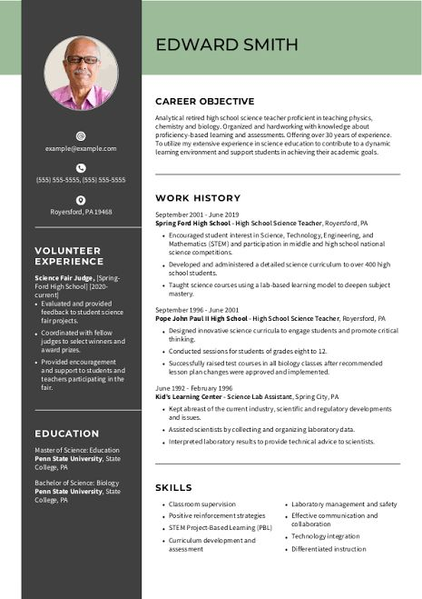

Slide 16
Thank You

