Slide 1
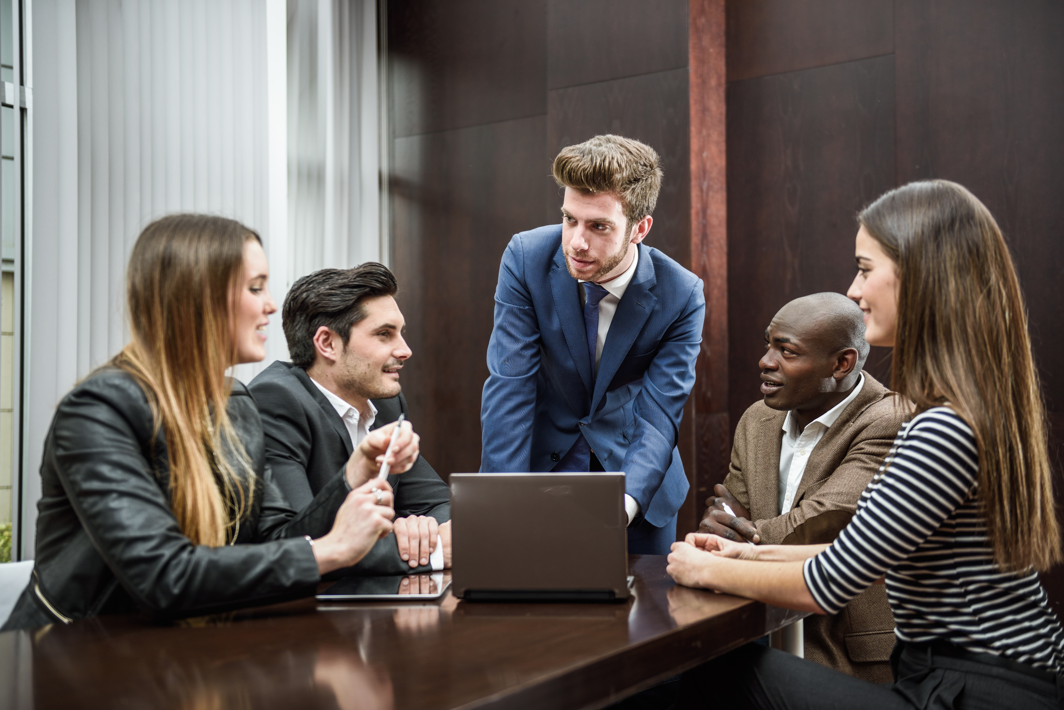
ABILITY TO WORK AS A TEAM
R.GNANARAJ

Slide 2
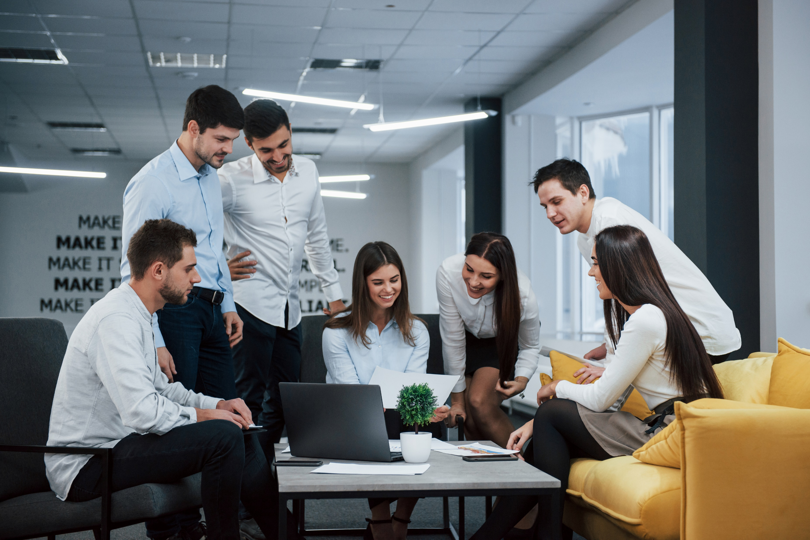
TEAMWORK SKILL
Teamwork skills are the qualities and abilities that allow you to work well with others during conversations, projects, meetings or other collaborations. Having teamwork skills is dependent on your ability to communicate well, actively listen and be responsible and honest.

Slide 3
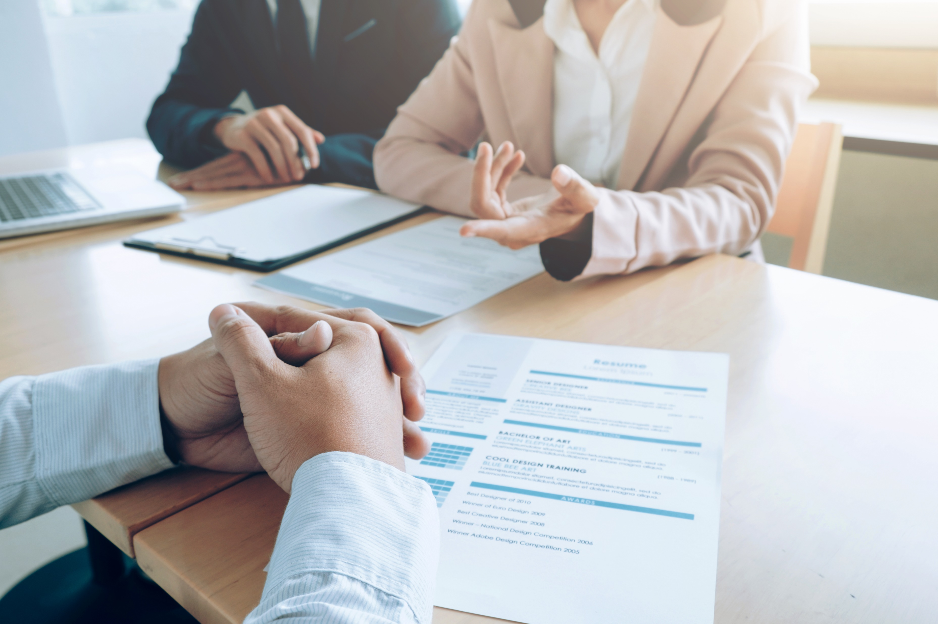
Doing so in an empathetic, efficient and responsible manner can help you accomplish career goals, grow your resume and contribute positively to your organization. It can also help you build rapport with others.

Slide 4
Examples of teamwork skills

Slide 5
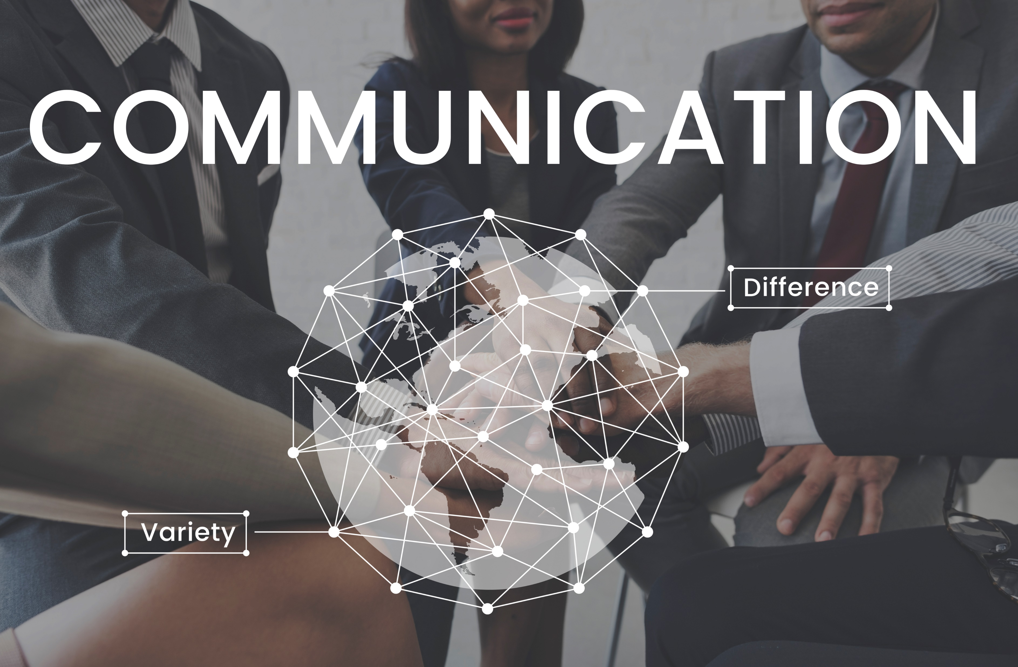
1. Communication
The ability to communicate in a clear, efficient way is a critical teamwork skill. When working with others, it is important that you share relevant thoughts, ideas and key information.

Slide 6
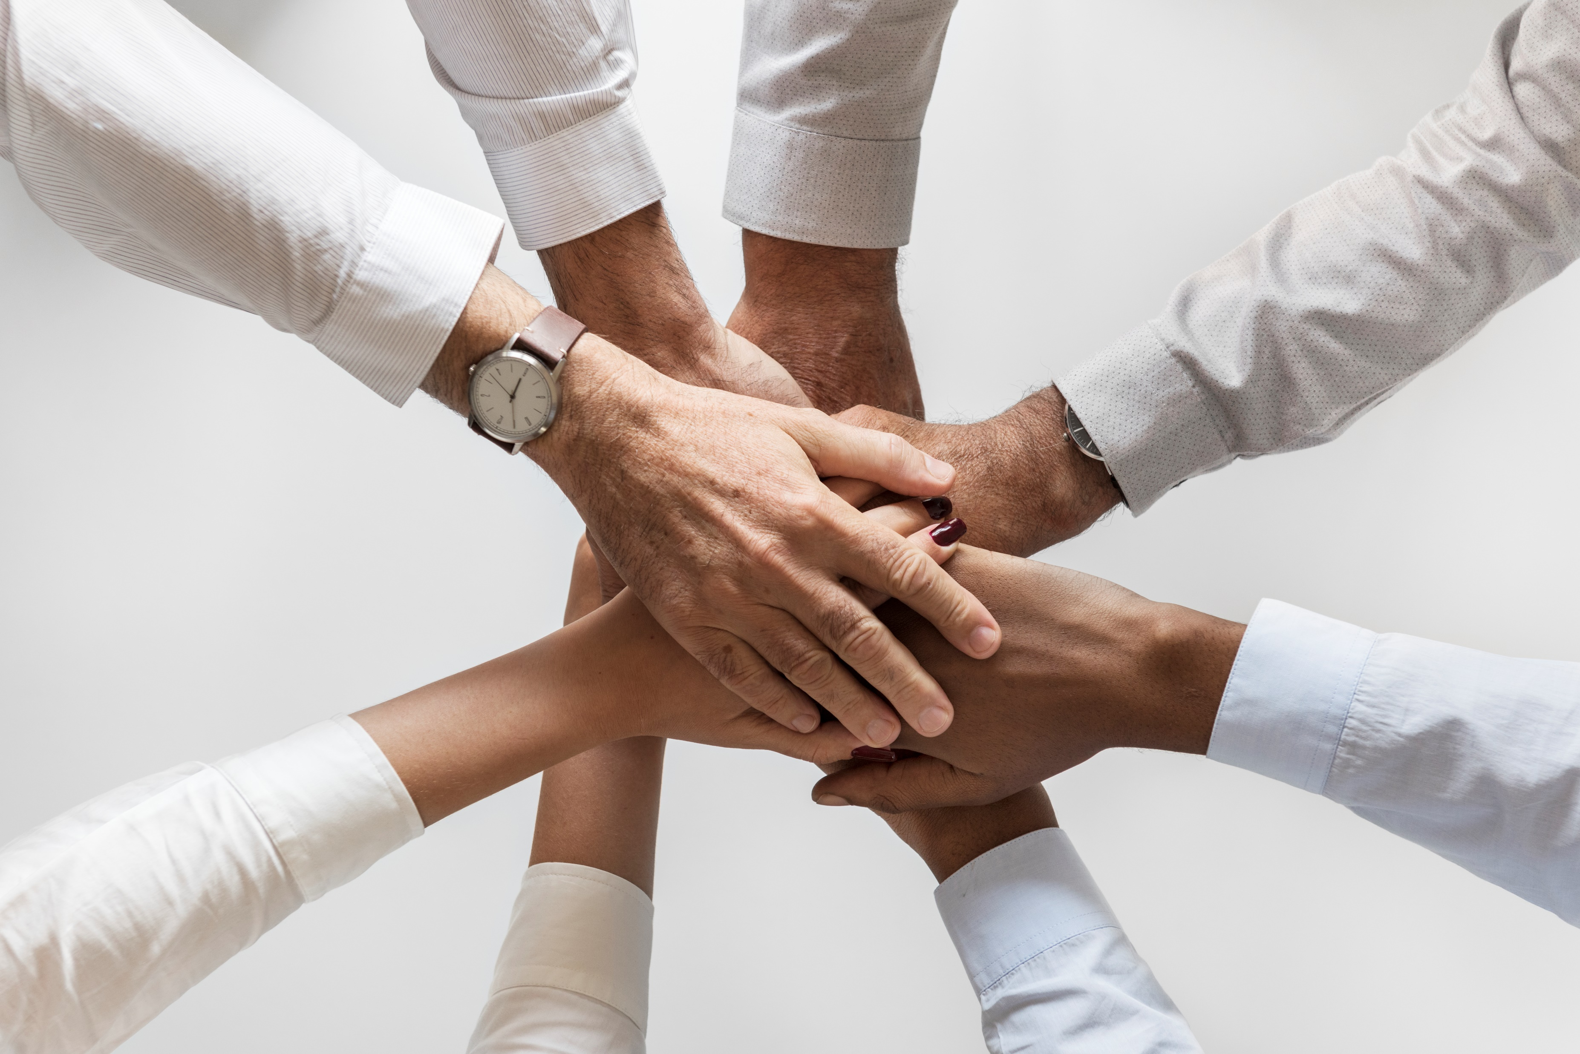
2. Responsibility
Within the dynamic of teamwork, it is important that the parties involved both understand the work they are responsible for and make the effort to complete said tasks on time and up to the expected standard.

Slide 7
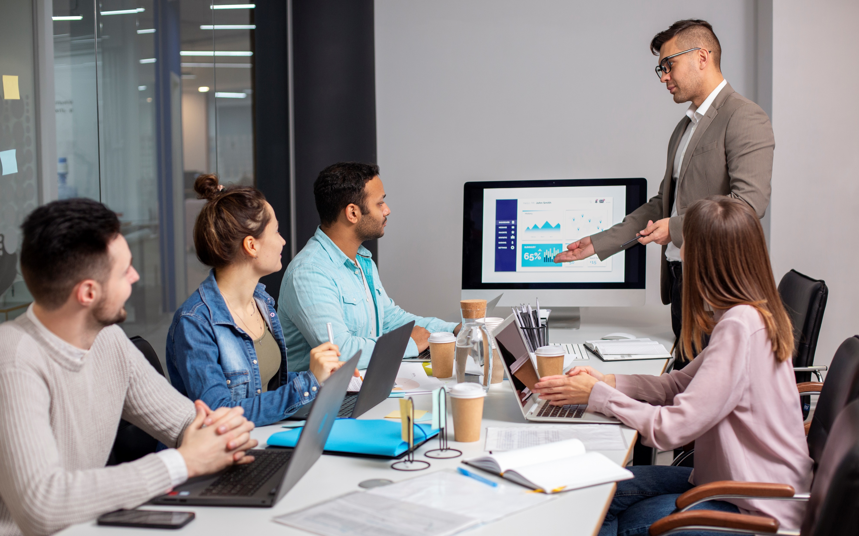
3. Active listening
Active listening is the act of making an effort to focus intently on one person as they share their ideas, thoughts or feelings. You might also ask follow-up questions to dig deeper into what they are communicating.

Slide 8
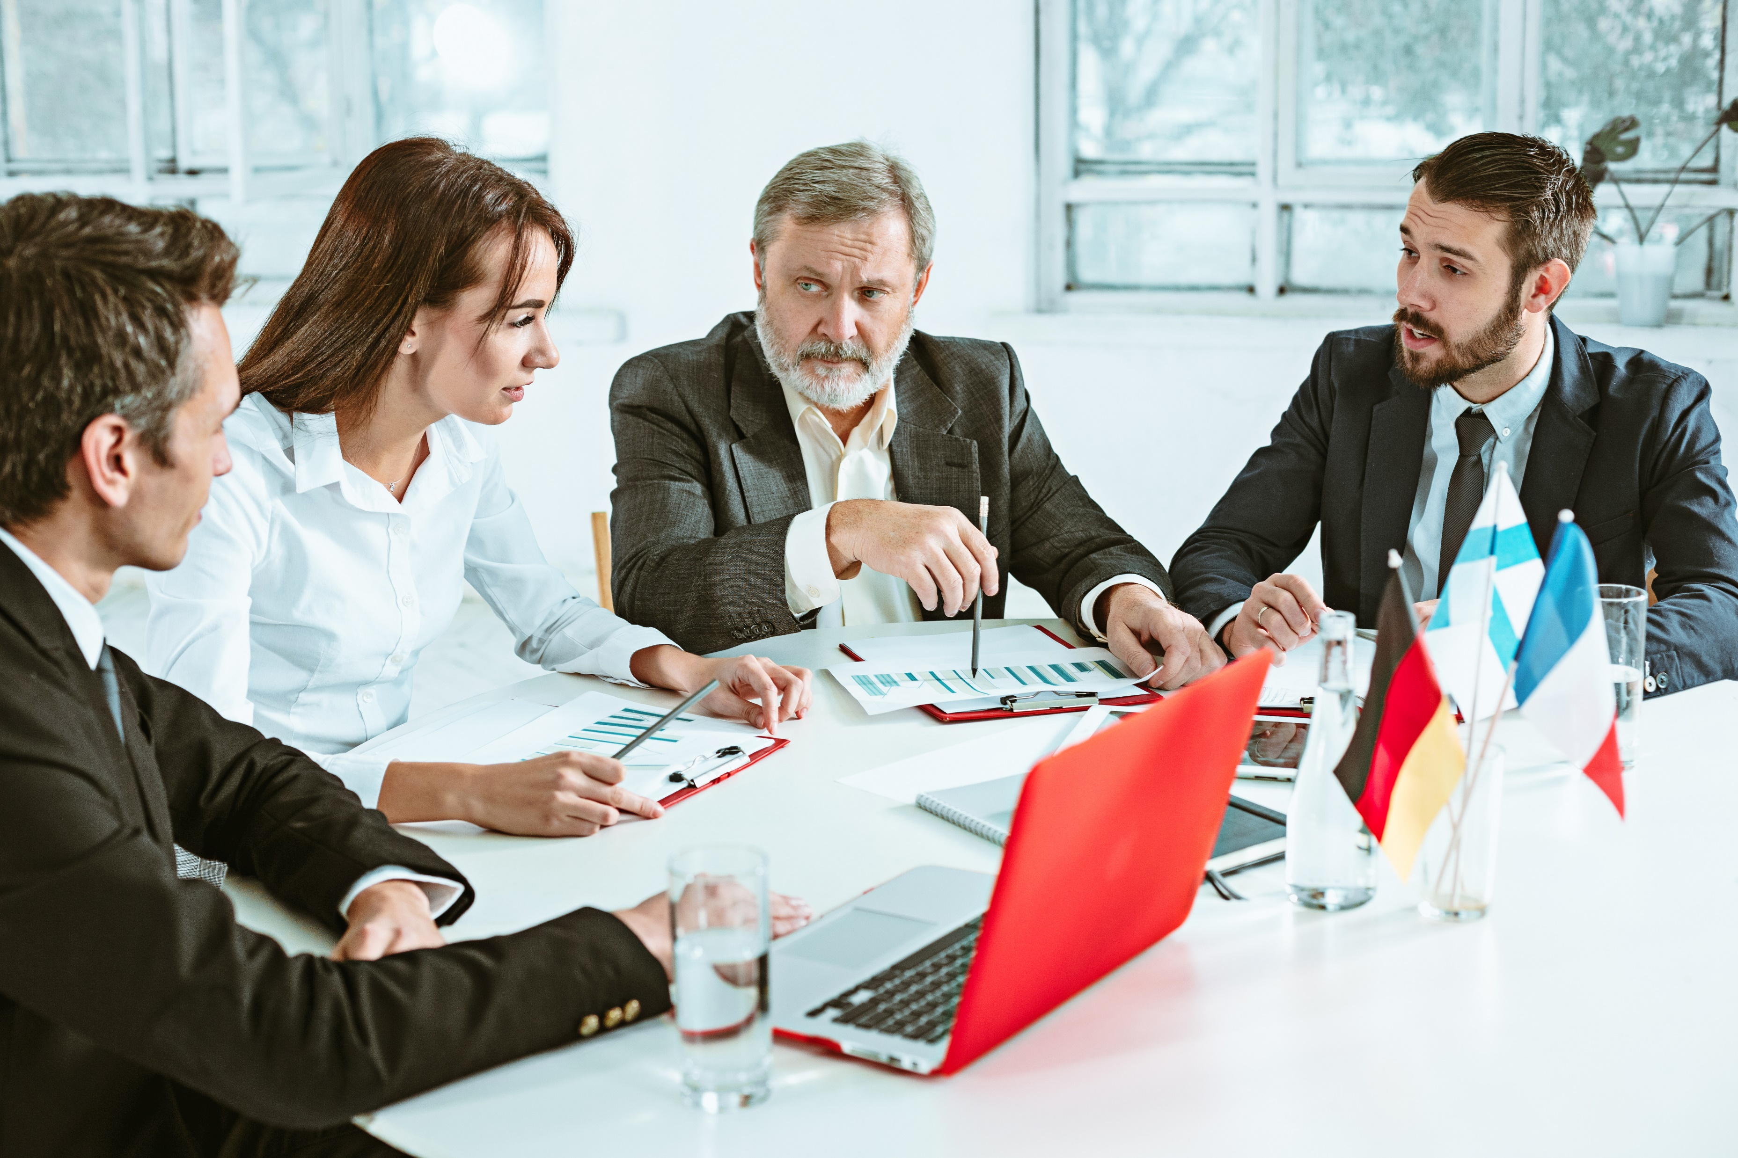
4.Awareness
In teamwork, it is important that you hone your ability to be aware of the team dynamic at all times. For example, if one person is dominating the conversation or does not allow others to share ideas, it is important that balance is restored so each teammate to contribute evenly.

Slide 9
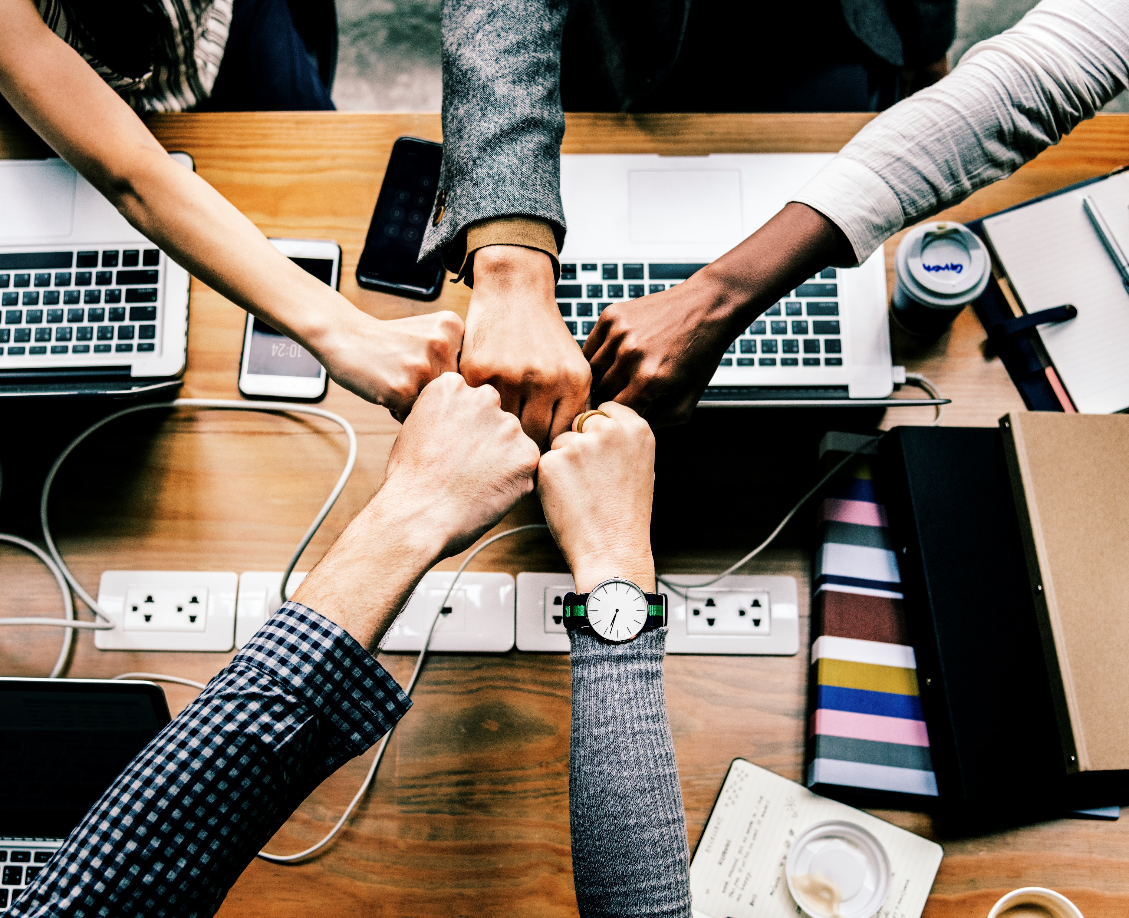
5. Collaboration
Teamwork exists so that a group of individuals with a diverse set of skills and talents can work together towards a common goal. It is crucial to work with other teammates to share ideas, improve each other’s work and help one another to form a good team.

Slide 10
Thank you

