Slide 1
Personality Development and other Soft skiLLS
Your Resume or Curriculum Vitae: The First Step Forward
- Hemnath V

Slide 2

Writing a Modern Resume
How make a Resume :
Choose the right Resume Format
Add Your Contact Information and Personal Details
Start With a Heading Statement
List Your Relevant Work Experience & Key Achievements
Reference Your Education Correctly
Put Relevant Skills That Fit the Job Ad
Include Additional Important Resume Sections
Complement Your Resume With a Cover Letter
Proofread, Save, and Email Your Resume the Right Way

Slide 3
Choose the Right Resume Format
Reverse-chronological format :
Pros: Traditional resume style, familiar to potential employers.
Cons: Very common, not the most creative resume design format.
Combination format :
Pros: Great for experienced pros and career changers for highlighting transferable skills.
Cons: Uncommon type, not as familiar, not recommended for entry-level jobseekers.

Slide 4
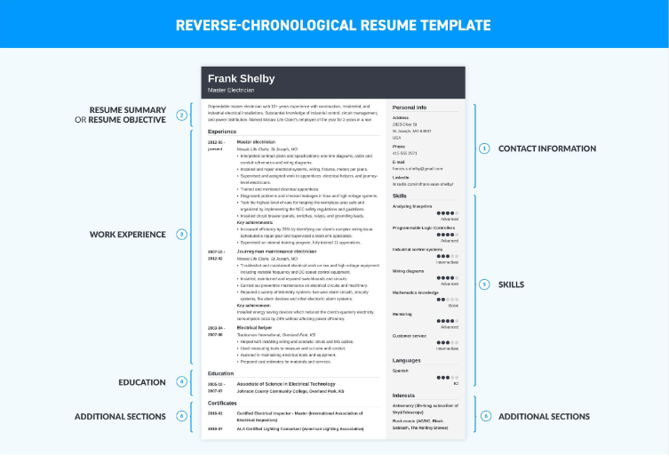
.
Functional format (skills-based) :
Pros: Entry-level job hunters can emphasize skills over lack of experience.
Cons: HR managers may think you're hiding something.

Slide 5
Add Your Contact Information and Personal Details
Contact Information to Include in a Resume:
Name: First name, last name (middle name optional).
Phone Number: Personal cell phone is preferred over the home phone number.
Email Address: Today's preferred means of communication.
LinkedIn URL: Include your LinkedIn profile (hiring managers will spy on you anyway).

Slide 6
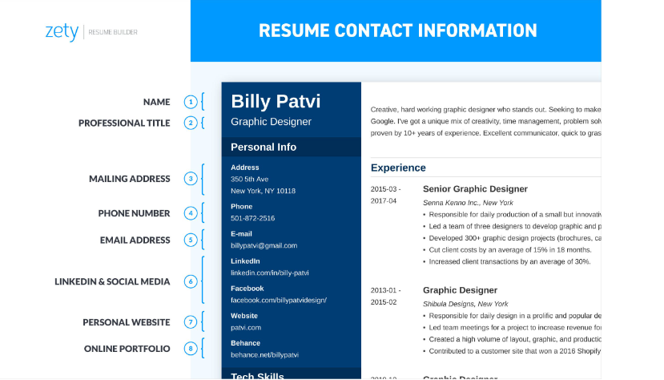
.
Contact Information to Leave Out:
Date of Birth: Adding your birthdate could lead to ageism. Add only if required, such as for jobs serving alcohol, for example.
Second Email or Phone Number: A second email address, mailing address, or phone number will just confuse them (and you).
Photo/Headshot: In the United States, resume images and profile photos are usually not recommended.

Slide 7
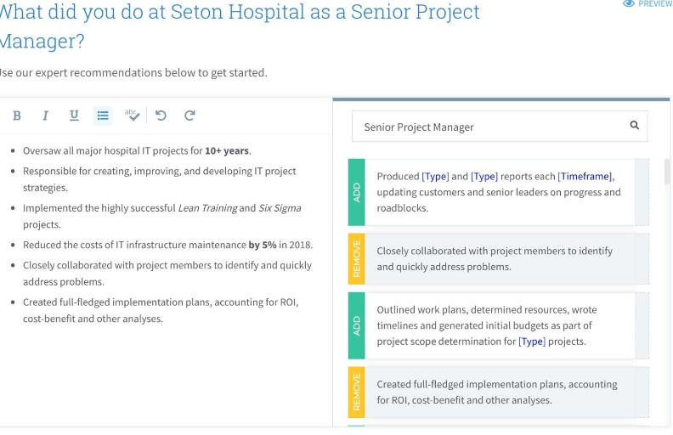
Start With a Heading Statement
Choose the resume objective statement if you have no work experience at all or at least none related to the position you're applying for (entry-level applicants, career changers, students, etc.).

Slide 8
List Your Relevant Work Experience & Key Achievements
The recommended way to format your employment history in the job experience section is this:
Job Title: This should go at the very top of each entry of work history so that it's easy for potential employers to scan and find. Make it bold and/or increase the font size by 1pt or 2pts from the rest of the entry.
Company, City, State: Include the previous employer's company name, and the city and state of the location you worked at.
Dates Employed: Put the timeframe of your employment there. You can add the year or both the month and the year, but there's no need to put exact days.
Key Responsibilities: Don't just list every single task you did in your job history. Focus on the few duties most relevant to the new job.
Key Achievements: Employers know what you did, but they need to know how well you did them.
Keywords: It is important to sprinkle resume keywords throughout the experience section.

Slide 9
Reference Your Education Correctly
How to List Your Education on a Resume:
Place your highest degree first.
List any other degrees in reverse-chronological order.
Skip the high school info if you finished a university.
Mention completed credits if your education is unfinished (some college on a resume is better than none).
Add any relevant coursework, list honors on your job application, or mention the awards you received (e.g., making the Dean's List).
Finish with relevant extracurricular activities.

Slide 10
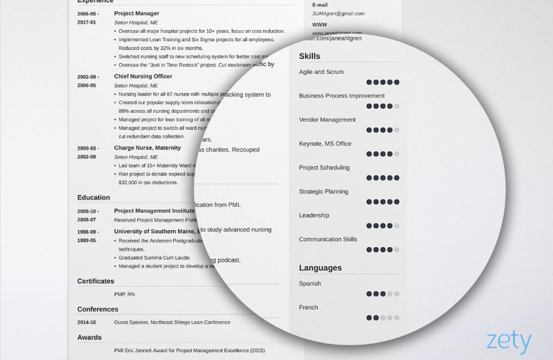
Put Relevant Skills That Fit the Job Ad
In case you’d like more guidance, here is a list of some common skills to put on a resume:
Communication skills
Technical skills
Job-specific skills
Leadership skills and management skills
Critical thinking skills

Slide 11
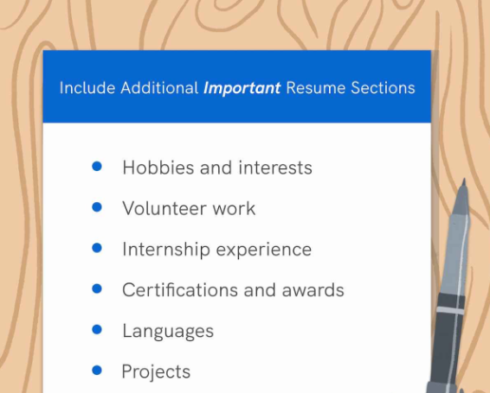
Include Additional Important Resume Sections
Hobbies and Interests
You might not think that your love of baseball and being the Little League assistant coach would be of interest to a potential employer.
Volunteer Work
Volunteering boosts employability, studies find.
Certifications and Awards
Got any certifications, licenses to show off on your resume?
If they are relevant to the job and industry, include them!

Slide 12
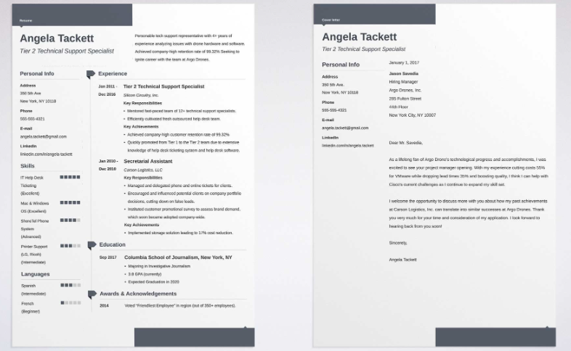
Complement Your Resume With a Cover Letter
You need to submit a cover letter, most definitely. Your cover letter or job application letter lets you expand upon things that you need to keep brief on your resume. Also, it allows you to speak easily in normal sentences!

Slide 13
Proofread, Save, and Email Your Resume the Right Way
Proofread & Double-Check
Double-check your CV or resume draft before sending it out. Scan your resume and cover letter (and email!) with a tool like Grammarly. Then, ask a friend or family member to triple-check. Better safe than sorry!
Email Your Resume the Right Way
When you send a resume to a catch-all email address such as contact@company.org, your resume and cover letter are entering a sea of similar emails from other job seekers fighting for the same position as you.

Slide 14
Thank You

